Slide 1
Online Experimentation at Microsoft
Ronny Kohavi, Experimentation Platform, Microsoft
Based on papers co-authored with Thomas Crook, Brian Frasca, and Roger Longbotham
http://exp-platform.com/expMicrosoft.aspx
http://exp-platform.com/ExPpitfalls.aspx

Slide 2
Goal / Problem Definition
Goal: Accelerate software innovation through trustworthy experimentation
  Enable a more scientific approach to planning and prioritization of features and designs
  Trust is key: getting a number is easy. Getting a number you should trust is much harder.
  The analyst may not realize problems.
Experimentation is not applicable everywhere
  Not covered in this talk: four necessary ingredients for experimentation to be useful (in paper, Section 6)
  Sweet spot: websites and services
Notes:
Ingredients: clear objective, easy to collect data, easy to changes and experiment with users, sufficient users

Slide 3
Controlled Experiments in One Slide
Concept is trivial
  Randomly split traffic between
  two (or more) versions
    A/Control
    B/Treatment
  Collect metrics of interest
  Analyze
Best scientific way to prove causality, i.e., the changes in metrics are caused by changes introduced in treatment
Must run statistical tests to confirm differences are not due to chance

Slide 4
Examples
Three experiments that ran at Microsoft recently
All had enough users for statistical validity
Game: see how many you get right
  Everyone please stand up
  Three choices are:
    A wins (the difference is statistically significant)
    A and B are approximately the same (no stat sig diff)
    B wins
  If you guess randomly
    1/3 left standing after first question
    1/9 after the second question

Slide 5
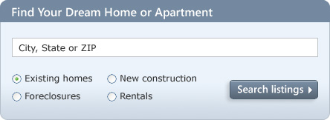
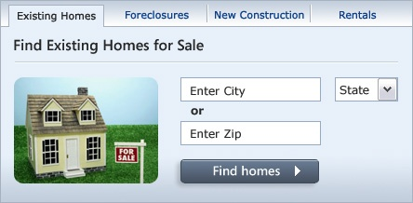
MSN Real Estate
“Find a house” widget variations
Overall Evaluation Criterion: Revenue to Microsoft generated every time a user clicks search/find button
A
B
Raise your right hand if you think A Wins
Raise your left hand if you think B Wins
Don’t raise your hand if you think they’re about the same

Slide 6
MSN Real Estate
If you did not raise a hand, please sit down
If you raised your left hand, please sit down
A was 8.5% better

Slide 7
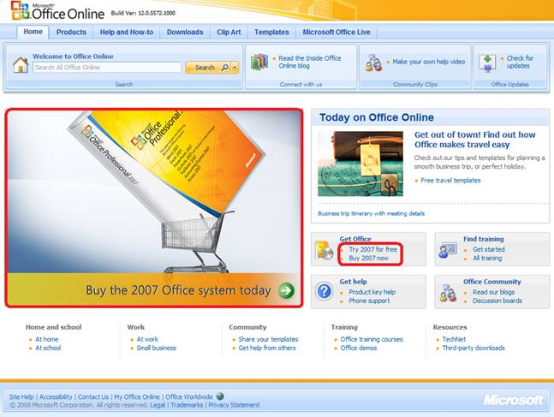
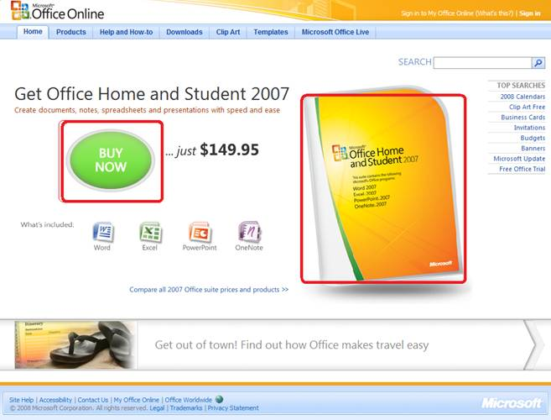
Office Online
Test new design for Office Online homepage
OEC: Clicks on revenue generating links (red below)
A
B
Raise your right hand if you think A Wins
Raise your left hand if you think B Wins
Don’t raise your hand if you think they’re about the same

Slide 8
Office Online
If you did not raise a hand, please sit down
If you raised your left hand, please sit down
B was 64% worse
The Office Online team wrote
  A/B testing is a fundamental and critical Web services… consistent use of A/B testing could save the company millions of dollars

Slide 9


MSN Home Page Search Box
OEC: Clickthrough rate for Search box and popular searches
A
B
Differences: A has taller search box (overall size is the same), has magnifying glass icon, “popular searches”
B has big search button
Raise your right hand if you think A Wins
Raise your left hand if you think B Wins
Don’t raise your hand if they are the about the same

Slide 10
Search Box
If you raised any hand, please sit down
Insight
  Stop debating, it’s easier to get the data

Slide 11


US Search Box for Bing Launch
For the launch of Bing, Microsoft’s search engine, there was an effort to improve the search box on the MSN home page
Control:
Treatment:
New version was statistically significantly better
Small changes have big impact

Slide 12
ROI on Experiments
Estimated annual impact from multiple experiments (see paper for many examples) was over $1M each
How much of the value is due to the experimentation culture vs. the team having great ideas?
If the team just launched all ideas without testing, would they do well? … Not even close!
Small changes can have big impact, and large efforts sometimes had no impact or have negative impact
Key observations: we are poor at predicting the value of ideas, and hence the criticality of getting actual data

Slide 13

Hard to Assess the Value of Ideas:
Data Trumps Intuition
Based on experiments with ExP at Microsoft
  1/3 of ideas were positive ideas and statistically significant
  1/3 of ideas were flat: no statistically significant difference
  1/3 of ideas were negative and statistically significant
Our intuition is poor: 2/3rd of ideas do not improve the metric(s) they were designed to improve. Humbling!
At Amazon, half of the experiments failed to show improvement
QualPro tested 150,000 ideas over 22 years
  75 percent of important business decisions and
  business improvement ideas either have no impact on
  performance or actually hurt performance…
Notes:
there is no correlation between what people in the organization think will work and what actually does work

Slide 14
Key Lessons
Avoid the temptation to try and build optimal features through extensive planning without early testing of ideas
Experiment often
  To have a great idea, have a lot of them -- Thomas Edison
  If you have to kiss a lot of frogs to find a prince,
  find more frogs and kiss them faster and faster
  -- Mike Moran, Do it Wrong Quickly
Try radical ideas. You may be surprised
  Doubly true if it’s cheap to implement (e.g., shopping cart recommendations and Behavior-Based search at Amazon)
  If you're not prepared to be wrong, you'll never come up with anything original – Sir Ken Robinson, TED 2006

Slide 15

Cultural Challenges
Adaptive changes are hard. Microsoft knows how to ship shrink-wrapped software; less experience in online world
Education is important
  We started teaching a monthly ¾-day class on experimentation
  Initially, we couldn’t fill it; now wait listed; > 500 people attended
Published papers in KDD to establish credibility
inside Microsoft, and get reviewer feedback,
which was highly beneficial
We use the HiPPO as our mascot and
give stress HiPPOs at talks with our URL.
Acronym: Highest Paid Person’s Opinion

Slide 16
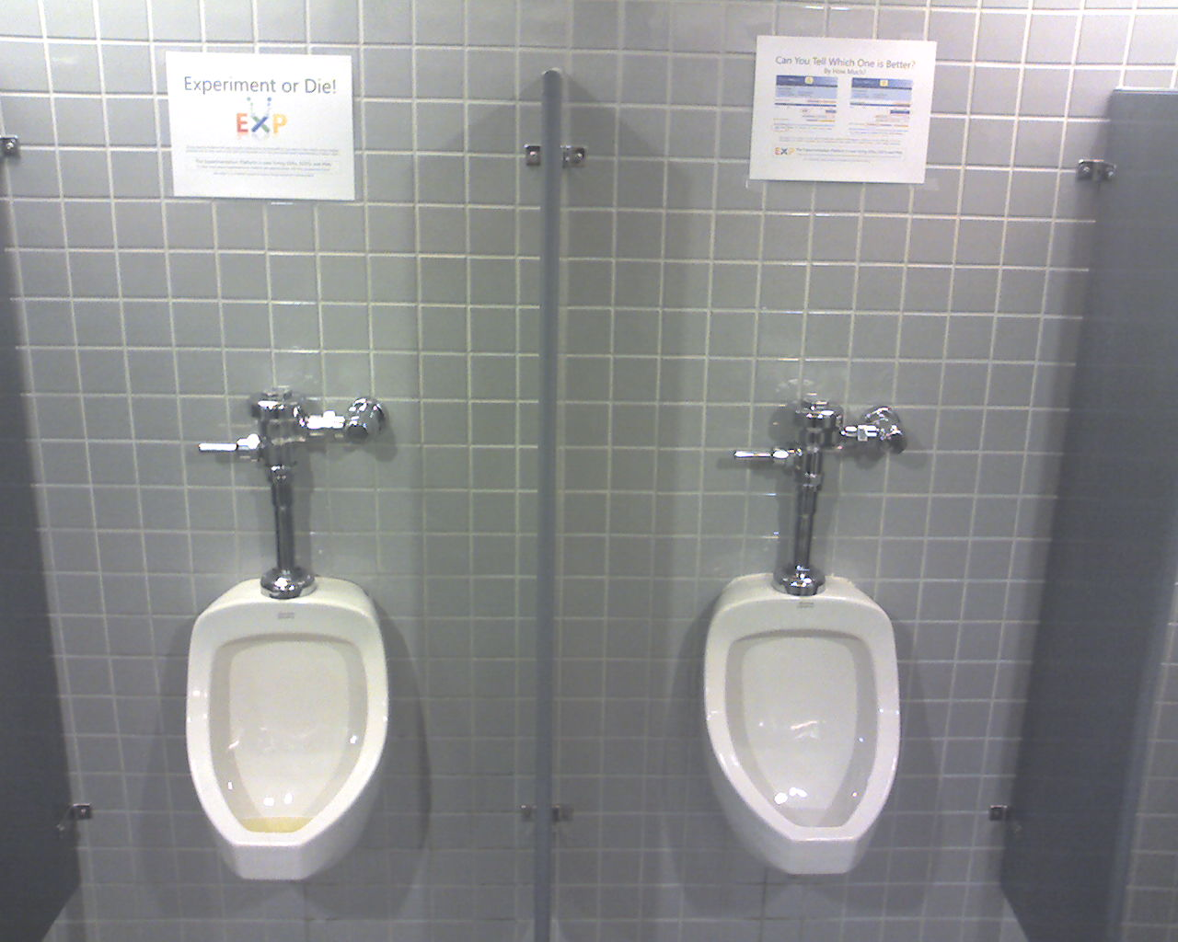

Unique Posters to Raise Awareness
We put posters across the campus to raise awareness
Usually in pairs with unique URLs to A/B test them
And in weird places…
Experiment or Die won
the first round

Slide 17

Some Controversy is Fine
A director of communications complained that the “Experiment or Die” poster is “threatening.”
We explained the usage
V2 was our most
successful poster
  Great image
  Quotation from Google’s Hal Varian

Slide 18
The Cultural Challenge
It is difficult to get a man to understand something when his salary depends upon his not understanding it.
-- Upton Sinclair
Why people/orgs avoid controlled experiments
  Some believe it threatens their job as decision makers
  At Microsoft, program managers select the next set of features to develop. Proposing several alternatives and admitting you don’t know which is best is hard
  Editors and designers get paid to select a great design
  Failures of ideas may hurt image and professional standing.
  It’s easier to declare success when the feature launches
  We’ve heard: “we know what to do. It’s in our DNA,” and
  “why don’t we just do the right thing?”

Slide 19
A Few Pitfalls
Getting a number is easy.
Getting a number you should trust is much harder
In the paper we shared seven pitfalls
Here are three

Slide 20
Best Practice: Ramp-up
Ramp-up
  Start an experiment at 0.1%
  Do some simple analyses to make sure no egregious problems can be detected
  Ramp-up to a larger percentage, and repeat until 50%
Big differences are easy to detect because the min sample size is quadratic in the effect we want to detect
  Detecting 10% difference requires a small sample and serious problems can be detected during ramp-up
  Detecting 0.1% requires a population 100^2 = 10,000 times bigger
Abort the experiment if treatment is significantly worse on OEC or other key metrics (e.g., time to generate page)

Slide 21
Pitfall : Combining Data During Ramp-up
Simplified example: 1,000,000 users per day
For each individual day the Treatment is much better
However, cumulative result for Treatment is worse
This counter-intuitive effect is called Simpson’s paradox
Conversion Rate for two days | Friday |  | Saturday |  | Total
 | C/T split: 99/1 |  | C/T split: 50/50
Control | 20,000 | = 2.02% | 5,000 | = 1.00% | 25,000 | = 1.68%
 | 990,000 |  | 500,000 |  | 1,490,000
Treatment | 230 | = 2.30% | 6,000 | = 1.20% | 6,230 | = 1.22%
 | 10,000 |  | 500,000 |  | 510,000
Notes:
One situation where you would face this issue is when ramping up the percent of users who are in the Treatment. As you gain confidence that the Treatment does not have bugs or other problems, you increase the percent in the Treatment at the beginning of the experiment.

Slide 22
Best Practice: A/A Test
Run A/A tests
  Run an experiment where the Treatment and Control variants are coded identically and validate the following:
    Are users split according to the planned percentages?
    Is the data collected matching the system of record?
    Are the results showing non-significant results 95% of the time?
This is a powerful technique for finding bugs and other integration issues before teams try to make data-driven decisions
Multiple integrations at Microsoft failed A/A tests
  Example problem: caching issues. If variants share an LRU cache and Control is 90% while treatment is 10%, control pages will be cached more often and be faster

Slide 23
Pitfall: Not Filtering out Robots
Internet sites can get a significant amount of robot traffic (search engine crawlers, email harvesters, botnets, etc.)
Robots can cause misleading results
  Most concerned about robots with high traffic (e.g. clicks or PVs) that stay in Treatment or Control (we’ve seen one robot with
  > 600,000 clicks in a month on one page)
Identifying robots can be difficult
  Some robots identify themselves
  Many look like human users and even execute JavaScript
  Use heuristics to ID and remove robots from analysis
  (e.g. more than 100 clicks in an hour)

Slide 24
Effect of Robots on A/A Experiment
Each hour
represents
clicks from
thousands
of users
The “spikes”
can be traced
to single “users”
(robots)

Slide 25
The OEC
OEC = Overall Evaluation Criterion
  Agree early on what you are optimizing
  Getting agreement on the OEC in the org is a huge step forward
  Suggestion: optimize for customer lifetime value, not immediate short-term revenue
  Criterion could be weighted sum of factors, such as
    Time on site (per time period, say week or month)
    Visit frequency
  Report many other metrics for diagnostics, i.e., to understand the why the OEC changed and raise new hypotheses

Slide 26
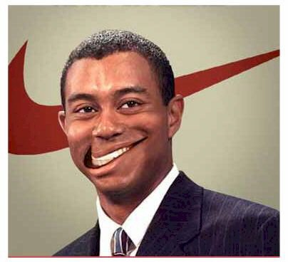
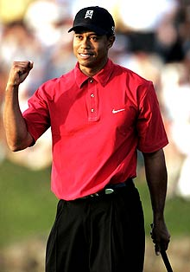

OEC Thought Experiment
Tiger Woods comes to you for advice on how to spend his time: improving golf, or improving ad revenue (most revenue comes from ads)
  Short term, he could improve his ad revenue
  by focusing on ads…
  But to optimize lifetime financial value
  (and immortality as a great golf player),
  he needs to focus on the game
  While the example seems obvious,
  organizations commonly make the mistake
  of focusing on the short term
Notes:
Motivated by Geoff Moore’s Dealing with Darwin: core vs. context

Slide 27
Pitfall: Wrong OEC
In the Office Online example, the treatment had a drop in the OEC of 64%, but it was clickthrough
  Were sales for Treatment correspondingly less also?
  Our interpretation is that not having the price shown in the Control lead more people to click to determine the price
Lesson: measure what you really need to measure, even if it’s difficult!
What’s a good OEC for the MSN home page?
  Click-through rate per user
  Clicks per user (captures increased visit frequency)
  (sum of (Click * estimated value-of-click)) per user

Slide 28
Summary
Our goal is to accelerate software innovation through trustworthy experimentation
We built an Experimentation Platform to reduce the costs of running experiments and decrease complexity of analysis
Cultural and adaptive challenges are tough.
We addressed them through education, awareness (posters), publications (building credibility), and most important: successful experiments with significant ROI
  Trust is key: getting a number is easy.
  Getting a number you should trust is much harder

Slide 29

http://exp-platform.com
Accelerating software Innovation through trustworthy experimentation

Slide 30
Appendix

Slide 31
Stress HiPPO
  The less data, the stronger the opinions
Whenever you feel stressed that a decision is made without data, squeeze the Stress-HiPPO
Put one in your office to show others you believe in data-driven decisions based on experiments
Hippos kill more humans than any
other (non-human) mammal (really)
Don’t let HiPPOs in your org
kill innovative ideas. ExPeriment!

Slide 32
Advantages of Controlled Experiments
Controlled experiments test for causal relationships, not simply correlations
When the variants run concurrently, only two things could explain a change in metrics:
  The “feature(s)” (A vs. B)
  Random chance
  Everything else happening affects both the variants
  For #2, we conduct statistical tests for significance
The gold standard in science and the only way to prove efficacy of drugs in FDA drug tests

Slide 33
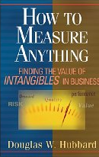
Issues with Controlled Experiments (1 of 2)
If you don't know where you are going, any road will take you there
—Lewis Carroll
Org has to agree on OEC (Overall Evaluation Criterion).
  This is hard, but it provides a clear direction and alignment
  Some people claim their goals are “soft” or “intangible” and cannot be quantified.
  Think hard and read Hubbard’s How to Measure Anything: Finding the Value
  of Intangibles in Business
Quantitative metrics, not always explanations of “why”
  A treatment may lose because page-load time is slower.
  At Amazon, we slowed pages by 100-250msec and lost 1% of revenue
  A treatment may have JavaScript that fails on certain browsers, causing users to abandon.

Slide 34
Issues with Controlled Experiments (2 of 2)
Primacy/newness effect
  Changing navigation in a website may degrade the customer experience (temporarily), even if the new navigation is better
  Evaluation may need to focus on new users, or run for a long period
Multiple experiments
  Even though the methodology shields an experiment from other changes, statistical variance increases making it harder to get significant results.
  There can also be strong interactions (rarer than most people think)
Consistency/contamination
  On the web, assignment is usually cookie-based, but people may use multiple computers, erase cookies, etc. Typically a small issue
Launch events / media announcements sometimes preclude controlled experiments
  The journalists need to be shown the “new” version
Notes:
Good example of primacy: Office 2007 vs. Office 2003

Slide 35
Run Experiments at 50/50%
Novice experimenters run 1% experiments
To detect an effect, you need to expose a certain number of users to the treatment (based on power calculations)
Fastest way to achieve that exposure is to run equal-probability variants (e.g., 50/50% for A/B)
If you perceive risk, don’t start an experiment at 50/50% from the beginning: Ramp-up over a short period

Slide 36

Randomization
Good randomization is critical.
It’s unbelievable what mistakes developers will make in favor of efficiency
Properties of user assignment
  Consistent assignment. User should see the same variant on successive visits
  Independent assignment. Assignment to one experiment should have no effect on assignment to others (e.g., Eric Peterson’s code in his book gets this wrong)
  Monotonic ramp-up. As experiments are ramped-up to larger percentages, users who were exposed to treatments must stay in those treatments (population from control shifts)

Slide 37
Simpson’s Paradox
Lack of awareness can lead to mistaken conclusions about causality
Unlike esoteric brain teasers, it happens in real life. My team at Blue Martini spent days debugging our software once, but it was fine
In the next few slides I’ll share examples that seem “impossible”
We’ll then explain why they are possible and do happen
Discuss implications/warning
Notes:
“There are three kinds of lies: lies, damn lies, and statistics”

Slide 38
Exampes 1: Drug Treatment
Real-life example for kidney stone treatments
Overall success rates:
  Treatment A succeeded 78%, Treatment B succeeded 83% (better)
Further analysis splits the population by stone size
  For small stones
    Treatment A succeeded 93% (better), Treatment B succeeded 87%
  For large stones
    Treatment A succeeded 73% (better), Treatment B succeeded 69%
  Hence treatment A is better in both cases, yet was worse in total
People going into treatment have either small stones or large stones
A similar real-life example happened when the two populations segments were cities (A was better in each city, but worse overall)
Adopted from wikipedia/simpson’s paradox
Notes:
For cities, treatment A was better in each city, but lost overall
Small Stones Large Stones Total
Treatment A 81/ 87 = 93% 192/263 = 73% 273/350 = 78%
Treatment B 234/270 = 87% 55/ 80 = 69% 289/350 = 83%

Slide 39
Example 2: Sex Bias?
Adopted from real data for UC Berkeley admissions
Women claimed sexual discrimination
  Only 34% of women were accepted, while 44% of men were accepted
Segmenting by departments to isolate the bias, they found that all departments accept a higher percentage of women applicants than men applicants.
(If anything, there is a slight bias in favor of women!)
There is no conflict in the above statements.
It’s possible and it happened
Bickel, P. J., Hammel, E. A., and O'Connell, J. W. (1975). Sex bias in graduate
admissions: Data from Berkeley. Science, 187, 1975, 398-404.

Slide 40
Last Example: Batting Average
Baseball example
  One player can hit for a higher batting average than another player during the first half of the year
  Do so again during the second half
  But to have a lower batting average for the entire year
Example
Key to the “paradox” is that the segmenting variable (e.g., half year) interacts with “success” and with the counts.
E.g., “A” was sick and rarely played in the 1st half, then “B” was sick in the 2nd half, but the 1st half was “easier” overall.

Slide 41
Not Really a Paradox, Yet Non-Intuitive
If a/b < A/B and c/d < C/D, it’s possible that
(a+c)/(b+d) > (A+C)/(B+D)
We are essentially dealing with weighted averages when we combine segments

Slide 42
Important, not Just a Cool Teaser
Why is this so important?
In knowledge discovery, we state probabilities (correlations) and associate them with causality
  Treatment T1 works better
  Berkeley discriminates against women
We must be careful to check for confounding variables, which may be latent hidden
With Controlled Experiments, we scientifically prove causality
(But Simpson’s paradox can, and does occur, if different days use different proportions for control/treatment.)

