Slide 1
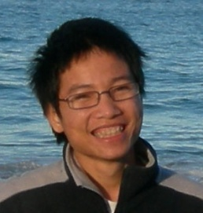
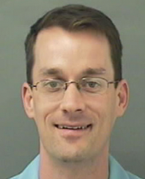

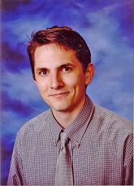

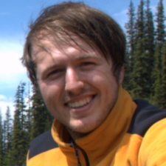
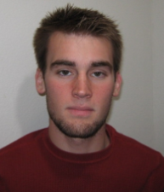


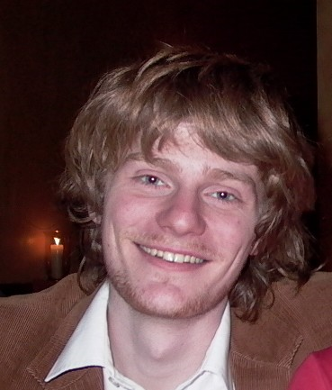
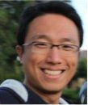
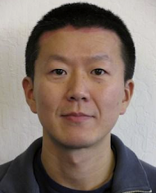
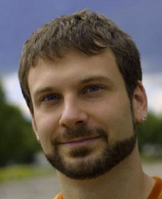
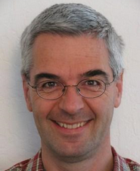
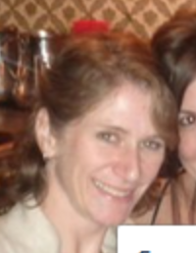
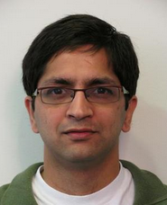
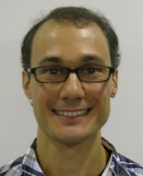
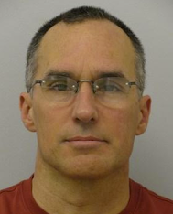
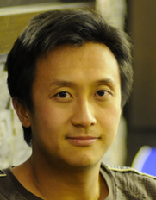
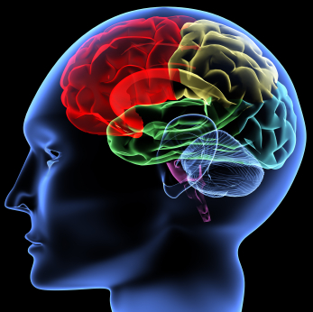
Machine Learning and AI
via Brain simulations
Andrew Ng
Stanford University & Google
Thanks to:
Stanford:
Adam Coates Quoc Le Honglak Lee Andrew Saxe Andrew Maas Chris Manning Jiquan Ngiam Richard Socher Will Zou
Google:
Quoc Le
Jeff Dean
Kai Chen Greg Corrado Jeff Dean Matthieu Devin Andrea Frome Rajat Monga Marc’Aurelio Paul Tucker Kay Le
Ranzato
Notes:
NVIDIA or ATI will be future of AI. Probably NVIDIA.

Slide 2
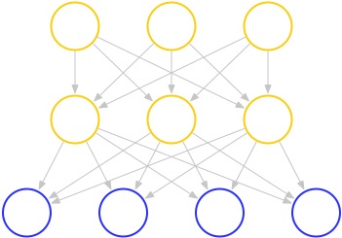
Training Deep Neural Networks
a₁
a₂
a₃
x₁
x₂
x₃
x₄

Slide 3
Images
CIFAR Object classification | Accuracy
Prior art (Ciresan et al., 2011) | 80.5%
Stanford Feature learning | 82.0%
NORB Object classification | Accuracy
Prior art (Scherer et al., 2010) | 94.4%
Stanford Feature learning | 95.0%
Galaxy
Video
Hollywood2 Classification | Accuracy
Prior art (Laptev et al., 2004) | 48%
Stanford Feature learning | 53%
YouTube | Accuracy
Prior art (Liu et al., 2009) | 71.2%
Stanford Feature learning | 75.8%
KTH | Accuracy
Prior art (Wang et al., 2010) | 92.1%
Stanford Feature learning | 93.9%
UCF | Accuracy
Prior art (Wang et al., 2010) | 85.6%
Stanford Feature learning | 86.5%
Text/NLP
Paraphrase detection | Accuracy
Prior art (Das & Smith, 2009) | 76.1%
Stanford Feature learning | 76.4%
Sentiment (MR/MPQA data) | Accuracy
Prior art (Nakagawa et al., 2010) | 77.3%
Stanford Feature learning | 77.7%
Multimodal (audio/video)
Other unsupervised feature learning records:
Pedestrian detection (Yann LeCun)
Speech recognition (Geoff Hinton)
PASCAL VOC object classification (Kai Yu)
AVLetters Lip reading | Accuracy
Prior art (Zhao et al., 2009) | 58.9%
Stanford Feature learning | 65.8%
Notes:
Other SOTA performance records held by Kai Yu, Geoff Hinton.

Slide 4
How do you build a high accuracy learning system?
Notes:
NVIDIA or ATI will be future of AI. Probably NVIDIA.

Slide 5
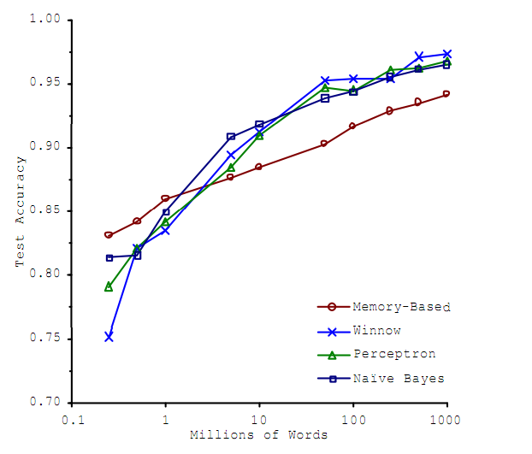
Supervised Learning
Choices of learning algorithm:
  Memory based
  Winnow
  Perceptron
  Naïve Bayes
  SVM
  ….
What matters the most?
Accuracy
Training set size (millions)
[Banko & Brill, 2001]
“It’s not who has the best algorithm that wins. It’s who has the most data.”

Slide 6
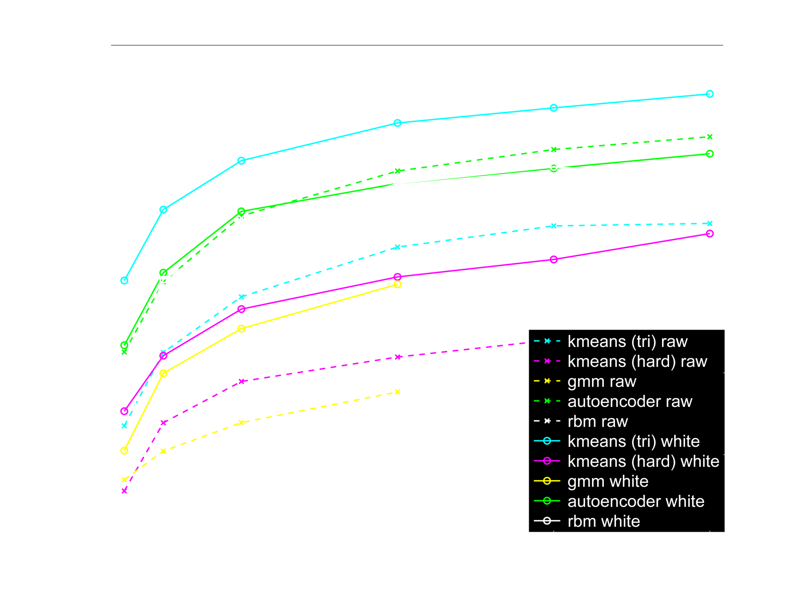
Unsupervised Learning
Large numbers of features is critical. The specific learning algorithm is important, but ones that can scale to many features also have a big advantage.
[Adam Coates]

Slide 8
Learning from Labeled data

Slide 9
Learning from Labeled data
Notes:
NVIDIA or ATI will be future of AI. Probably NVIDIA.

Slide 10
Model
Training Data

Slide 11
Model
Machine (Model Partition)
Training Data

Slide 12
Model
Machine (Model Partition)
Training Data
Core

Slide 13
Basic DistBelief Model Training
Model
Unsupervised or Supervised Objective
Minibatch Stochastic Gradient Descent (SGD)
Model parameters sharded by partition
10s, 100s, or 1000s of cores per model
Training Data

Slide 14
Basic DistBelief Model Training
Model
But training is still slow with large data sets if a model only considers tiny minibatches (10-100s of items) of data at a time.
How can we add another dimension of parallelism, and have multiple model instances train on data in parallel?
Training Data

Slide 15
Two Approaches to Multi-Model Training
(1) Downpour: Asynchronous Distributed SGD
(2) Sandblaster: Distributed L-BFGS

Slide 16
Asynchronous Distributed Stochastic Gradient Descent
p’ = p + ∆p
Parameter Server
p’’ = p’ + ∆p’
∆p
∆p’
p’
p
Model
Data

Slide 17
Asynchronous Distributed Stochastic Gradient Descent
Parameter Server
p’ = p + ∆p
∆p
p’
Model
Workers
Data
Shards

Slide 18
Asynchronous Distributed Stochastic Gradient Descent
Parameter Server
Will the workers’ use of stale parameters to
compute gradients mess the whole thing up?
Model
Workers
Data Shards
From an engineering standpoint, superior to a single model with the same number of total machines:
Better robustness to individual slow machines
Makes forward progress even during evictions/restarts

Slide 19
Asynchronous Distributed Stochastic Gradient Descent
A few recent papers...
A neural probabilistic language model
Y. Bengio, R. Ducharme, P. Vincent, C. Jauvin, JMLR 2003
Slow Learners are Fast
John Langford, Alexander J. Smola, Martin Zinkevich NIPS 2009
Distributed Delayed Stochastic Optimization
Alekh Agarwal, John Duchi NIPS 2011
Hogwild!: A Lock-Free Approach to Parallelizing
Stochastic Gradient Descent
Feng Niu, Benjamin Recht, Christopher Re, Stephen J. Wright NIPS 2011
Only bound badness for convex problems, and we’re far from convex.
In practice, works quite well on many of our applications

Slide 20
L-BFGS: a Big Batch Alternative to SGD.
Async-SGD
first derivatives only
many small steps
mini-batched data
(10s of examples)
tiny compute and data requirements per step
theory is dicey
at most 10s or 100s of model replicas
L-BFGS
first and second derivatives
larger, smarter steps
mega-batched data (millions of examples)
huge compute and data requirements per step
strong theoretical grounding
1000s of model replicas

Slide 21
L-BFGS: a Big Batch Alternative to SGD.
Leverages the same parameter server implementation as Async-SGD, but uses it to shard computation within a mega-batch.
Coordinator
(small messages)
Some current numbers:
20,000 cores in a single cluster
up to 1 billion data items / mega-batch (in ~1 hour)
Parameter Server
Model
Workers
Data
More network friendly at large scales than Async-SGD.
The possibility of running on multiple data centers...

Slide 22
Acoustic Modeling for Speech Recognition
8000-label Softmax
One or more hidden layers
of a few thousand nodes each.
11 Frames of 40-value Log Energy Power Spectra and the label for central frame

Slide 23
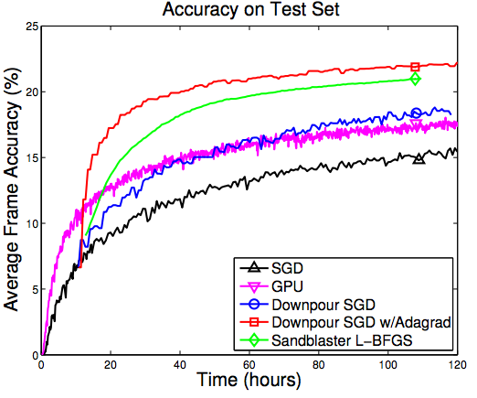
Acoustic Modeling for Speech Recognition
Async SGD and L-BFGS can both speed up model training.
To reach the same model quality DistBelief reached in 4 days took 55 days using a GPU....
DistBelief can support much larger models than a GPU (useful for unsupervised learning).

Slide 25
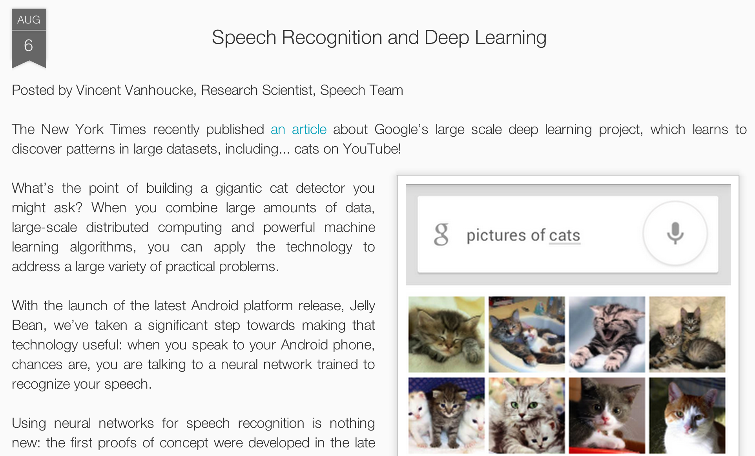
Speech recognition on Android

Slide 26
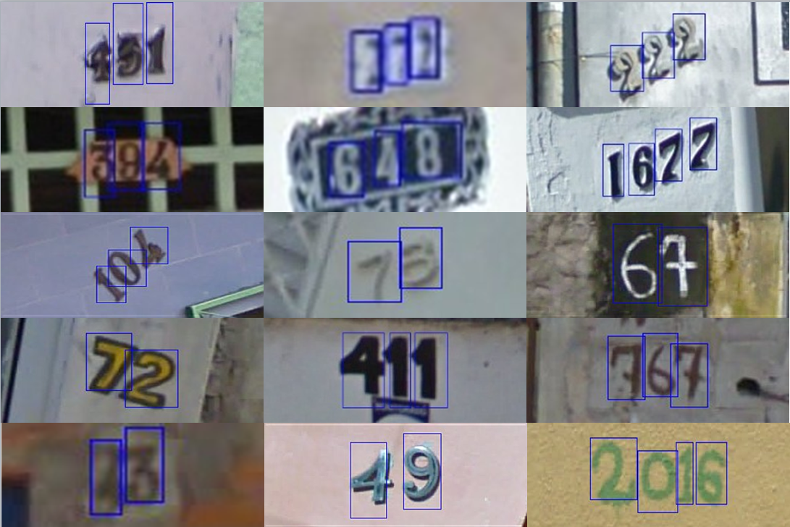
Application to Google Streetview
[with Yuval Netzer, Julian Ibarz]

Slide 27
Learning from Unlabeled data
Notes:
NVIDIA or ATI will be future of AI. Probably NVIDIA.

Slide 28
Supervised Learning
Choices of learning algorithm:
  Memory based
  Winnow
  Perceptron
  Naïve Bayes
  SVM
  ….
What matters the most?
Accuracy
Training set size (millions)
[Banko & Brill, 2001]
“It’s not who has the best algorithm that wins. It’s who has the most data.”

Slide 29
Unsupervised Learning
Large numbers of features is critical. The specific learning algorithm is important, but ones that can scale to many features also have a big advantage.
[Adam Coates]

Slide 30
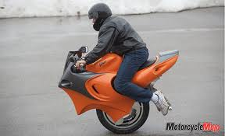

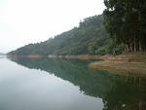
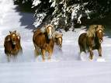
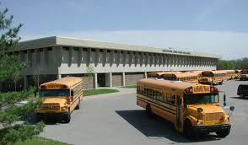
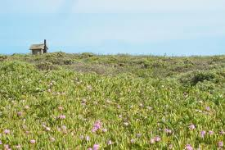

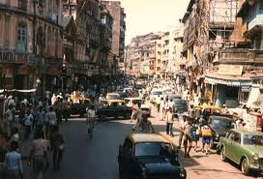
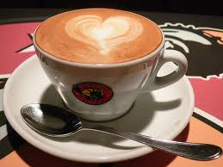
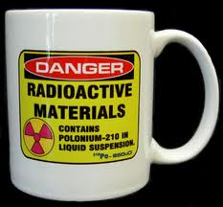
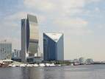
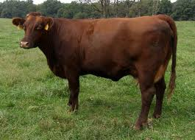
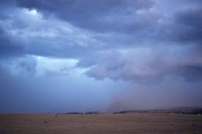
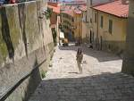
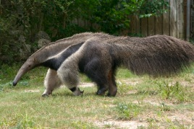
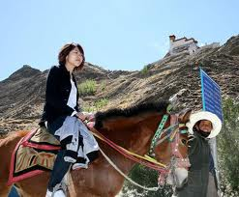
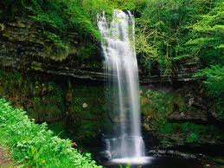

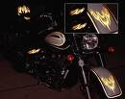
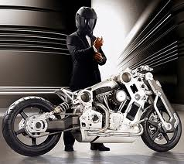

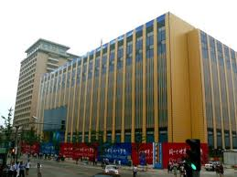

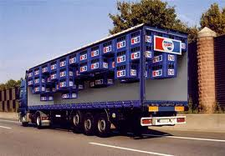
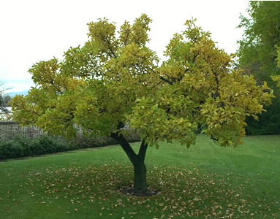
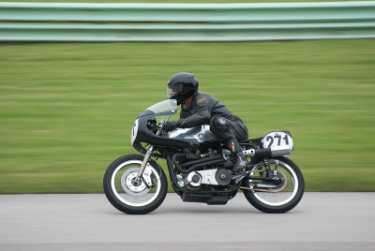


Self-taught learning (Unsupervised Feature Learning)
…
Unlabeled images
Testing:
What is this?
Motorcycles
Not motorcycles
[This uses unlabeled data. One can learn the features from labeled data too.]

Slide 31
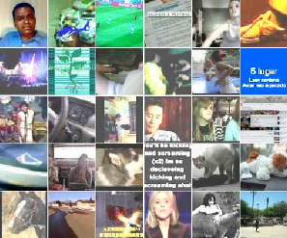
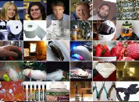
Training procedure
What features can we learn if we train a massive model on a massive amount of data. Can we learn a “grandmother cell”?
Train on 10 million images (YouTube)
1000 machines (16,000 cores) for 1 week.
1.15 billion parameters
Test on novel images
Training set (YouTube) Test set (FITW + ImageNet)

Slide 32
50 thousand 32x32 images
10 million parameters

Slide 33
10 million 200x200 images
1 billion parameters

Slide 34
Training
RICA
Dataset: 10 million 200x200 unlabeled images from YouTube/Web
Train on 2000 machines (16000 cores) for 1 week
1.15 billion parameters
100x larger than previously reported
Small compared to visual cortex
RICA
RICA
Image
Le, et al., Building high-level features using large-scale unsupervised learning. ICML 2012
Input to another layer above
(image with 8 channels)
Number of output
channels = 8
LCN Size = 5
H
Pooling Size = 5
Number
of maps = 8
One layer
W
RF size = 18
Number of input
channels = 3
Image Size = 200

Slide 35
Training procedure
What features can we learn if we train a massive model on a massive amount of data. Can we learn a “grandmother cell”?
Train on 10 million images (YouTube)
1000 machines (16,000 cores) for 1 week.
Test on novel images
Training set (YouTube) Test set (FITW + ImageNet)

Slide 36
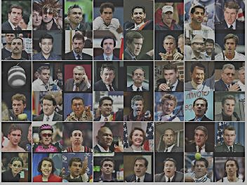
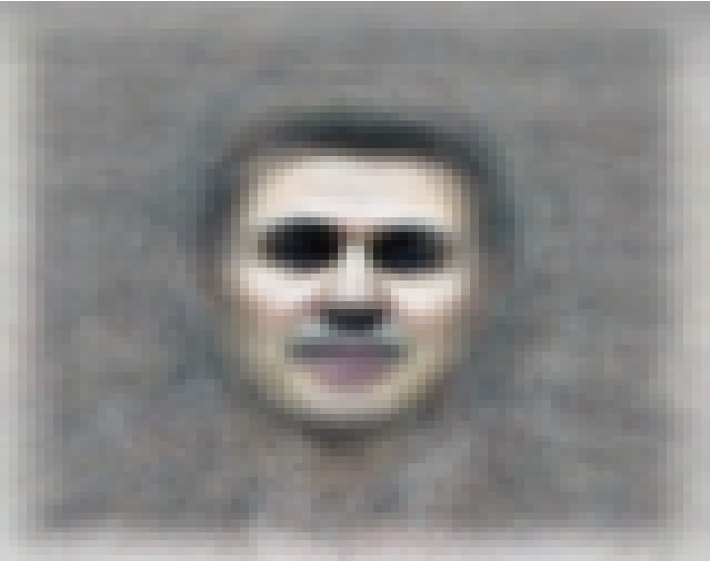
The face neuron
Top stimuli from the test set
Optimal stimulus
by numerical optimization
Le, et al., Building high-level features using large-scale unsupervised learning. ICML 2012

Slide 37
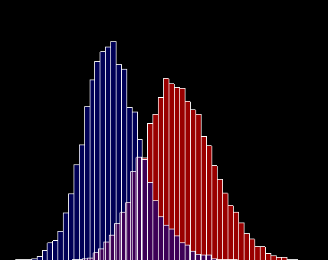
Random distractors
Faces
Frequency
Feature value
Le, et al., Building high-level features using large-scale unsupervised learning. ICML 2012

Slide 38
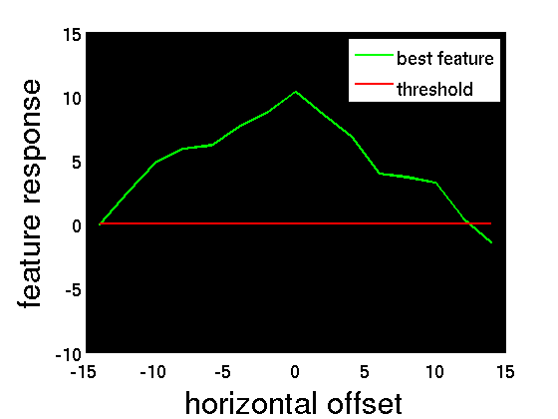
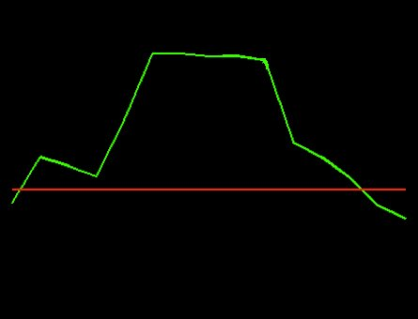


Invariance properties
Feature response
Feature response
0 pixels
20 pixels
0 pixels
20 pixels
Horizontal shifts
Vertical shifts
Feature response
Feature response
o
o
0
90
0.4x
1x
1.6x
3D rotation angle
Scale factor
Le, et al., Building high-level features using large-scale unsupervised learning. ICML 2012

Slide 39

Optimal stimulus
by numerical optimization
Le, et al., Building high-level features using large-scale unsupervised learning. ICML 2012

Slide 40

Random distractors
Pedestrians
Frequency
Feature value
Le, et al., Building high-level features using large-scale unsupervised learning. ICML 2012

Slide 41

The cat neuron
Optimal stimulus
by numerical optimization
Le, et al., Building high-level features using large-scale unsupervised learning. ICML 2012

Slide 42

Random distractors
Cat faces
Frequency
Feature value
Le, et al., Building high-level features using large-scale unsupervised learning. ICML 2012

Slide 43


Slide 44


Slide 45


Slide 46





Best stimuli
Feature 1
Feature 2
Feature 3
Feature 4
Feature 5
Le, et al., Building high-level features using large-scale unsupervised learning. ICML 2012
Input to another layer above
(image with 8 channels)
Number of output
channels = 8
LCN Size = 5
H
Pooling Size = 5
Number
of maps = 8
One layer
W
RF size = 18
Number of input
channels = 3
Image Size = 200

Slide 47




Best stimuli
Feature 6
Feature 7
Feature 8
Feature 9
Le, et al., Building high-level features using large-scale unsupervised learning. ICML 2012
Input to another layer above
(image with 8 channels)
Number of output
channels = 8
LCN Size = 5
H
Pooling Size = 5
Number
of maps = 8
One layer
W
RF size = 18
Number of input
channels = 3
Image Size = 200

Slide 48





Best stimuli
Feature 10
Feature 11
Feature 12
Feature 13
Le, et al., Building high-level features using large-scale unsupervised learning. ICML 2012
Input to another layer above
(image with 8 channels)
Number of output
channels = 8
LCN Size = 5
H
Pooling Size = 5
Number
of maps = 8
One layer
W
RF size = 18
Number of input
channels = 3
Image Size = 200

Slide 49
ImageNet classification
22,000 categories
14,000,000 images
Hand-engineered features (SIFT, HOG, LBP),
Spatial pyramid, SparseCoding/Compression
Le, et al., Building high-level features using large-scale unsupervised learning. ICML 2012

Slide 50





22,000 is a lot of categories…
…
smoothhound, smoothhound shark, Mustelus mustelus
American smooth dogfish, Mustelus canis
Florida smoothhound, Mustelus norrisi
whitetip shark, reef whitetip shark, Triaenodon obseus
Atlantic spiny dogfish, Squalus acanthias
Pacific spiny dogfish, Squalus suckleyi
hammerhead, hammerhead shark
smooth hammerhead, Sphyrna zygaena
smalleye hammerhead, Sphyrna tudes
shovelhead, bonnethead, bonnet shark, Sphyrna tiburo
angel shark, angelfish, Squatina squatina, monkfish
electric ray, crampfish, numbfish, torpedo
smalltooth sawfish, Pristis pectinatus
guitarfish
roughtail stingray, Dasyatis centroura
butterfly ray
eagle ray
spotted eagle ray, spotted ray, Aetobatus narinari
cownose ray, cow-nosed ray, Rhinoptera bonasus
manta, manta ray, devilfish
Atlantic manta, Manta birostris
devil ray, Mobula hypostoma
grey skate, gray skate, Raja batis
little skate, Raja erinacea
…
Stingray
Mantaray

Slide 51
0.005%
9.5%
?
Random guess
State-of-the-art
(Weston, Bengio ‘11)
Feature learning
From raw pixels
Le, et al., Building high-level features using large-scale unsupervised learning. ICML 2012

Slide 52
0.005%
9.5%
21.3%
Random guess
State-of-the-art
(Weston, Bengio ‘11)
Feature learning
From raw pixels
Le, et al., Building high-level features using large-scale unsupervised learning. ICML 2012

Slide 53
[YouTube videos demo]
Credit: Quoc Le & John Shlens
Notes:
NVIDIA or ATI will be future of AI. Probably NVIDIA.

Slide 54
Discussion: Engineering vs. Data
Notes:
NVIDIA or ATI will be future of AI. Probably NVIDIA.

Slide 55
Discussion: Engineering vs. Data
Contribution to performance
Human
ingenuity
Data/
learning
Notes:
NVIDIA or ATI will be future of AI. Probably NVIDIA.

Slide 56
Discussion: Engineering vs. Data
Contribution to performance
Time
Now
Notes:
NVIDIA or ATI will be future of AI. Probably NVIDIA.

Slide 57










Deep Learning & Self-Taught Learning
Deep Learning and Self-Taught learning: Lets learn rather than manually design our features.
Computer systems/scalability research as driver of performance.
Supervised learning & Unsupervised learning settings
To learn about deep learning:
http://deeplearning.stanford.edu/wiki
Car
Motorcycle
Unlabeled images
Stanford
Adam Coates Quoc Le Honglak Lee Andrew Saxe Andrew Maas Chris Manning Jiquan Ngiam Richard Socher Will Zou
Google
Quoc Le
Jeff Dean
Kai Chen Greg Corrado Jeff Dean Matthieu Devin Andrea Frome Rajat Monga Marc’Aurelio Paul Tucker Kay Le
Ranzato

Slide 58
This talk
The idea of “deep learning.” Using brain simulations, hope to:
- Make learning algorithms much better and easier to use.
- Make revolutionary advances in machine learning and AI.
Vision is not only mine; shared with many researchers:
E.g., Samy Bengio, Yoshua Bengio, Tom Dean, Jeff Dean, Nando de Freitas, Jeff Hawkins, Geoff Hinton, Quoc Le, Yann LeCun, Honglak Lee, Tommy Poggio, Marc’Aurelio Ranzato, Ruslan Salakhutdinov, Josh Tenenbaum, Kai Yu, Jason Weston, ….
I believe this is our best shot at progress towards real AI.

Slide 59



Develop ideas using…
Computer vision
Audio
Text

Slide 60

Computer vision is hard!
Notes:
Good faith effort to implement state-of-the-art.
Cluttered scenes.

Slide 61
Machine learning and feature representations
pixel 1
Learning
algorithm
pixel 2
Input
Motorbikes
Input space
“Non”-Motorbikes
pixel 2
pixel 1

Slide 62
Machine learning and feature representations
Learning
algorithm
Input
Motorbikes
Input space
“Non”-Motorbikes
pixel 2
pixel 1

Slide 63
Machine learning and feature representations
handle
Feature representation
Learning
algorithm
wheel
Input
Motorbikes
Input space
Feature space
“Non”-Motorbikes
“handle”
pixel 2
pixel 1
“wheel”

Slide 64
Object classification
handlebars
Feature representation
Learning
algorithm
wheel
Input
Feature space
Motorbikes
“Non”-Motorbikes
“handlebars”
“wheel”

Slide 65



What do we want computers to do with our data?
Label: “Motorcycle”
Suggest tags
Image search
…
Images/video
Audio
Text
Speech recognition
Music classification
Speaker identification
…
Web search
Anti-spam
Machine translation
…

Slide 66









Computer vision is hard!
Motorcycle
Motorcycle
Motorcycle
Motorcycle
Motorcycle
Motorcycle
Motorcycle
Motorcycle
Motorcycle
Notes:
Good faith effort to implement state-of-the-art.
Cluttered scenes.

Slide 67

What do we want computers to do with our data?
Label: “Motorcycle”
Suggest tags
Image search
…
Images/video
Audio
Text
Speech recognition
Speaker identification
Music classification
…
Web search
Anti-spam
Machine translation
…
Machine learning performs well on many of these problems, but is a lot of work. What is it about machine learning that makes it so hard to use?

Slide 68
Machine learning for image classification
“Motorcycle”
This talk: Develop ideas using images and audio. Ideas apply to other problems (e.g., text) too.

Slide 69










Machine learning for image classification
Motorcycles
Not a motorcycle
Testing:
What is this?

Slide 70

Why is this hard?
You see this:
But the camera sees this:

Slide 71

Machine learning and feature representations
pixel 1
Learning
algorithm
pixel 2
Input
Motorbikes
Raw image
“Non”-Motorbikes
pixel 2
pixel 1

Slide 72
Machine learning and feature representations
pixel 1
Learning
algorithm
pixel 2
Input
Motorbikes
Raw image
“Non”-Motorbikes
pixel 2
pixel 1

Slide 73
Machine learning and feature representations
pixel 1
Learning
algorithm
pixel 2
Input
Motorbikes
Raw image
“Non”-Motorbikes
pixel 2
pixel 1

Slide 74
What we want
handlebars
Feature representation
Learning
algorithm
wheel
Input
E.g., Does it have Handlebars? Wheels?
Motorbikes
Raw image
“Non”-Motorbikes
Features
pixel 2
Wheels
pixel 1
Handlebars

Slide 75
The idea of feature representations
Learning
algorithm
Input
Motorbikes
“Non”-Motorbikes
Raw image
pixel 2
pixel 1

Slide 76
Object classification
handlebars
Feature representation
Learning
algorithm
wheel
Input
Feature space
Motorbikes
“Non”-Motorbikes
“handlebars”
“wheel”

Slide 77

















Computing features in computer vision
But… we don’t have a handlebars detector. So, researchers try to hand-design features to capture various statistical properties of the image.
0.1
0.7
0.4
0.6
0.1
0.7
0.4
0.6
0.1
0.4
0.5
0.5
…
0.1
0.4
0.5
0.5
0.1
0.6
0.5
0.7
0.2
0.3
0.4
0.4
Final
feature
vector
Find edges
at four
orientations
Sum up edge
strength in
each quadrant

Slide 78
Feature representations
Feature Representation
Learning
algorithm
Input
Notes:
Where do we get these low-level representations from?

Slide 79
Feature representations
Notes:
Where do we get these low-level representations from?

Slide 80





How is computer perception done?
Images/video
Image
Vision features
Detection
Audio
Image
Low-level features
Grasp point
Audio
Audio features
Speaker ID
Text classification, Machine translation, Information retrieval, ....
Text
Text
Text features

Slide 81
How is computer perception done?
Images/video
“Motorcycle”
Image
Vision features
Recognition
Audio
Image
Low-level features
Grasp point
Audio
Audio features
Speaker ID
Information retrieval,
Machine translation,
Text classification,
etc.
Text
Text
Text features

Slide 82
Feature representations
Feature Representation
Learning
algorithm
Input
Notes:
Where do we get these low-level representations from?

Slide 83
Feature representations
Learning
algorithm
Input
Notes:
Where do we get these low-level representations from?

Slide 84
Feature representations
Feature Representation
Learning
algorithm
Input
E.g., SIFT, HoG, etc.
Notes:
Where do we get these low-level representations from?

Slide 85
Feature representations
Input
Feature Representation
Learning
algorithm
Notes:
Where do we get these low-level representations from?

Slide 86
How is computer perception done?
Object detection
Image
Vision features
Detection
Audio classification
Image
Low-level features
Grasp point
Audio
Audio features
Speaker ID
Text classification, Machine translation, Information retrieval, etc.
NLP
Text
Text features

Slide 87
Feature representations
Input
Feature Representation
Learning
algorithm
Notes:
Where do we get these low-level representations from?

Slide 88









Computer vision features
SIFT
Spin image
HoG
RIFT
Textons
GLOH

Slide 89




Audio features
Spectrogram
MFCC
Flux
ZCR
Rolloff

Slide 90






NLP features
NER/SRL
Stemming
Parser features
Anaphora
POS tagging
WordNet features

Slide 91
NLP features
Named entity recognition
Stemming
Parser features
Coming up with features is difficult, time-consuming, requires expert knowledge.
When working applications of learning, we spend a lot of time tuning the features.
Anaphora
Part of speech
Ontologies (WordNet)

Slide 92
Feature representations
Input
Feature Representation
Learning
algorithm
Notes:
Where do we get these low-level representations from?

Slide 93
The hypothesis
Much of perception in the brain can be explained with a single learning algorithm.

Slide 94



The “one learning algorithm” hypothesis
Auditory Cortex
Auditory cortex learns to see
[Roe et al., 1992]

Slide 95


The “one learning algorithm” hypothesis
Somatosensory Cortex
Somatosensory cortex learns to see
[Metin & Frost, 1989]

Slide 96






Sensor representations in the brain
Seeing with your tongue
Human echolocation (sonar)
Haptic belt: Direction sense
Implanting a 3rd eye
[BrainPort; Welsh & Blasch, 1997; Nagel et al., 2005; Constantine-Paton & Law, 2009]

Slide 97

Sensor representations in the brain
Array of electrodes
allows you to see with your tongue.
Human echolocation (sonar)
[BrainPort; Welsh & Blasch, 1997]

Slide 98


Sensor representation in the brain
Auditory cortex learns to see.
(Same rewiring process also works for touch/ somatosensory cortex.)
Auditory
Cortex
Seeing with your tongue
Human echolocation (sonar)
[Roe et al., 1992; BrainPort; Welsh & Blasch, 1997]

Slide 99

Other sensory remapping examples
Haptic compass belt. North facing motor vibrates. Gives you a “direction” sense.
Implanting a 3rd eye.
[Nagel et al., 2005; Constantine-Paton & Law, 2009]
Dunlop et al., 2006

Slide 100
On two approaches to computer perception
The adult visual (or audio) system is incredibly complicated.
We can try to directly implement what the adult visual (or audio) system is doing. (E.g., implement features that capture different visual properties: 2d and 3d shapes, context, relations between object parts, …).
Or, if there is a more general computational principal/algorithm that underlies most of perception, can we instead try to discover and implement that?

Slide 101



On two approaches to computer perception
The adult visual system computes an incredibly complicated function of the input.
We can try to directly implement most of this incredibly complicated function (hand-engineer features).
Can we learn this function instead?
A trained learning algorithm (e.g., neural network, boosting, decision tree, SVM,…) is very complex. But the learning algorithm itself is usually very simple. The complexity of the trained algorithm comes from the data, not the algorithm.

Slide 102






Learning input representations
Find a better way to represent images than pixels.

Slide 103

Learning input representations
Find a better way to represent audio.

Slide 104

Feature learning problem
Given a 14x14 image patch x, can represent it using 196 real numbers.
Problem: Can we find a learn a better feature vector to represent this?
255
98
93
87
89
91
48
…

Slide 105
Self-taught learning (Unsupervised Feature Learning)
…
Unlabeled images
Testing:
What is this?
Motorcycles
Not motorcycles
[This uses unlabeled data. One can learn the features from labeled data too.]

Slide 106
Self-taught learning (Unsupervised Feature Learning)
…
Unlabeled images
Testing:
What is this?
Motorcycles
Not motorcycles
[This uses unlabeled data. One can learn the features from labeled data too.]

Slide 107

























Summary of ML formalisms: Cars vs. motorcycles
Supervised learning
Semi-supervised learning.
Self-taught learning (unsupervised feature learning)
Cars
Motorcycles
Cars
Motorcycles
Unlabeled cars & motorcycles
Car
Motorcycle
Random images

Slide 108
Self-taught learning (Unsupervised Feature Learning)
Unlabeled data (all images can be associated with lales)
Testing:
What is this?
Motorcycles
Not motorcycles
[This uses unlabeled data. One can learn the features from labeled data too.]

Slide 109
Self-taught learning (Feature learning problem)
Motorcycles
Labeled Motorcycles
Labeled Cars
Not motorcycles
Testing:
What is this?
[Lee, Raina and Ng, 2006; Raina, Lee, Battle, Packer & Ng, 2007]

Slide 110
Self-taught learning (Feature learning problem)
Motorcycles
Not motorcycles
Testing:
What is this?
…
Unlabeled images
[Lee, Raina and Ng, 2006; Raina, Lee, Battle, Packer & Ng, 2007]
[This uses unlabeled data. One can learn the features from labeled data too.]

Slide 111
Supervised Learning
Labeled Cars
Labeled Motorcycles
Testing:
What is this?
[Lee, Raina and Ng, 2006; Raina, Lee, Battle, Packer & Ng, 2007]

Slide 112
Unsupervised Feature Learning (Self-taught learning)
Labeled Cars
Labeled Motorcycles
Testing:
What is this?
Unlabeled images
[Lee, Raina and Ng, 2006; Raina, Lee, Battle, Packer & Ng, 2007]

Slide 113
Traditional machine learning
Labeled Cars
Labeled Motorcycles
Testing:
What is this?

Slide 114
Unsupervised feature learning (Self-taught learning)
Unlabeled images
Testing:
What is this?
Labeled Car(s)
Labeled Motorcycle(s)
[Lee, Raina and Ng, 2006; Raina, Lee, Battle, Packer & Ng, 2007]

Slide 115

First stage of visual processing: V1
V1 is the first stage of visual processing in the brain.
Neurons in V1 typically modeled as edge detectors:
Neuron #1 of visual cortex
(model)
Neuron #2 of visual cortex
(model)
Notes:
http://www.ldeo.columbia.edu/4d4/wavelets/dm.html

Slide 116

Learning sensor representations
Sparse coding (Olshausen & Field,1996)
Model developed to explain visual perception in the brain.
Input: Images x⁽¹⁾, x⁽²⁾, …, x^{(m)} (each in R^{n x n})
Learn: Dictionary of bases φ₁, φ₂, …, φ_{k} (also R^{n x n}), so that each input x can be approximately decomposed as:
x ∑ a_{j} φ_{j}
s.t. a_{j}’s are mostly zero (“sparse”)
^{k}
^{j=1}
[NIPS 2006, 2007]

Slide 117



First stage of visual processing: V1
V1 is the first stage of visual processing in the brain.
Hubel & Wiesel (1962)’s simple cell model:
Green: Responds to white dot.
Red: Responds to black dot.
Schematic of simple cell
Actual simple cell
Alternative treatment: Model as “Gabor functions.”
Also used in image compression and denoising.
[Images from DeAngelis, Ohzawa & Freeman, 1995]
Notes:
http://www.ldeo.columbia.edu/4d4/wavelets/dm.html

Slide 118
Learning sensor representations
Sparse coding (Olshausen & Field,1996)
Input: Images x⁽¹⁾, x⁽²⁾, …, x^{(m)} (each in R^{n x n})
Learn: Dictionary of bases φ₁, φ₂, …, φ_{k} (also R^{n x n}), so that each input x can be approximately decomposed as:
x ∑ a_{j} φ_{j}
s.t. a_{j}’s are mostly zero (“sparse”)
Use to represent 14x14 image patch succinctly, as [a₇=0.8, a₃₆=0.3, a₄₁ = 0.5]. I.e., this indicates which “basic edges” make up the image.
^{k}
^{j=1}
[NIPS 2006, 2007]

Slide 119
Feature Learning via Sparse Coding
Sparse coding (Olshausen & Field,1996). Originally developed to explain early visual processing in the brain (edge detection).
Input: Images x⁽¹⁾, x⁽²⁾, …, x^{(m)} (each in R^{n x n})
Learn: Dictionary of bases φ₁, φ₂, …, φ_{k} (also R^{n x n}), so that each input x can be approximately decomposed as:
x ∑ a_{j} φ_{j}
s.t. a_{j}’s are mostly zero (“sparse”)
^{k}
^{j=1}
[NIPS 2006, 2007]

Slide 120







Sparse coding illustration
Natural Images
Learned bases (φ_{1 , …,} φ₆₄): “Edges”
Test example
≈ 0.8 * + 0.3 * + 0.5 *
x ≈ 0.8 * φ₃₆ + 0.3 * φ₄₂ + 0.5 * φ₆₃
[a₁, …, a₆₄] = [0, 0, …, 0, 0.8, 0, …, 0, 0.3, 0, …, 0, 0.5, 0]
(feature representation)
More succinct, higher-level, representation.

Slide 121








More examples
Represent as: [a₁₅=0.6, a₂₈=0.8, a₃₇ = 0.4].
Represent as: [a₅=1.3, a₁₈=0.9, a₂₉ = 0.3].
0.6 * + 0.8 * + 0.4 *
φ₁₅ φ₂₈ φ₃₇
1.3 * + 0.9 * + 0.3 *
φ₅ φ₁₈ φ₂₉
Method “invents” edge detection.
Automatically learns to represent an image in terms of the edges that appear in it. Gives a more succinct, higher-level representation than the raw pixels.
Quantitatively similar to primary visual cortex (area V1) in brain.

Slide 122
Sparse coding applied to audio
Image shows 20 basis functions learned from unlabeled audio.
[Evan Smith & Mike Lewicki, 2006]

Slide 123
Sparse coding applied to audio
Image shows 20 basis functions learned from unlabeled audio.
[Evan Smith & Mike Lewicki, 2006]

Slide 124



Sparse coding applied to touch data
Collect touch data using a glove, following distribution of grasps used by animals in the wild.
Grasps used by animals
[Macfarlane & Graziano, 2009]
Example learned representations
Biological data
Learning Algorithm
[Andrew Saxe]

Slide 125
What about text?
Sparse coding works great on “natural signals” like images and audio.
But text is different!
≈ 0.8 * + 0.3 * + 0.5 *
φ₃₆ φ₄₂ φ₆₃
Image ≈ 0.8 * “Edge 36” + 0.3 * “Edge 42” + 0.5 * “Edge 63”

Slide 126
Sparse coding on bag-of-word vectors (illustration)
a
aardvark
aardwolf
able
account
acid
across
…
baby
back
…
cradle
…
…
…
zylophone
1
0
0
0
1
0
0
0
1
0
0
1
0
0
0
1
x
Document

Slide 127
Sparse coding on bag-of-word vectors (illustration)
a
aardvark
aardwolf
able
account
acid
across
…
baby
back
…
cradle
…
…
…
zylophone
1
0
0
0
1
0
0
0
1
0
0
1
0
0
0
1
.1
.2
0
0
.1
.1
0
0
1.2
0
0
1
0
.1
0
.1
1.8
0
.1
0
0
.1
0
.2
0
0
.2
.1
0
.1
.1
0
.1
0
0
0.8
0
0
.1
.2
.1
.2
0
.3
0
0
0
1.2
0.8 * + 0.3 * + 0.5 *
Basis functions correspond to topics. But who needs another topic model? (Already have LSA, LDA, etc….)
φ₃₆ φ₄₂ φ₆₃
x
Document ≈ 0.8 * “Topic 36” + 0.3 * “Topic 42” + 0.5 * “Topic 63”

Slide 128
Sparse coding on text
Top five words in example “topics”:
Topic 1: Share, exchange, stock securities, commission.
Topic 2: Subscribe, online, service, server, database.
Topic 3: Actor, actress, film, comedian, star.
But… who needs another topic model? LSA (Landauer, et al., 1998), Distributional clustering (Brown et al 1992; Pereira et al., 1993) LDA (Blei et al., 2003), ….

Slide 129
Learning feature hierarchies
Higher layer
(Combinations of edges;
cf. V2)
a₁
a₂
a₃
“Sparse coding”
(edges; cf. V1)
x₁
x₂
x₃
x₄
Input image (pixels)
[Technical details: Sparse autoencoder or sparse version of Hinton’s DBN.]
[Lee, Ranganath & Ng, 2007]

Slide 130
Learning feature hierarchies
Higher layer
(Model V3?)
Higher layer
(Model V2?)
a₁
a₂
a₃
Model V1
x₁
x₂
x₃
x₄
Input image
[Technical details: Sparse autoencoder or sparse version of Hinton’s DBN.]
[Lee, Ranganath & Ng, 2007]

Slide 131


Hierarchical Sparse coding (Sparse DBN): Trained on face images
object models
object parts
(combination
of edges)
Training set: Aligned
images of faces.
edges
pixels
[Honglak Lee]

Slide 132
Hierarchical Sparse coding (Sparse DBN)
Features learned from training on different object classes.
Faces
Cars
Elephants
Chairs
[Honglak Lee]

Slide 133
Training on multiple objects
Features learned by training on 4 classes (cars, faces, motorbikes, airplanes).
Third layer bases learned from 4 object categories.
Object specific features
Features shared across object classes
Second layer bases learned from 4 object categories.
Edges
[Honglak Lee]

Slide 134

Training on multiple objects
Trained on 4 classes (cars, faces, motorbikes, airplanes).
Second layer: Shared-features and object-specific features.
Third layer: More specific features.
Third layer bases learned from 4 object categories.
Plot of H(class|neuron active)
Second layer bases learned from 4 object categories.

Slide 135

Hierarchical probabilistic inference
Generating posterior samples from faces by “filling in” experiments
(cf. Lee and Mumford, 2003). Combine bottom-up and top-down inference.
Input images
Samples from
feedforward
Inference (control)
Samples from
Full posterior
inference
Notes:
Aglioti et al., 1994; Halligan et al., 1993; Weinstein, 1969; Ramachandran, 1998; Halligan et al., 1993; Sadato et al., 1996; Halligan et al., 1999

Slide 136
Machine learning applications

Slide 137
Traditional machine learning
Cars
Motorcycles
Testing:
What is this?

Slide 138
Unsupervised feature learning (Self-taught learning)
Unlabeled data
Testing:
What is this?
Car
Motorcycle
[Lee, Raina and Ng, 2007; Raina, Lee, Battle, Packer & Ng, 2008]

Slide 139


Unsupervised feature learning (Self taught learning)
Natural scenes
Testing:
What is this?
Segway
[NIPS 2006, ICML 2007]

Slide 140



Unsupervised feature learning (Self-taught learning)
Unlabeled data
Image
Learned bases φ_{i}
Learned representation [a₁, ... , a₆₄]
Off-the-shelf classifier (SVM)
In NLP:
Distributional representations and vector space model ideas. (Brown et al., 1992; Pereira, Tishby & Lee, 1993; Salton et al., 1975; Pantel & Lin, 2002; Rapp, 2003; Turney et al., 2003).
Latent Semantic Analysis (Deerwester et al.,1990)
Structural Learning (Ando & Zhang, 2005)
….

Slide 141

Video Activity recognition (Hollywood 2 benchmark)
Method | Accuracy
Hessian + ESURF [Williems et al 2008] | 38%
Harris3D + HOG/HOF [Laptev et al 2003, 2004] | 45%
Cuboids + HOG/HOF [Dollar et al 2005, Laptev 2004] | 46%
Hessian + HOG/HOF [Laptev 2004, Williems et al 2008] | 46%
Dense + HOG / HOF [Laptev 2004] | 47%
Cuboids + HOG3D [Klaser 2008, Dollar et al 2005] | 46%
Unsupervised feature learning (our method) | 52%
Unsupervised feature learning significantly improves on the previous state-of-the-art.
[Le, Zhou & Ng, 2011]

Slide 142



Self-taught learning: Example applications
Handwritten character classification
Speaker identification
Digits
Alphabets
Spectrogram | 38.5%
MFCCs | 43.8%
Sparse coding | 48.7%
Raw | 54.8%
PCA | 54.8%
Sparse coding | 58.5%
8.7% error reduction
8.2% error reduction
Music genre classification
Text classification
Newswire
Webpages
Spectrogram | 48.4%
MFCCs | 54.0%
Music-specific model | 49.3%
Sparse coding | 56.6%
# examples | 4 | 10 | 20
Raw words | 70.4% | 75.7% | 81.6%
LDA | 66.8% | 75.3% | 82.4%
Exp. Fam. Sparse coding | 75.0% | 81.4% | 85.1%
5.7% error reduction
15-23% error reduction
[Lee, Battle, Raina, & Ng, 2006; Raina, Battle, Lee, Packer & Ng, 2007, Grosse, Raina, Kwong & Ng, 2007]

Slide 143


Sparse coding on audio (speech)
Spectrogram
≈ 0.9 * + 0.7 * + 0.2 *
x φ₃₆ φ₄₂ φ₆₃

Slide 144
Dictionary of bases φ_{i} learned for speech
Many bases seem to correspond to phonemes.
[Honglak Lee]
Notes:
Visual bases: Look at them and see if make sense/correspond to Gabors. Try to perform similar analysis on audio bases.

Slide 145
Hierarchical Sparse coding (sparse DBN) for audio
Spectrogram
[Honglak Lee]
Notes:
Time-invariant features

Slide 146
Hierarchical Sparse coding (sparse DBN) for audio
Spectrogram
[Honglak Lee]

Slide 147

Convolutional DBN for audio
Max pooling
Second CDBN
layer
Detection units
Max pooling
One CDBN
layer
Detection units
[ICML 2009, NIPS 2009]

Slide 148
Hierarchical Sparse coding (sparse DBN) for audio
[Honglak Lee]

Slide 149
Phoneme Classification (TIMIT benchmark)
Method | Accuracy
Clarkson and Moreno (1999) | 77.6%
Gunawardana et al. (2005) | 78.3%
Sung et al. (2007) | 78.5%
Petrov et al. (2007) | 78.6%
Sha and Saul (2006) | 78.9%
Yu et al. (2006) | 79.2%
Unsupervised feature learning (our method) | 80.3%
Unsupervised feature learning significantly improves on the previous state-of-the-art.
[Lee et al., 2009]

Slide 150



Audio problems
Gender classification:
Music genre classification:
Music artist classification:
Outperforms MFCC baselines. Having a deeper network generally does better.

Slide 151

Speaker Identification
Test set accuracy:
[16] D. A. Reynolds. Speech Commun,1995.
The CDBN features outperform the MFCC features, especially when the number of training examples is small.

Slide 152
State-of-the-art Unsupervised feature learning

Slide 153
Images
CIFAR Object classification | Accuracy
Prior art (Ciresan et al., 2011) | 80.5%
Stanford Feature learning | 82.0%
NORB Object classification | Accuracy
Prior art (Scherer et al., 2010) | 94.4%
Stanford Feature learning | 95.0%
Galaxy
Video
Hollywood2 Classification | Accuracy
Prior art (Laptev et al., 2004) | 48%
Stanford Feature learning | 53%
YouTube | Accuracy
Prior art (Liu et al., 2009) | 71.2%
Stanford Feature learning | 75.8%
KTH | Accuracy
Prior art (Wang et al., 2010) | 92.1%
Stanford Feature learning | 93.9%
UCF | Accuracy
Prior art (Wang et al., 2010) | 85.6%
Stanford Feature learning | 86.5%
Text/NLP
Paraphrase detection | Accuracy
Prior art (Das & Smith, 2009) | 76.1%
Stanford Feature learning | 76.4%
Sentiment (MR/MPQA data) | Accuracy
Prior art (Nakagawa et al., 2010) | 77.3%
Stanford Feature learning | 77.7%
Multimodal (audio/video)
Other unsupervised feature learning records:
Pedestrian detection (Yann LeCun)
Speech recognition (Geoff Hinton)
PASCAL VOC object classification (Kai Yu)
AVLetters Lip reading | Accuracy
Prior art (Zhao et al., 2009) | 58.9%
Stanford Feature learning | 65.8%
Notes:
Other SOTA performance records held by Kai Yu, Geoff Hinton.

Slide 154
Image Segmentation
MSRC segmentation | Accuracy
Prior art (Gould et al., 2008) | 76.5%
Stanford Feature learning | 76.7%
Stanford multi-class segmentation | Accuracy
Prior art (Tighe & Lazebnik, 2010) | 77.5%
Stanford Feature learning | 78.1%
Text/NLP
Paraphrase detection | Accuracy
Prior art (Das & Smith, 2009) | 76.1%
Stanford Feature learning | 76.4%
Sentiment (MR/MPQA data) | Accuracy
Prior art (Nakagawa et al., 2010) | 77.3%
Stanford Feature learning | 77.7%
Notes:
Other SOTA performance records held by Kai Yu, Geoff Hinton.

Slide 155
Audio
TIMIT Phone classification | Accuracy
Prior art (Clarkson et al.,1999) | 79.6%
Stanford Feature learning | 80.3%
TIMIT Speaker identification | Accuracy
Prior art (Reynolds, 1995) | 99.7%
Stanford Feature learning | 100.0%
Images
CIFAR Object classification | Accuracy
Prior art (Ciresan et al., 2011) | 80.5%
Stanford Feature learning | 82.0%
NORB Object classification | Accuracy
Prior art (Scherer et al., 2010) | 94.4%
Stanford Feature learning | 95.0%
Galaxy
Video
Hollywood2 Classification | Accuracy
Prior art (Laptev et al., 2004) | 48%
Stanford Feature learning | 53%
YouTube | Accuracy
Prior art (Liu et al., 2009) | 71.2%
Stanford Feature learning | 75.8%
KTH | Accuracy
Prior art (Wang et al., 2010) | 92.1%
Stanford Feature learning | 93.9%
UCF | Accuracy
Prior art (Wang et al., 2010) | 85.6%
Stanford Feature learning | 86.5%
Multimodal (audio/video)
AVLetters Lip reading | Accuracy
Prior art (Zhao et al., 2009) | 58.9%
Stanford Feature learning | 65.8%
Notes:
Other SOTA performance records held by Kai Yu, Geoff Hinton.

Slide 156
Image Segmentation
MSRC segmentation | Accuracy
Prior art (Gould et al., 2008) | 76.5%
Stanford Feature learning | 76.7%
Stanford multi-class segmentation | Accuracy
Prior art (Tighe & Lazebnik, 2010) | 77.5%
Stanford Feature learning | 78.1%
Text/NLP
Paraphrase detection | Accuracy
Prior art (Das & Smith, 2009) | 76.1%
Stanford Feature learning | 76.4%
Sentiment (MR/MPQA data) | Accuracy
Prior art (Nakagawa et al., 2010) | 77.3%
Stanford Feature learning | 77.7%
Other unsupervised feature learning records:
Pedestrian detection (Yann LeCun)
Different audio tasks (Geoff Hinton)
ImageNet challenge; PASCAL VOC 09 object classification (Kai Yu)
Notes:
Other SOTA performance records held by Kai Yu, Geoff Hinton.

Slide 157


Kai Yu’s PASCAL VOC (Object recognition) result (2009)
Class
Feature
Learning
Best of
Other Teams
Difference
Sparse coding to learn features.
Unsupervised feature learning beat all the other approaches by a significant margin.
[Courtesy of Kai Yu]

Slide 158
Technical challenge: Scaling up

Slide 159
Supervised Learning
Choices of learning algorithm:
  Memory based
  Winnow
  Perceptron
  Naïve Bayes
  SVM
  ….
What matters the most?
Accuracy
Training set size (millions)
[Banko & Brill, 2001]
“It’s not who has the best algorithm that wins. It’s who has the most data.”

Slide 160
Scaling and classification accuracy (CIFAR-10)
Large numbers of features is critical. The specific learning algorithm is important, but ones that can scale to many features also have a big advantage.
[Adam Coates]

Slide 161

Approaches to scaling up
Efficient sparse coding algorithms. (Lee et al., NIPS 2006)
GPUs for deep learning. (Raina et al., ICML 2008)
Tiled Convolutional Networks (Le et al., NIPS 2010)
  The scaling advantage of convolutional networks, but without hard-coding translation invariance.
Simple, fast feature decoders (Coates et al., 2011)
[Raina, Madhavan and Ng, 2008]

Slide 162
Approaches to scaling up
Efficient sparse coding algorithms. (Lee et al., NIPS 2006)
Parallel implementations via Map-Reduce (Chu et al., NIPS 2006)
GPUs for deep learning. (Raina et al., ICML 2008)
Tiled Convolutional Networks (Le et al., NIPS 2010)
Efficient optimization algorithms (Le et al., ICML 2011)
Simple, fast feature decoders (Coates et al., AISTATS 2011)
[Raina, Madhavan and Ng, 2008]

Slide 163
Attempts to scale up
Significant effort spent on algorithmic tricks to get algorithms to run faster.
Efficient sparse coding. [LeCun, Ng, Yu]
Efficient posterior inference [Bengio, Hinton]
Convolutional Networks. [Bengio, de Freitas, LeCun, Lee, Ng]
Tiled Networks. [Hinton, Ng]
Randomized/fast parameter search. [DiCarlo, Ng]
Massive data synthesis. [LeCun, Schmidhuber]
Massive embedding models [Bengio, Collobert, Hinton, Weston]
Fast decoder algorithms. [LeCun, Lee, Ng, Yu]
FPGA and ASIC implementations. [Dean, LeCun, Olukotun]
GPU implementations [Ng, and now many others]
[Raina, Madhavan and Ng, 2008]

Slide 164
Scaling up using GPU hardware
Use GPU (Graphics Processor Unit) hardware.
You already have this in your desktop, and it runs 10-100x faster than your CPU.
[Raina, Madhavan and Ng, 2008]

Slide 165
Images
CIFAR Object classification | Accuracy
Prior art (Ciresan et al., 2011) | 80.5%
Stanford Feature learning | 82.0%
NORB Object classification | Accuracy
Prior art (Scherer et al., 2010) | 94.4%
Stanford Feature learning | 95.0%
Galaxy
Video
Hollywood2 Classification | Accuracy
Prior art (Laptev et al., 2004) | 48%
Stanford Feature learning | 53%
YouTube | Accuracy
Prior art (Liu et al., 2009) | 71.2%
Stanford Feature learning | 75.8%
KTH | Accuracy
Prior art (Wang et al., 2010) | 92.1%
Stanford Feature learning | 93.9%
UCF | Accuracy
Prior art (Wang et al., 2010) | 85.6%
Stanford Feature learning | 86.5%
Text/NLP
Paraphrase detection | Accuracy
Prior art (Das & Smith, 2009) | 76.1%
Stanford Feature learning | 76.4%
Sentiment (MR/MPQA data) | Accuracy
Prior art (Nakagawa et al., 2010) | 77.3%
Stanford Feature learning | 77.7%
Multimodal (audio/video)
Other unsupervised feature learning records:
Pedestrian detection (Yann LeCun)
Speech recognition (Geoff Hinton)
PASCAL VOC object classification (Kai Yu)
AVLetters Lip reading | Accuracy
Prior art (Zhao et al., 2009) | 58.9%
Stanford Feature learning | 65.8%
Notes:
Other SOTA performance records held by Kai Yu, Geoff Hinton.

Slide 166
Audio
TIMIT Phone classification | Accuracy
Prior art (Clarkson et al.,1999) | 79.6%
Stanford Feature learning | 80.3%
TIMIT Speaker identification | Accuracy
Prior art (Reynolds, 1995) | 99.7%
Stanford Feature learning | 100.0%
Images
CIFAR Object classification | Accuracy
Prior art (Ciresan et al., 2011) | 80.5%
Stanford Feature learning | 82.0%
NORB Object classification | Accuracy
Prior art (Scherer et al., 2010) | 94.4%
Stanford Feature learning | 95.0%
Galaxy
Video
Hollywood2 Classification | Accuracy
Prior art (Laptev et al., 2004) | 48%
Stanford Feature learning | 53%
YouTube | Accuracy
Prior art (Liu et al., 2009) | 71.2%
Stanford Feature learning | 75.8%
KTH | Accuracy
Prior art (Wang et al., 2010) | 92.1%
Stanford Feature learning | 93.9%
UCF | Accuracy
Prior art (Wang et al., 2010) | 85.6%
Stanford Feature learning | 86.5%
Multimodal (audio/video)
AVLetters Lip reading | Accuracy
Prior art (Zhao et al., 2009) | 58.9%
Stanford Feature learning | 65.8%
Other unsupervised feature learning records:
Pedestrian detection (Yann LeCun)
Different audio tasks (Geoff Hinton, Honglak Lee)
PASCAL VOC object classification (Kai Yu)
Notes:
Other SOTA performance records held by Kai Yu, Geoff Hinton.

Slide 167
Scaling up: Discovering object classes
[Quoc V. Le, Marc'Aurelio Ranzato, Rajat Monga, Greg Corrado, Matthieu Devin, Kai Chen, Jeff Dean]

Slide 168
Local Receptive Field networks
Machine #1
Machine #2
Machine #3
Machine #4
Sparse features
Image
Le, et al., Tiled Convolutional Neural Networks. NIPS 2010

Slide 169

Asynchronous Parallel SGD
Le, et al., Building high-level features using large-scale unsupervised learning. ICML 2012

Slide 170

Asynchronous Parallel SGD
Parameter server
Le, et al., Building high-level features using large-scale unsupervised learning. ICML 2012

Slide 171
Asynchronous Parallel SGD
Parameter server
Le, et al., Building high-level features using large-scale unsupervised learning. ICML 2012

Slide 172
Training procedure
What features can we learn if we train a massive model on a massive amount of data. Can we learn a “grandmother cell”?
Train on 10 million images (YouTube)
1000 machines (16,000 cores) for 1 week.
1.15 billion parameters
Test on novel images
Training set (YouTube) Test set (FITW + ImageNet)

Slide 173

Face neuron
Top Stimuli from the test set
Optimal stimulus by numerical optimization
[Raina, Madhavan and Ng, 2008]

Slide 174
Random distractors
Faces

Slide 175



Invariance properties
Feature response
Feature response
+15 pixels
+15 pixels
Horizontal shift
Vertical shift
Feature response
Feature response
o
90
1.6x
3D rotation angle
Scale factor

Slide 176



Cat neuron
Top Stimuli from the test set
Average of top stimuli from test set
[Raina, Madhavan and Ng, 2008]

Slide 179
ImageNet classification
20,000 categories
16,000,000 images
Others: Hand-engineered features (SIFT, HOG, LBP),
Spatial pyramid, SparseCoding/Compression
Le, et al., Building high-level features using large-scale unsupervised learning. ICML 2012

Slide 180
Best stimuli
Feature 1
Feature 2
Feature 3
Feature 4
Feature 5
Le, et al., Building high-level features using large-scale unsupervised learning. ICML 2012
Input to another layer above
(image with 8 channels)
Number of output
channels = 8
LCN Size = 5
H
Pooling Size = 5
Number
of maps = 8
One layer
W
RF size = 18
Number of input
channels = 3
Image Size = 200

Slide 181
Best stimuli
Feature 6
Feature 7
Feature 8
Feature 9
Le, et al., Building high-level features using large-scale unsupervised learning. ICML 2012
Input to another layer above
(image with 8 channels)
Number of output
channels = 8
LCN Size = 5
H
Pooling Size = 5
Number
of maps = 8
One layer
W
RF size = 18
Number of input
channels = 3
Image Size = 200

Slide 182
Best stimuli
Feature 10
Feature 11
Feature 12
Feature 13
Le, et al., Building high-level features using large-scale unsupervised learning. ICML 2012
Input to another layer above
(image with 8 channels)
Number of output
channels = 8
LCN Size = 5
H
Pooling Size = 5
Number
of maps = 8
One layer
W
RF size = 18
Number of input
channels = 3
Image Size = 200

Slide 183

20,000 is a lot of categories…
…
smoothhound, smoothhound shark, Mustelus mustelus
American smooth dogfish, Mustelus canis
Florida smoothhound, Mustelus norrisi
whitetip shark, reef whitetip shark, Triaenodon obseus
Atlantic spiny dogfish, Squalus acanthias
Pacific spiny dogfish, Squalus suckleyi
hammerhead, hammerhead shark
smooth hammerhead, Sphyrna zygaena
smalleye hammerhead, Sphyrna tudes
shovelhead, bonnethead, bonnet shark, Sphyrna tiburo
angel shark, angelfish, Squatina squatina, monkfish
electric ray, crampfish, numbfish, torpedo
smalltooth sawfish, Pristis pectinatus
guitarfish
roughtail stingray, Dasyatis centroura
butterfly ray
eagle ray
spotted eagle ray, spotted ray, Aetobatus narinari
cownose ray, cow-nosed ray, Rhinoptera bonasus
manta, manta ray, devilfish
Atlantic manta, Manta birostris
devil ray, Mobula hypostoma
grey skate, gray skate, Raja batis
little skate, Raja erinacea
…
Stingray
Mantaray

Slide 184
0.005%
9.5%
?
Random guess
State-of-the-art
(Weston, Bengio ‘11)
Feature learning
From raw pixels
Le, et al., Building high-level features using large-scale unsupervised learning. ICML 2012

Slide 185
0.005%
9.5%
15.8%
Random guess
State-of-the-art
(Weston, Bengio ‘11)
Feature learning
From raw pixels
ImageNet 2009 (10k categories): Best published result: 17%
(Sanchez & Perronnin ‘11 ),
Our method: 20%
Using only 1000 categories, our method > 50%
Le, et al., Building high-level features using large-scale unsupervised learning. ICML 2012

Slide 186
Speech recognition on Android

Slide 187
Cat face neuron
Random distractors
Cat faces

Slide 188

Control experiments

Slide 189


Visualization
Top Stimuli from the test set
Optimal stimulus by numerical optimization

Slide 190
Pedestrian neuron
Random distractors
Pedestrians

Slide 191
Weaknesses & Criticisms

Slide 192
Weaknesses & Criticisms
You’re learning everything. It’s better to encode prior knowledge about structure of images (or audio, or text).
A: Wasn’t there a similar machine learning vs. linguists debate in NLP ~20 years ago….
Unsupervised feature learning cannot currently do X, where X is:
  Go beyond Gabor (1 layer) features.
  Work on temporal data (video).
  Learn hierarchical representations (compositional semantics).
  Get state-of-the-art in activity recognition.
  Get state-of-the-art on image classification.
  Get state-of-the-art on object detection.
  Learn variable-size representations.
  A: Many of these were true, but not anymore (were not fundamental weaknesses). There’s still work to be done though!
Notes:
Q1: Encode translation, rotational invariance.
Q2: Kai Yu’s result.

Slide 193
Weaknesses & Criticisms
You’re learning everything. It’s better to encode prior knowledge about structure of images (or audio, or text).
A: Wasn’t there a similar machine learning vs. linguists debate in NLP ~20 years ago….
Unsupervised feature learning cannot currently do X, where X is:
  Go beyond Gabor (1 layer) features.
  Work on temporal data (video).
  Learn hierarchical representations (compositional semantics).
  Get state-of-the-art in activity recognition.
  Get state-of-the-art on image classification.
  Get state-of-the-art on object detection.
  Learn variable-size representations.
  A: Many of these were true, but not anymore (were not fundamental weaknesses). There’s still work to be done though!
We don’t understand the learned features.
A: True. Though many vision/audio/etc. features also suffer from this (e.g, concatenations/combinations of different features).
Notes:
Q1: Encode translation, rotational invariance.
Q2: Kai Yu’s result.

Slide 194
Conclusion

Slide 195


Unsupervised Feature Learning Summary
Deep Learning and Self-Taught learning: Lets learn rather than manually design our features.
Discover the fundamental computational principles that underlie perception?
Sparse coding and deep versions very successful on vision and audio tasks. Other variants for learning recursive representations.
To get this to work for yourself, see online tutorial:
http://deeplearning.stanford.edu/wiki
Car
Motorcycle
Unlabeled images
Stanford
Adam Coates Quoc Le Honglak Lee Andrew Saxe Andrew Maas Chris Manning Jiquan Ngiam Richard Socher Will Zou
Google
Kai Chen Greg Corrado Jeff Dean Matthieu Devin Andrea Frome Rajat Monga Marc’Aurelio Paul Tucker Kay Le
Ranzato

Slide 196
Advanced Topics
Andrew Ng
Stanford University & Google

Slide 197
Language:
Learning Recursive Representations

Slide 198
Feature representations of words
Imagine taking each word, and computing an n-dimensional feature vector for it.
[Distributional representations, or Bengio et al., 2003, Collobert & Weston, 2008.]
2-d embedding example below, but in practice use ~100-d embeddings.
5
4
3
2
1
On
8
5
0
0
0
0
1
0
0
0
0
1
0
0
0
0
0
0
2
4
Monday
x₂
Tuesday
2.1
3.3
Britain
9
2
France
9.5
1.5
Monday Britain
0 1 2 3 4 5 6 7 8 9 10
x₁
On Monday, Britain ….
Representation:
8
5
2
4
9
2
E.g., LSA (Landauer & Dumais, 1997); Distributional clustering (Brown et al., 1992; Pereira et al., 1993);

Slide 199
“Generic” hierarchy on text doesn’t make sense
Node has to represent sentence fragment “cat sat on.” Doesn’t make sense.
9
1
5
3
7
1
8
5
9
1
4
3
The cat sat
The cat on the mat.
Feature representation for words

Slide 200
What we want (illustration)
S
This node’s job is to represent
“on the mat.”
VP
PP
NP
NP
9
1
5
3
7
1
8
5
9
1
4
3
The cat sat
The cat on the mat.

Slide 201
What we want (illustration)
5
4
S
This node’s job is to represent
“on the mat.”
7
3
VP
8
3
PP
5
2
NP
3
3
NP
9
1
5
3
7
1
8
5
9
1
4
3
The cat sat
The cat on the mat.

Slide 202
What we want (illustration)
5
4
3
2
1
The day after my birthday
x₂
Monday
Tuesday
The country of my birth
Britain
France
0 1 2 3 4 5 6 7 8 9 10
x₁
3
5
9
3
8
3
9
2
5
2
3
3
2
8
3
2
g
9
2
3
2
g
9
9
3
2
8
5
2
4
9
2
8
5
9
2
2
2
The day after my birthday, …
The country of my birth…

Slide 203
Learning recursive representations
5
4
S
This node’s job is to represent
“on the mat.”
7
3
VP
8
3
PP
5
2
NP
3
3
NP
9
1
5
3
7
1
8
5
9
1
4
3
The cat sat
The cat on the mat.

Slide 204
Learning recursive representations
This node’s job is to represent
“on the mat.”
8
3
3
3
8
5
9
1
4
3
The cat on the mat.

Slide 205
Learning recursive representations
This node’s job is to represent
“on the mat.”
8
3
3
3
8
5
9
1
4
3
The cat on the mat.

Slide 206
Learning recursive representations
Basic computational unit: Neural Network that inputs two candidate children’s representations, and outputs:
Whether we should merge the two nodes.
The semantic representation if the two nodes are merged.
This node’s job is to represent
“on the mat.”
8
3
8
3
“Yes”
3
3
Neural
Network
8
5
9
1
4
3
The cat on the mat.
8
5
3
3

Slide 207
Parsing a sentence
5
2
0
1
0
1
0
0
3
3
Yes
No
No
No
Yes
Neural
Network
Neural
Network
Neural
Network
Neural
Network
Neural
Network
9
1
5
3
7
1
8
5
9
1
4
3
The cat sat
The cat on the mat.

Slide 208
Parsing a sentence
0
1
0
1
8
3
No
No
Yes
Neural
Network
Neural
Network
Neural
Network
5
2
3
3
9
1
5
3
7
1
8
5
9
1
4
3
The cat sat
The cat on the mat.

Slide 209
Parsing a sentence
0
1
8
3
No
Yes
Neural
Network
Neural
Network
5
2
3
3
9
1
5
3
8
5
9
1
4
3
The cat on the mat.
[Socher, Manning & Ng]

Slide 210
Parsing a sentence
5
4
7
3
8
3
5
2
3
3
9
1
5
3
7
1
8
5
9
1
4
3
The cat sat
The cat on the mat.

Slide 211
Finding Similar Sentences
Each sentence has a feature vector representation.
Pick a sentence (“center sentence”) and list nearest neighbor sentences.
Often either semantically or syntactically similar. (Digits all mapped to 2.)
Similarities | Center Sentence | Nearest Neighbor Sentences (most similar feature vector)
Bad News | Both took further hits yesterday | We 're in for a lot of turbulence ... BSN currently has 2.2 million common shares outstanding This is panic buying We have a couple or three tough weeks coming
Something said | I had calls all night long from the States, he said | Our intent is to promote the best alternative, he says We have sufficient cash flow to handle that, he said Currently, average pay for machinists is 22.22 an hour, Boeing said Profit from trading for its own account dropped, the securities firm said
Gains and good news | Fujisawa gained 22 to 2,222 | Mochida advanced 22 to 2,222 Commerzbank gained 2 to 222.2 Paris loved her at first sight Profits improved across Hess's businesses
Unknown words which are cities | Columbia , S.C | Greenville , Miss UNK , Md UNK , Miss UNK , Calif

Slide 212
Finding Similar Sentences
Similarities | Center Sentence | Nearest Neighbor Sentences in Embedding Space
Bad News | Both took further hits yesterday | We 're in for a lot of turbulence ... BSN currently has 2.2 million common shares outstanding This is panic buying We have a couple or three tough weeks coming
Something said | I had calls all night long from the States, he said | Our intent is to promote the best alternative, he says We have sufficient cash flow to handle that, he said Currently, average pay for machinists is 22.22 an hour, Boeing said Profit from trading for its own account dropped, the securities firm said
Gains and good news | Fujisawa gained 22 to 2,222 | Mochida advanced 22 to 2,222 Commerzbank gained 2 to 222.2 Paris loved her at first sight Profits improved across Hess's businesses
Unknown words which are cities | Columbia , S.C | Greenville , Miss UNK , Md UNK , Miss UNK , Calif

Slide 213
Finding Similar Sentences
Similarities | Center Sentence | Nearest Neighbor Sentences (most similar feature vector)
Declining to comment = not disclosing | Hess declined to comment | PaineWebber declined to comment Phoenix declined to comment Campeau declined to comment Coastal wouldn't disclose the terms
Large changes in sales or revenue | Sales grew almost 2 % to 222.2 million from 222.2 million | Sales surged 22 % to 222.22 billion yen from 222.22 billion Revenue fell 2 % to 2.22 billion from 2.22 billion Sales rose more than 2 % to 22.2 million from 22.2 million Volume was 222.2 million shares , more than triple recent levels
Negation of different types | There's nothing unusual about business groups pushing for more government spending | We don't think at this point anything needs to be said It therefore makes no sense for each market to adopt different circuit breakers You can't say the same with black and white I don't think anyone left the place UNK UNK
People in bad situations | We were lucky | It was chaotic We were wrong People had died They still are

Slide 214
Experiments
No linguistic features. Train only using the structure and words of WSJ training trees, and word embeddings from (Collobert & Weston, 2008).
Parser evaluation dataset: Wall Street Journal (standard splits for training and development testing).
Method | Unlabeled F1
Greedy Recursive Neural Network (RNN) | 76.55
Greedy, context-sensitive RNN | 83.36
Greedy, context-sensitive RNN + category classifier | 87.05
Left Corner PCFG, (Manning and Carpenter, '97) | 90.64
CKY, context-sensitive, RNN + category classifier (our work) | 92.06
Current Stanford Parser, (Klein and Manning, '03) | 93.98

Slide 215
Application: Paraphrase Detection
Task: Decide whether or not two sentences are paraphrases of each other. (MSR Paraphrase Corpus)
Method | F1
Baseline | 79.9
Rus et al., (2008) | 80.5
Mihalcea et al., (2006) | 81.3
Islam et al. (2007) | 81.3
Qiu et al. (2006) | 81.6
Fernando & Stevenson (2008) (WordNet based features) | 82.4
Das et al. (2009) | 82.7
Wan et al (2006) (many features: POS, parsing, BLEU, etc.) | 83.0
Stanford Feature Learning | 83.4
Method | F1
Baseline | 57.8
Tf-idf + cosine similarity (from Mihalcea, 2006) | 75.3
Kozareva and Montoyo (2006) (lexical and semantic features) | 79.6
RNN-based Model (our work) | 79.7
Mihalcea et al. (2006) (word similarity measures: WordNet, dictionaries, etc.) | 81.3
Fernando & Stevenson (2008) (WordNet based features) | 82.4
Wan et al (2006) (many features: POS, parsing, BLEU, etc.) | 83.0

Slide 216

Parsing sentences and parsing images
A small crowd quietly enters the historic church.
Each node in the hierarchy has a “feature vector” representation.

Slide 217

Nearest neighbor examples for image patches
Each node (e.g., set of merged superpixels) in the hierarchy has a feature vector.
Select a node (“center patch”) and list nearest neighbor nodes.
I.e., what image patches/superpixels get mapped to similar features?
Selected patch
Nearest Neighbors

Slide 218





Multi-class segmentation (Stanford background dataset)
Method | Accuracy
Pixel CRF (Gould et al., ICCV 2009) | 74.3
Classifier on superpixel features | 75.9
Region-based energy (Gould et al., ICCV 2009) | 76.4
Local labelling (Tighe & Lazebnik, ECCV 2010) | 76.9
Superpixel MRF (Tighe & Lazebnik, ECCV 2010) | 77.5
Simultaneous MRF (Tighe & Lazebnik, ECCV 2010) | 77.5
Stanford Feature learning (our method) | 78.1
Clarkson and Moreno (1999): 77.6%
Gunawardana et al. (2005): 78.3%
Sung et al. (2007): 78.5%
Petrov et al. (2007): 78.6%
Sha and Saul (2006): 78.9%
Yu et al. (2009): 79.2%

Slide 219








Multi-class Segmentation MSRC dataset: 21 Classes
Methods | Accuracy
TextonBoost (Shotton et al., ECCV 2006) | 72.2
Framework over mean-shift patches (Yang et al., CVPR 2007) | 75.1
Pixel CRF (Gould et al., ICCV 2009) | 75.3
Region-based energy (Gould et al., IJCV 2008) | 76.5
Stanford Feature learning (out method) | 76.7
Notes:
Unpublished !!!!!!!!!!!!!!!!!!!!

Slide 220
Analysis of feature learning algorithms
Andrew Coates Honglak Lee

Slide 221
Supervised Learning
Choices of learning algorithm:
  Memory based
  Winnow
  Perceptron
  Naïve Bayes
  SVM
  ….
What matters the most?
Training set size
Accuracy
[Banko & Brill, 2001]
“It’s not who has the best algorithm that wins. It’s who has the most data.”

Slide 222








Receptive fields learned by several algorithms
The primary goal of unsupervised feature learning: To discover Gabor functions.
Sparse auto-encoder (with and without whitening)
Sparse RBM (with and without whitening)
K-means (with and without whitening)
Gaussian mixture model (with and without whitening)

Slide 223
Analysis of single-layer networks
Many components in feature learning system:
  Pre-processing steps (e.g., whitening)
  Network architecture (depth, number of features)
  Unsupervised training algorithm
  Inference / feature extraction
  Pooling strategies
Which matters most?
  Much emphasis on new models + new algorithms. Is this the right focus?
  Many algorithms hindered by large number of parameters to tune.
  Simple algorithm + carefully chosen architecture = state-of-the-art.
  Unsupervised learning algorithm may not be most important part.

Slide 224
Unsupervised Feature Learning
Many choices in feature learning algorithms;
  Sparse coding, RBM, autoencoder, etc.
  Pre-processing steps (whitening)
  Number of features learned
  Various hyperparameters.
What matters the most?

Slide 225
Unsupervised feature learning
Most algorithms learn Gabor-like edge detectors.
Sparse auto-encoder

Slide 226
Unsupervised feature learning
Weights learned with and without whitening.
with whitening
without whitening
with whitening
without whitening
Sparse auto-encoder
Sparse RBM
with whitening
without whitening
with whitening
without whitening
K-means
Gaussian mixture model

Slide 227
Scaling and classification accuracy (CIFAR-10)

Slide 228
Results on CIFAR-10 and NORB (old result)
K-means achieves state-of-the-art
  Scalable, fast and almost parameter-free, K-means does surprisingly well.
CIFAR-10 Test accuracy
Raw pixels | 37.3%
RBM with back-propagation | 64.8%
3-Way Factored RBM (3 layers) | 65.3%
Mean-covariance RBM (3 layers) | 71.0%
Improved Local Coordinate Coding | 74.5%
Convolutional RBM | 78.9%
Sparse auto-encoder | 73.4%
Sparse RBM | 72.4%
K-means (Hard) | 68.6%
K-means (Triangle, 1600 features) | 77.9%
K-means (Triangle, 4000 features) | 79.6%
NORB Test accuracy (error)
Convolutional Neural Networks | 93.4% (6.6%)
Deep Boltzmann Machines | 92.8% (7.2%)
Deep Belief Networks | 95.0% (5.0%)
Jarrett et al., 2009 | 94.4% (5.6%)
Sparse auto-encoder | 96.9% (3.1%)
Sparse RBM | 96.2% (3.8%)
K-means (Hard) | 96.9% (3.1%)
K-means (Triangle) | 97.0% (3.0%)

Slide 229
Kai Yu’s PASCAL VOC (Object recognition) result (2009)
Class
Feature
Learning
Best of
Other Teams
Difference
Sparse coding to learn features.
Unsupervised feature learning beat all the other approaches by a significant margin.
[Slide courtesy of Kai Yu]

Slide 230
Music Classification results
Music Genre Classification
Music Artist Classification
The CDBN features give better performance than the MFCC features.

Slide 231

Tiled Convolution Neural Networks
Quoc Le Jiquan Ngiam

Slide 232
Learning Invariances
We want to learn invariant features.
Convolutional networks uses weight tying to:
  Reduce number of weights that need to be learned. → Allows scaling to larger images/models.
  Hard code translation invariance. Makes it harder to learn more complex types of invariances.
Goal: Preserve computational scaling advantage of convolutional nets, but learn more complex invariances.

Slide 233

Fully Connected Topographic ICA
Pooling Units
(Sqrt)
Simple Units
(Square)
Input
Doesn’t scale to large images.

Slide 234
Fully Connected Topographic ICA
Pooling Units
(Sqrt)
Simple Units
(Square)
Orthogonalize
Input
Doesn’t scale to large images.

Slide 235
Local Receptive Fields
Pooling Units
(Sqrt)
Simple Units
(Square)
Input

Slide 236
Convolution Neural Networks (Weight Tying)
Pooling Units
(Sqrt)
Simple Units
(Square)
Input

Slide 237
Tiled Networks (Partial Weight Tying)
Pooling Units
(Sqrt)
Tile Size (k) = 2
Simple Units
(Square)
Input
Local pooling can capture complex invariances (not just translation); but total number of parameters is small.

Slide 238
Tiled Networks (Partial Weight Tying)
Pooling Units
(Sqrt)
Tile Size (k) = 2
Simple Units
(Square)
Input

Slide 239
Tiled Networks (Partial Weight Tying)
Pooling Units
(Sqrt)
Tile Size (k) = 2
Number of Maps (l)
= 3
Simple Units
(Square)
Input

Slide 240
Tiled Networks (Partial Weight Tying)
Pooling Units
(Sqrt)
Tile Size (k) = 2
Number of Maps (l)
= 3
Simple Units
(Square)
Local
Orthogonalization
Input

Slide 241
NORB and CIFAR-10 results
Algorithms | NORB Accuracy
Deep Tiled CNNs [this work] | 96.1%
CNNs [Huang & LeCun, 2006] | 94.1%
3D Deep Belief Networks [Nair & Hinton, 2009] | 93.5%
Deep Boltzmann Machines [Salakhutdinov & Hinton, 2009] | 92.8%
TICA [Hyvarinen et al., 2001] | 89.6%
SVMs | 88.4%
Algorithms | CIFAR-10 Accuracy
Improved LCC [Yu et al., 2010] | 74.5%
Deep Tiled CNNs [this work] | 73.1%
LCC [Yu et al., 2010] | 72.3%
mcRBMs [Ranzato & Hinton, 2010] | 71.0%
Best of all RBMs [Krizhevsky, 2009] | 64.8%
TICA [Hyvarinen et al., 2001] | 56.1%

Slide 242
Scaling up: Discovering object classes
[Quoc V. Le, Marc'Aurelio Ranzato, Rajat Monga, Greg Corrado, Matthieu Devin, Kai Chen, Jeff Dean]

Slide 243
Training procedure
What features can we learn if we train a massive model on a massive amount of data. Can we learn a “grandmother cell”?
Train on 10 million images (YouTube)
1000 machines (16,000 cores) for 1 week.
1.15 billion parameters
Test on novel images
Training set (YouTube) Test set (FITW + ImageNet)

Slide 244
Face neuron
Top Stimuli from the test set
Optimal stimulus by numerical optimization
[Raina, Madhavan and Ng, 2008]

Slide 245
Random distractors
Faces

Slide 246
Invariance properties
Feature response
Feature response
+15 pixels
+15 pixels
Horizontal shift
Vertical shift
Feature response
Feature response
o
90
1.6x
3D rotation angle
Scale factor

Slide 247
Cat neuron
Top Stimuli from the test set
Optimal stimulus by numerical optimization
[Raina, Madhavan and Ng, 2008]

Slide 248
Cat face neuron
Random distractors
Cat faces

Slide 249
Control experiments

Slide 250
Visualization
Top Stimuli from the test set
Optimal stimulus by numerical optimization

Slide 251
Pedestrian neuron
Random distractors
Pedestrians

Slide 252
Weaknesses & Criticisms

Slide 253
Weaknesses & Criticisms
You’re learning everything. It’s better to encode prior knowledge about structure of images (or audio, or text).
A: Wasn’t there a similar machine learning vs. linguists debate in NLP ~20 years ago….
Unsupervised feature learning cannot currently do X, where X is:
  Go beyond Gabor (1 layer) features.
  Work on temporal data (video).
  Learn hierarchical representations (compositional semantics).
  Get state-of-the-art in activity recognition.
  Get state-of-the-art on image classification.
  Get state-of-the-art on object detection.
  Learn variable-size representations.
  A: Many of these were true, but not anymore (were not fundamental weaknesses). There’s still work to be done though!
We don’t understand the learned features.
A: True. Though many vision/audio/etc. features also suffer from this (e.g, concatenations/combinations of different features).
Notes:
Q1: Encode translation, rotational invariance.
Q2: Kai Yu’s result.

Slide 254
Summary/Big ideas

Slide 255

Probabilistic vs. non-probabilistic models

Slide 256
Where these algorithms work
Two main settings in which good results obtained. Has been confusing to outsiders.
  Lots of labeled data. “Train the heck out of the network.”
  Small amount of labeled data. (Lots of unlabeled data.) Unsupervised Feature Learning/Self-Taught learning.

Slide 257
Summary
Large scale brain simulations as revisiting of the big “AI dream.”
“Deep learning” has had two big ideas:
  Learning multiple layers of representation
  Learning features from unlabeled data
Scalability is important.
Detailed tutorial: http://deeplearning.stanford.edu/wiki

Slide 258
END END END
Notes:
NS goal: Understanding the brain
CS/engineering goal:

