Slide 1
Tera-scale deep learning
Quoc V. Le
Stanford University and Google
Notes:
Hello everyone, I am gonna to talk about our recent work on scaling up machine learning, and specifically a class of algorithms called deep learning. I am going to describe techniques to scale up these algorithms using ten thousands of machines… and their success stories thanks to scaling up.

Slide 2
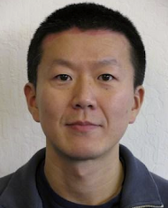
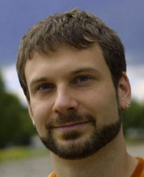
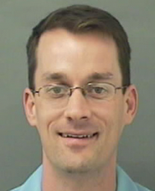
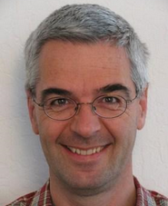
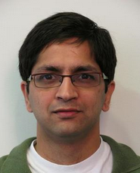
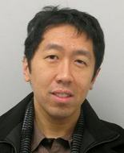
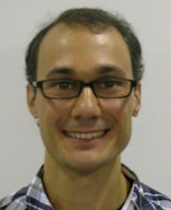
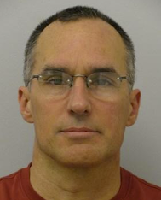
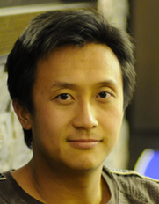
Joint work with
Kai Chen
Greg Corrado
Jeff Dean
Matthieu Devin
Rajat Monga
Andrew Ng
Marc’Aurelio
Ranzato
Paul Tucker
Ke Yang
Additional
Thanks:
Samy Bengio, Zhenghao Chen, Tom Dean, Pangwei Koh, Mark Mao, Jiquan Ngiam, Patrick Nguyen, Andrew Saxe, Mark Segal, Jon Shlens, Vincent Vanhouke, Xiaoyun Wu, Peng Xe, Serena Yeung, Will Zou

Slide 3

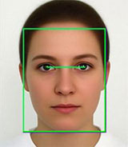
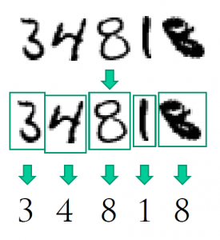
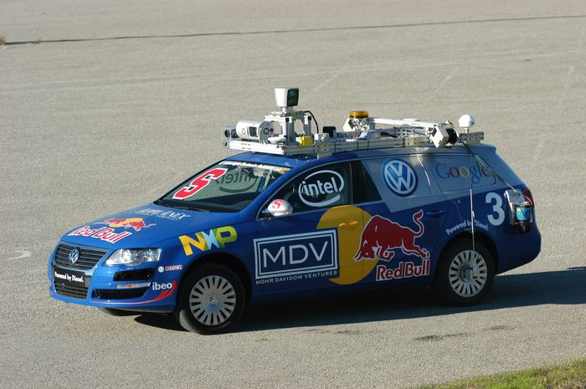

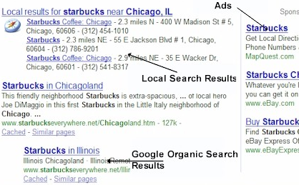
Machine Learning successes
Face recognition
OCR
Autonomous car
Email classification
Recommendation systems
Web page ranking
Notes:
At google, we’re interested in machine learning. Over the years, we have many success stories…For example…..This is only the beginning because there are still many machine learning applications within Google and in the sillicon valley.

Slide 4
What makes Machine Learning hard?
Notes:
Over the years, I am personally interested in the question of “What makes machine learning difficult to use in practice?” What should we do better to make machine learning easy to use. And through many discussions with friends, I manage to come up with a list of technical challenges that we as researchers could provide good solutions.

Slide 5
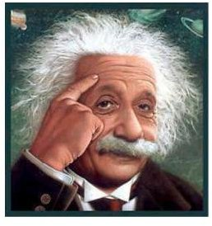
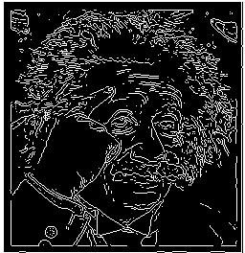
#1: Feature Designing
Classifier
Feature extraction
(Mostly hand-crafted features)
Notes:
The first challenge is the question of designing features. So it turns out that in many applications, what people spend most of their time on is trying to come up with relevant features. Let’s take computer vision as an example. Let’s say we want to recognize if there is a face in the image.

Slide 6
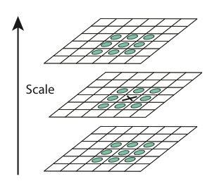
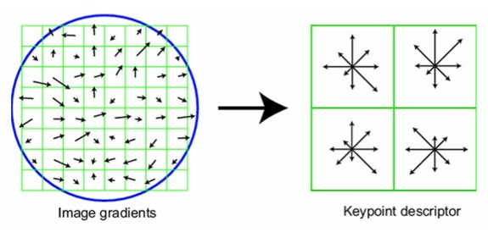
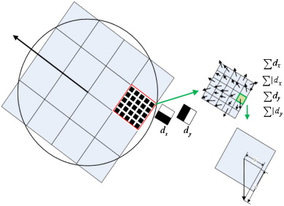
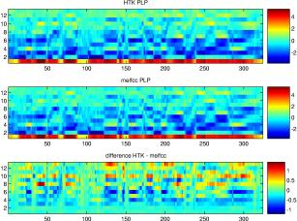
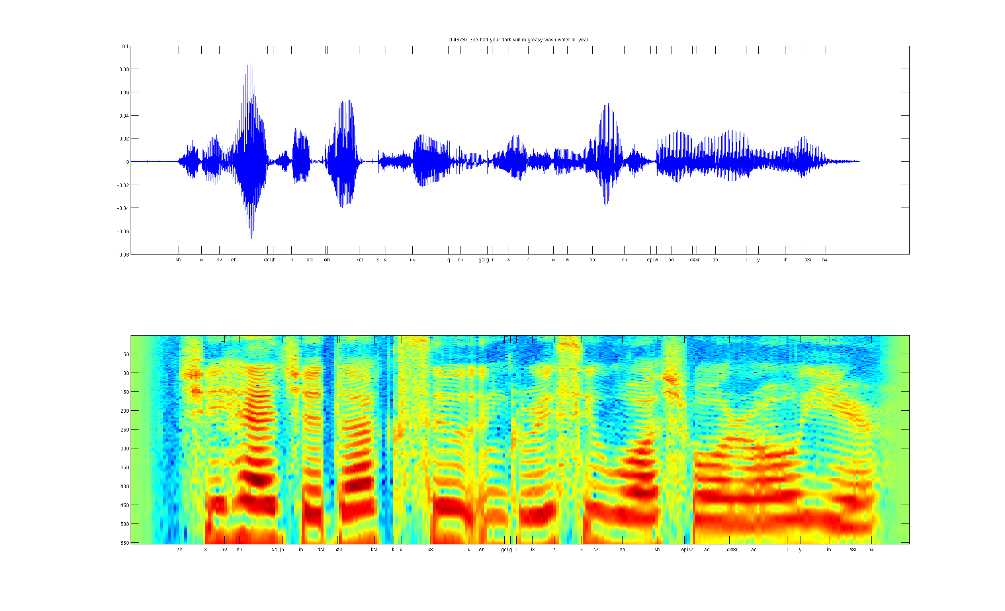
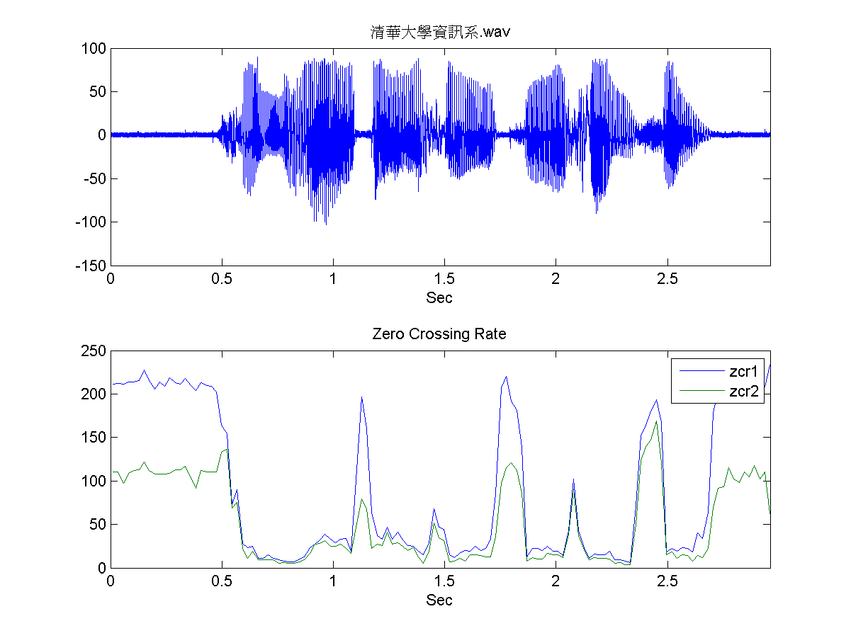
Hand-Crafted Features
Computer vision:
…
SIFT/HOG
SURF
Speech Recognition:
…
MFCC
Spectrogram
ZCR
Notes:
A lot of features are actually hand-crafted and take a long time to develop. They also require a lot of expert and domain knowledge. For instance, in computer vision, speech recognition, information retrieval, NLPs.

Slide 7
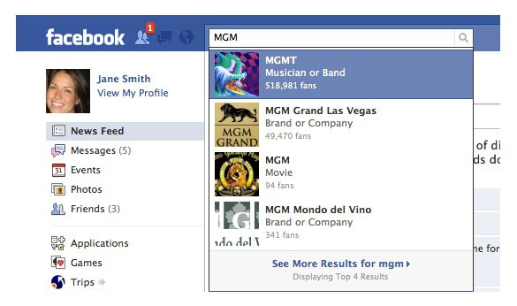
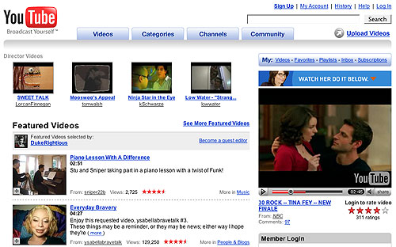
#2: SmallData and BigData
1 ImageNet per 1 hour 20 minutes
Massive amount of data -> Computational challenge
Mostly unlabeled or weakly labeled data -> Algorithmic challenge
Notes:
The second challenge is the dilemma between smalldata and bigdata. A lot of our models have been developed on small data and a machine. But machine learning works better if we have more data. Right now, people start talking about using BigData as a way to improve machine learning. To give a sense of scale, let’s again take computer vision as an application. In academia, the biggest computer vision dataset is ImageNet, 15 million images and took several years to construct. But if we work at google or facebook, that’s quite small because we can achieve such amount of data in an hour.

Slide 8
What makes Machine Learning hard?
Unsupervised feature learning / Deep Learning
Feature engineering is hard
Large amount of unlabeled data
Too much data for one computer to deal with
The availability of weakly labeled data
Parallelism using a computer
cluster
Data-centric algorithm
Notes:
In summary, here’s the list of challenges that I talked about. First, I talked about the challenge of inventing new features…

Slide 9
Unsupervised Feature Learning and Deep Learning with
Reconstruction ICA
Notes:
Over the years, in machine learning community, we have succeed in developing algorithms

Slide 10
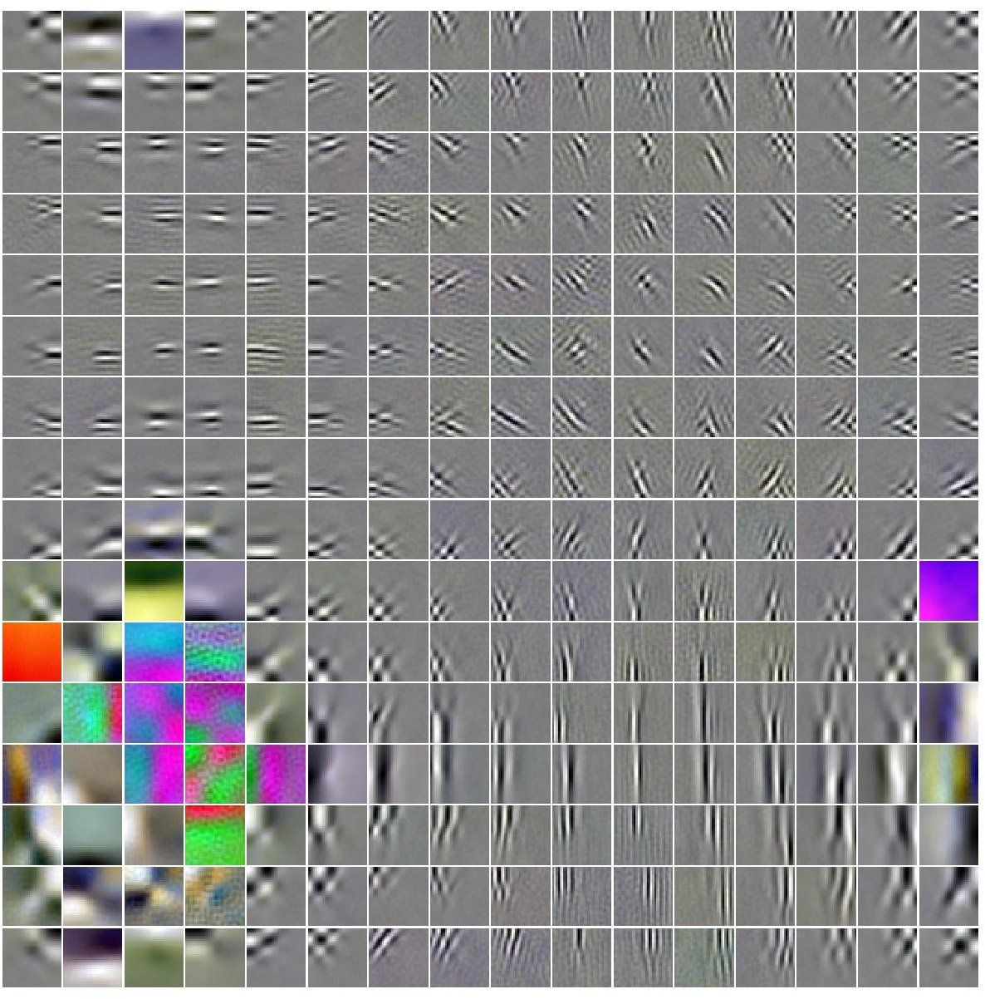
Topographic Independent Component Analysis (TICA)

Slide 11
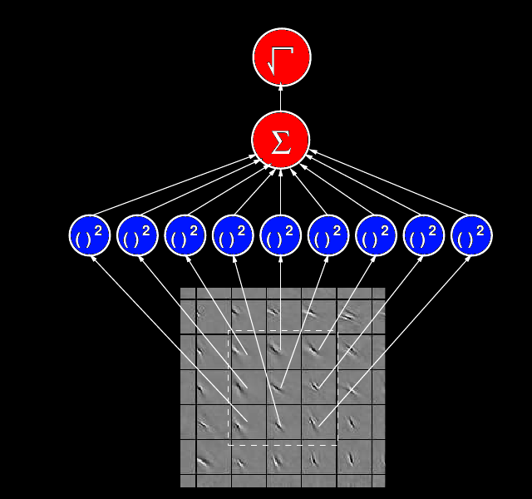



1. Feature computation
2
2. Learning
2
(
T
)
(
T
)
W
W
9
1
T
T
W
W
9
1
W
W
9
1
W
1
W =
W
2
.
.
W
10000
Input data:

Slide 12
Topographic Independent Component Analysis (TICA)

Slide 13
Invariance explained
Images
Image1
Image2
Features
Loc1
Loc2
1
0
F1
F2
0
1
2
2
Pooled feature of F1 and F2
sqrt(1 + 0 ) = 1
2
2
sqrt(0 + 1 ) = 1
Same value regardless the location of the edge

Slide 14
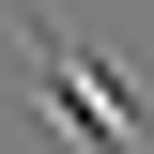
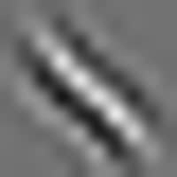
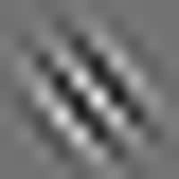
Translation invariance
Rotational invariance
Scale invariance
Le, et al., Tiled Convolutional Neural Networks. NIPS 2010

Slide 15



TICA:
Reconstruction ICA:
Equivalence between Sparse Coding, Autoencoders, RBMs and ICA
Build deep architecture by treating the output of one layer as input to another layer
Le, et al., ICA with Reconstruction Cost for Efficient Overcomplete Feature Learning. NIPS 2011

Slide 16
Reconstruction ICA:
Le, et al., ICA with Reconstruction Cost for Efficient Overcomplete Feature Learning. NIPS 2011

Slide 17


Reconstruction ICA:
Data whitening
Le, et al., ICA with Reconstruction Cost for Efficient Overcomplete Feature Learning. NIPS 2011

Slide 18

TICA:
Reconstruction ICA:
Data whitening
Le, et al., ICA with Reconstruction Cost for Efficient Overcomplete Feature Learning. NIPS 2011

Slide 19
Why RICA?
Algorithms
Speed
Ease of training
Invariant Features
Sparse Coding
RBMs/Autoencoders
TICA
Reconstruction ICA
Le, et al., ICA with Reconstruction Cost for Efficient Overcomplete Feature Learning. NIPS 2011

Slide 20
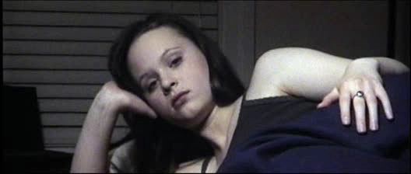
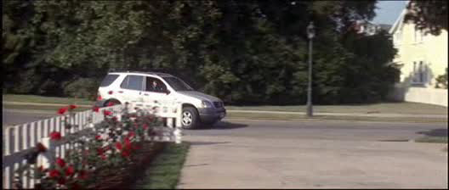
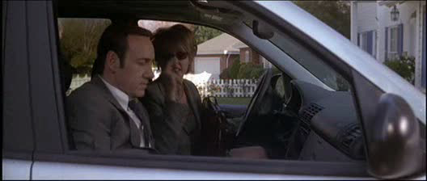
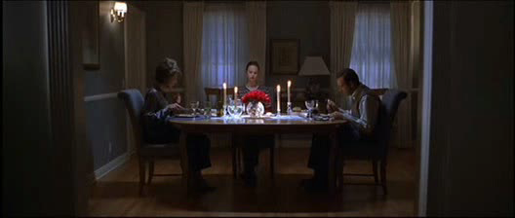

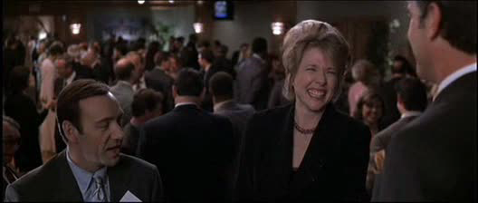
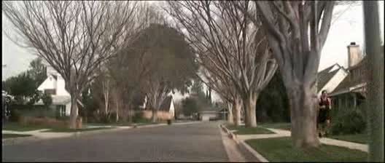
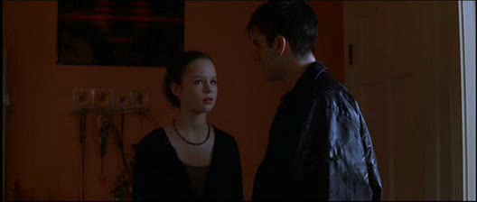

Action recognition
Sit up
Drive Car
Get Out of Car
Eat
Answer phone
Kiss
Run
Stand up
Shake hands
Le, et al., Learning hierarchical spatio-temporal features for
action recognition with independent subspace analysis. CVPR 2011
Notes:
[Mention state-of-the-art features]

Slide 21
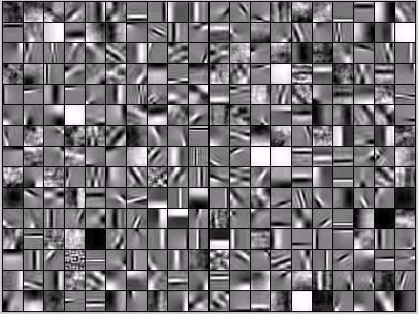
Le, et al., Learning hierarchical spatio-temporal features for
action recognition with independent subspace analysis. CVPR 2011

Slide 22
KTH
Hollywood2
Hessian/SURF
pLSA
HOF
GRBMs
3DCNN
HMAX
HOG
Learned Features
Hessian/SURF
HOG/HOF
HOG3D
GRBMS
HOF
Learned Features
UCF
YouTube
Hessian/SURF
HOG
Hessian
HOG.HOF
HOF
HOG3D
Combined
Engineered Features
Learned Features
Learned Features
Le, et al., Learning hierarchical spatio-temporal features for
action recognition with independent subspace analysis. CVPR 2011

Slide 23



Cancer classification
Apoptotic
Viable tumor
region
Necrosis
…
Le, et al., Learning Invariant Features of Tumor Signatures. ISBI 2012

Slide 24
What makes Machine Learning hard?
Unsupervised feature learning / Deep Learning
Feature engineering is hard
Large amount of unlabeled data
Too much data for one computer to deal with
The availability of weakly labeled data
Parallelism using a computer
cluster

Slide 25
Scaling up Deep Learning
Deep learning data
Real data

Slide 26
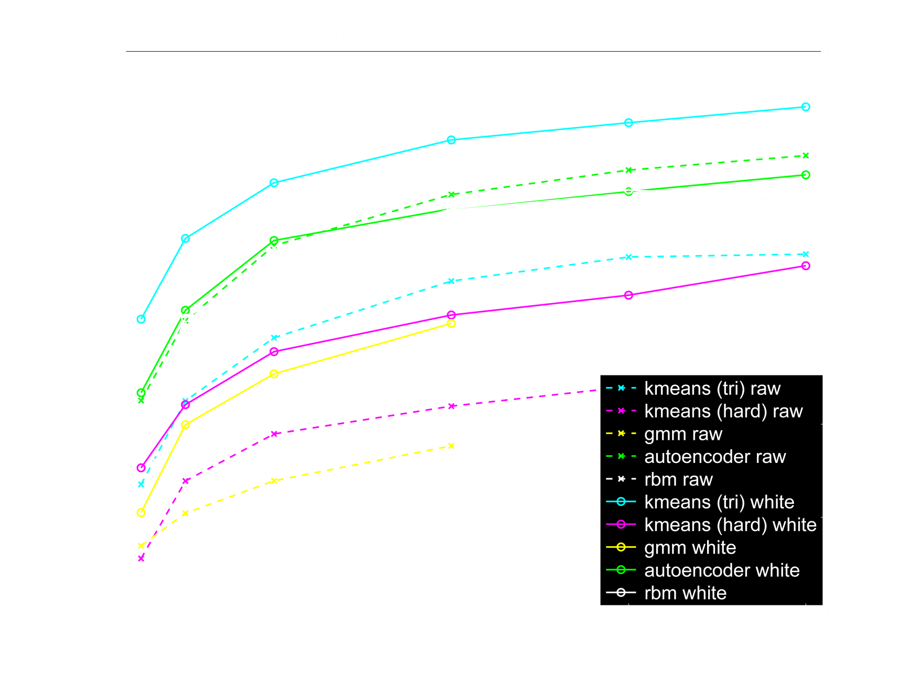
It’s better to have more features!
No matter the algorithm, more features always more successful.
Coates, et al., An Analysis of Single-Layer Networks in Unsupervised Feature Learning. AISTATS’11

Slide 27
Banko, Brill. Scaling to Very Large Corpora for Natural Language Disambiguation. 2001

Slide 28
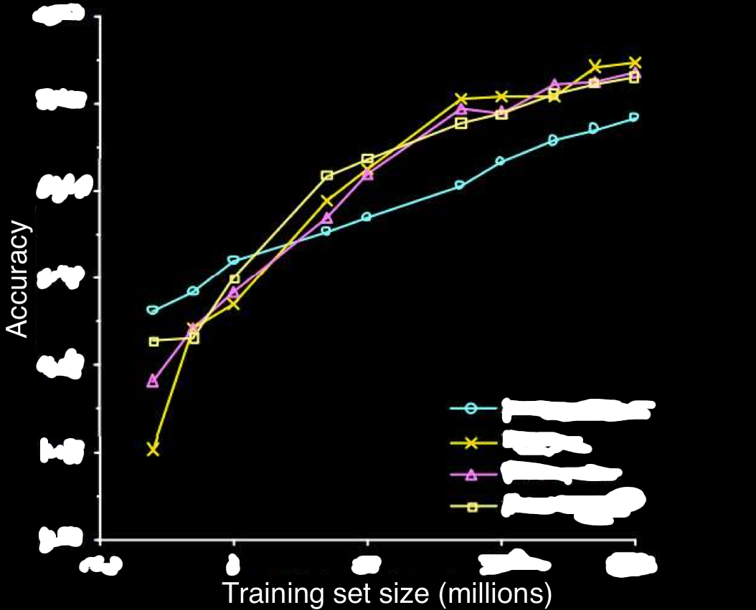
It’s better to use more data!
1.00
0.95
0.90
0.85
0.80
Memory-Based
0.75
Winnow
Perceptron
Naïve Bayes
0.1
1
10
100
1000
Banko, Brill. Scaling to Very Large Corpora for Natural Language Disambiguation. 2001

Slide 29
Most are
local features

Slide 30
Local receptive field networks
Machine #1
Machine #2
Machine #3
Machine #4
RICA features
Image
Le, et al., Tiled Convolutional Neural Networks. NIPS 2010

Slide 31
Challenges with 1000s of machines

Slide 32
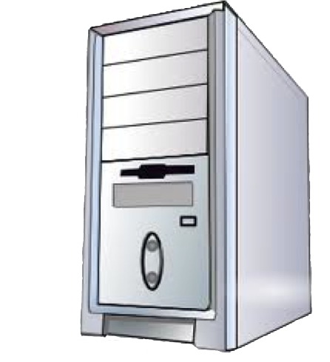
Asynchronous Parallel SGDs
Parameter server
Le, et al., Building high-level features using large-scale unsupervised learning. ICML 2012

Slide 33
Asynchronous Parallel SGDs
Parameter server
Le, et al., Building high-level features using large-scale unsupervised learning. ICML 2012
Notes:
Mention AdaGrad and John Duchi’s work

Slide 34
Parallel L-BFGS
Coordinator (communicate indices)
Parameter server
Le, et al., Building high-level features using large-scale unsupervised learning. ICML 2012
Notes:
Coordinator communicates small messages (indices) to perform load balancing between workers

Slide 35
Summary of Scaling up
Local connectivity
Asynchronous SGDs
… And more
RPC vs MapReduce
Prefetching
Single vs Double
Removing slow machines
…

Slide 36
10 million 200x200 images
1 billion parameters

Slide 37
Training
RICA
Dataset: 10 million 200x200 unlabeled images from YouTube/Web
Train on 2000 machines (16000 cores) for 1 week
1.15 billion parameters
100x larger than previously reported
Small compared to visual cortex
RICA
RICA
Image
Le, et al., Building high-level features using large-scale unsupervised learning. ICML 2012
Input to another layer above
(image with 8 channels)
Number of output
channels = 8
LCN Size = 5
H
Pooling Size = 5
Number
of maps = 8
One layer
W
RF size = 18
Number of input
channels = 3
Image Size = 200

Slide 38
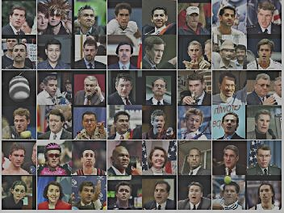
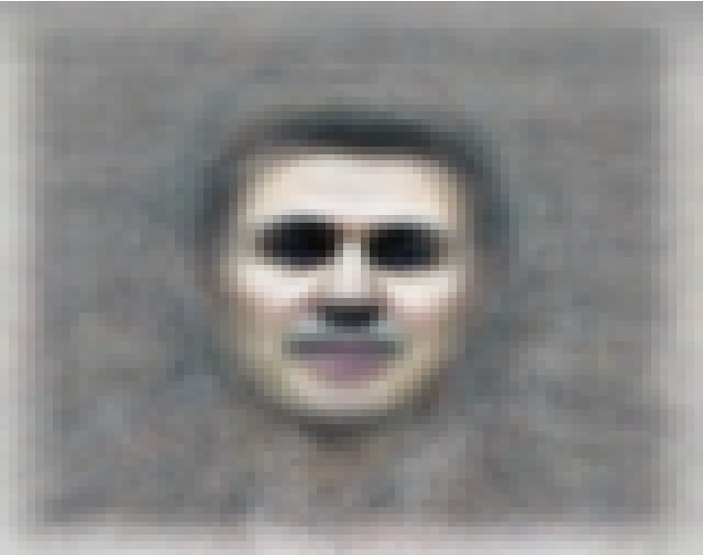
The face neuron
Top stimuli from the test set
Optimal stimulus
by numerical optimization
Le, et al., Building high-level features using large-scale unsupervised learning. ICML 2012

Slide 39
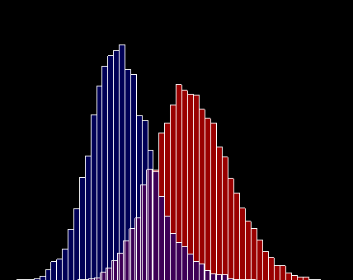
Random distractors
Faces
Frequency
Feature value
Le, et al., Building high-level features using large-scale unsupervised learning. ICML 2012

Slide 40
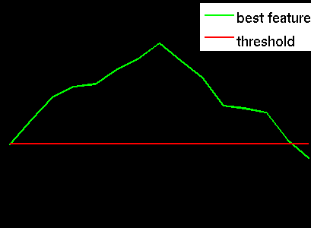
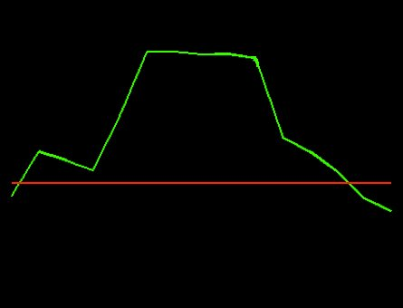
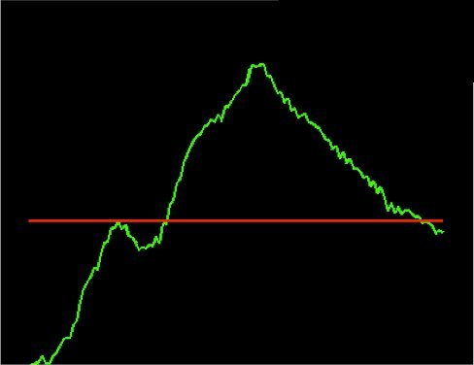
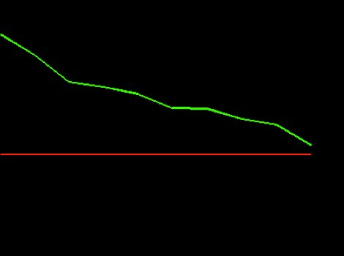
Invariance properties
Feature response
Feature response
0 pixels
20 pixels
0 pixels
20 pixels
Horizontal shifts
Vertical shifts
Feature response
Feature response
o
o
0
90
0.4x
1x
1.6x
3D rotation angle
Scale factor
Le, et al., Building high-level features using large-scale unsupervised learning. ICML 2012

Slide 41
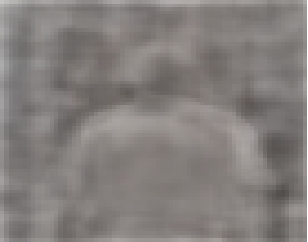
Optimal stimulus
by numerical optimization
Le, et al., Building high-level features using large-scale unsupervised learning. ICML 2012

Slide 42
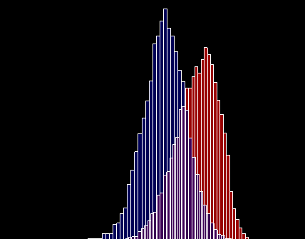
Random distractors
Pedestrians
Frequency
Feature value
Le, et al., Building high-level features using large-scale unsupervised learning. ICML 2012

Slide 43
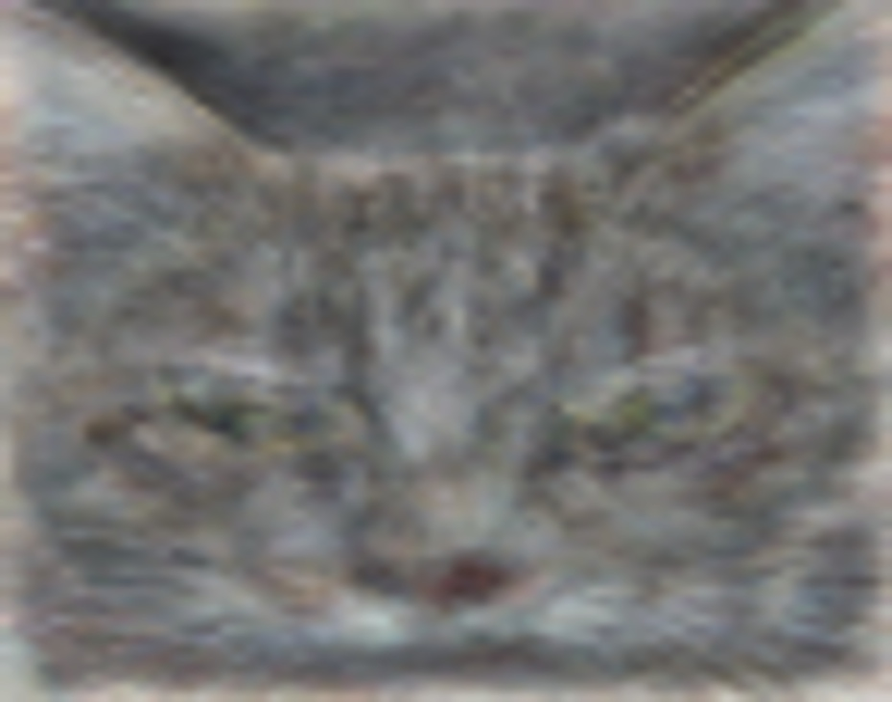
The cat neuron
Optimal stimulus
by numerical optimization
Le, et al., Building high-level features using large-scale unsupervised learning. ICML 2012

Slide 44
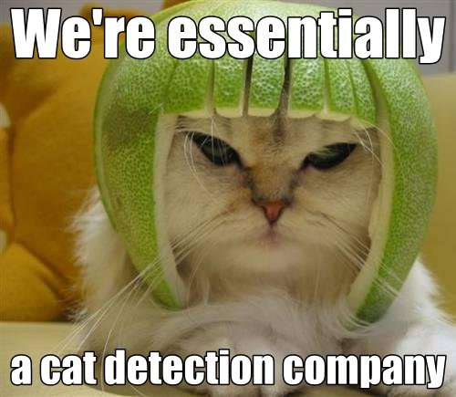

Slide 45

Random distractors
Cat faces
Frequency
Feature value
Le, et al., Building high-level features using large-scale unsupervised learning. ICML 2012

Slide 46


Slide 47





Best stimuli
Feature 1
Feature 2
Feature 3
Feature 4
Feature 5
Le, et al., Building high-level features using large-scale unsupervised learning. ICML 2012
Input to another layer above
(image with 8 channels)
Number of output
channels = 8
LCN Size = 5
H
Pooling Size = 5
Number
of maps = 8
One layer
W
RF size = 18
Number of input
channels = 3
Image Size = 200

Slide 48




Best stimuli
Feature 6
Feature 7
Feature 8
Feature 9
Le, et al., Building high-level features using large-scale unsupervised learning. ICML 2012
Input to another layer above
(image with 8 channels)
Number of output
channels = 8
LCN Size = 5
H
Pooling Size = 5
Number
of maps = 8
One layer
W
RF size = 18
Number of input
channels = 3
Image Size = 200

Slide 49





Best stimuli
Feature 10
Feature 11
Feature 12
Feature 13
Le, et al., Building high-level features using large-scale unsupervised learning. ICML 2012
Input to another layer above
(image with 8 channels)
Number of output
channels = 8
LCN Size = 5
H
Pooling Size = 5
Number
of maps = 8
One layer
W
RF size = 18
Number of input
channels = 3
Image Size = 200

Slide 50
ImageNet classification
22,000 categories
14,000,000 images
Hand-engineered features (SIFT, HOG, LBP),
Spatial pyramid, SparseCoding/Compression
Le, et al., Building high-level features using large-scale unsupervised learning. ICML 2012

Slide 51





22,000 is a lot of categories…
…
smoothhound, smoothhound shark, Mustelus mustelus
American smooth dogfish, Mustelus canis
Florida smoothhound, Mustelus norrisi
whitetip shark, reef whitetip shark, Triaenodon obseus
Atlantic spiny dogfish, Squalus acanthias
Pacific spiny dogfish, Squalus suckleyi
hammerhead, hammerhead shark
smooth hammerhead, Sphyrna zygaena
smalleye hammerhead, Sphyrna tudes
shovelhead, bonnethead, bonnet shark, Sphyrna tiburo
angel shark, angelfish, Squatina squatina, monkfish
electric ray, crampfish, numbfish, torpedo
smalltooth sawfish, Pristis pectinatus
guitarfish
roughtail stingray, Dasyatis centroura
butterfly ray
eagle ray
spotted eagle ray, spotted ray, Aetobatus narinari
cownose ray, cow-nosed ray, Rhinoptera bonasus
manta, manta ray, devilfish
Atlantic manta, Manta birostris
devil ray, Mobula hypostoma
grey skate, gray skate, Raja batis
little skate, Raja erinacea
…
Stingray
Mantaray

Slide 52
0.005%
9.5%
?
Random guess
State-of-the-art
(Weston, Bengio ‘11)
Feature learning
From raw pixels
Le, et al., Building high-level features using large-scale unsupervised learning. ICML 2012

Slide 53
0.005%
9.5%
21.3%
Random guess
State-of-the-art
(Weston, Bengio ‘11)
Feature learning
From raw pixels
Le, et al., Building high-level features using large-scale unsupervised learning. ICML 2012

Slide 54
Final prediction
prediction
prediction
prediction
hidden
hidden
hidden
hidden
hidden
hidden
hidden
hidden
hidden
Image
Image
Image

Slide 55
0.005%
9.5%
15.8%
Random guess
State-of-the-art
(Weston, Bengio ‘11)
Feature learning
From raw pixels
19.4%
Mixture of experts
From raw pixels
Le, et al., Building high-level features using large-scale unsupervised learning. ICML 2012

Slide 56
Object detection
42.5%
35.2%
State-of-the-art
(Smeulders et al ‘11)
Our method
51.8%
Our method
(On training set)

Slide 57
Develop more sophisticated algorithms to overcome overfitting
Use weakly labeled data

Slide 58


Slide 59


Slide 60


Slide 61


Slide 62


Slide 63


Slide 64


Slide 65


Slide 66


Slide 67


Slide 68


Slide 69


Slide 70


Slide 71


Slide 72


Slide 73


Slide 74


Slide 75


Slide 76
No matter the algorithm, more features always more successful.
Dramatically improves
  Speech recognition
  Machine Translation
Benefit many Google products
Also work well with existing hand-engineered features

Slide 77


Slide 78



Conclusions
RICA learns invariant features
Face neuron with totally unlabeled data
with enough training and data
State-of-the-art performances on
  Action Recognition
  Cancer image classification
  ImageNet
ImageNet
0.005%
9.5%
19.4%
Random guess
Best published result
Our method
Cancer classification
Action recognition
Action recognition benchmarks
Feature visualization
Face neuron

Slide 79
References
Q.V. Le, M.A. Ranzato, R. Monga, M. Devin, G. Corrado, K. Chen, J. Dean, A.Y. Ng. Building high-level features using large-scale unsupervised learning. ICML, 2012.
Q.V. Le, J. Ngiam, Z. Chen, D. Chia, P. Koh, A.Y. Ng. Tiled Convolutional Neural Networks. NIPS, 2010.
Q.V. Le, W.Y. Zou, S.Y. Yeung, A.Y. Ng. Learning hierarchical spatio-temporal features for action recognition with independent subspace analysis. CVPR, 2011.
Q.V. Le, J. Ngiam, A. Coates, A. Lahiri, B. Prochnow, A.Y. Ng. On optimization methods for deep learning. ICML, 2011.
Q.V. Le, A. Karpenko, J. Ngiam, A.Y. Ng. ICA with Reconstruction Cost for Efficient Overcomplete Feature Learning. NIPS, 2011.
Q.V. Le, J. Han, J. Gray, P. Spellman, A. Borowsky, B. Parvin. Learning Invariant Features for Tumor Signatures. ISBI, 2012.
I.J. Goodfellow, Q.V. Le, A.M. Saxe, H. Lee, A.Y. Ng, Measuring invariances in deep networks. NIPS, 2009.
http://ai.stanford.edu/~quocle

Slide 80


