Slide 1
Robots and Brains
Andrew Ng, Associate Professor of Computer Science

Slide 2
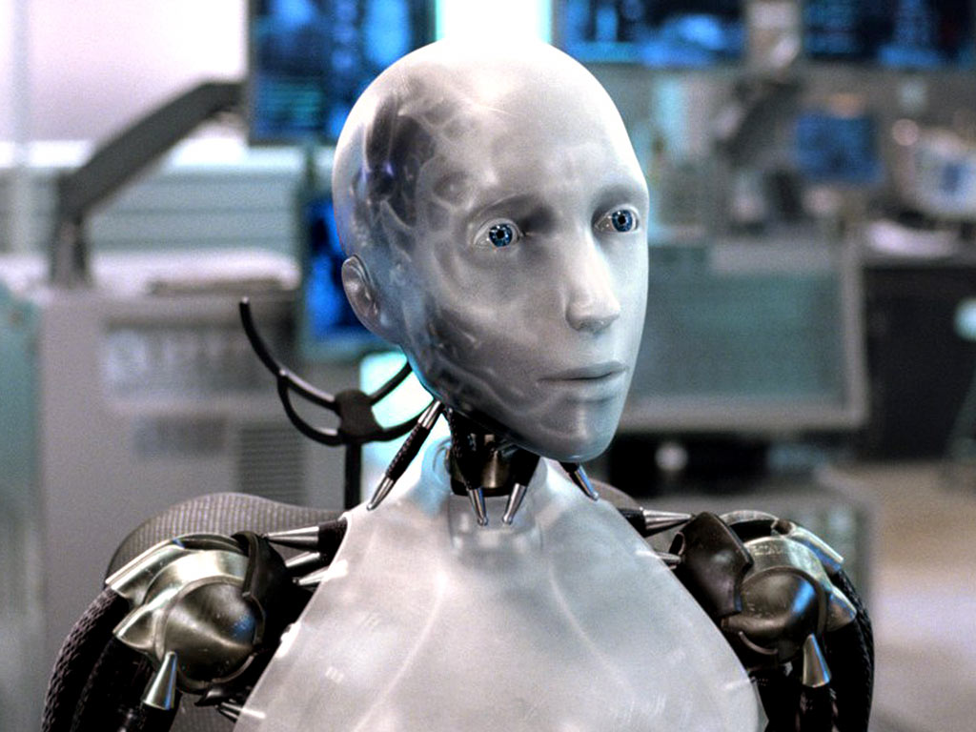
Who wants a robot to clean your house?
[Photo Credit: iRobot]
Notes:
Who wants a robot to clean you house? Raise your hands… great.. Everyone wants a robot! We been thinking of housecleaning robots as being the realm of science fiction, but is this really the case? I’m going to show you a video of a robot built at Stanford.

Slide 3
Stanford STAIR Robot
[Credit: Ken Salisbury]
Notes:
Things aren’t as they seem in this video, and there’s a cheat in it. Let me show you the video. (Show video) What do you think the cheat is?

Slide 4
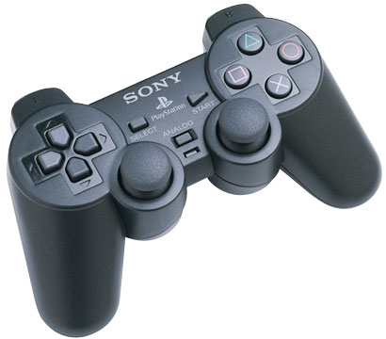
Notes:
This is the cheat. Every tiny little motion of the robot was controlled by a grad student using a joystick. [[I could have a live robot there, and just briefly show a couple of motions of the robots controlled by the joystick.]]

Slide 5
What’s missing?
The software
Control
Perception
Notes:
So, what’s missing? The software. In other words, there’s good news and bad news. The good news is that our robots today are mechanically/physically capable of cleaning our houses, and doing pretty much all the things we want a robot to do. The bad news is that they aren’t smart enough to this by themselves. What does the software need to do? In robotics, we need to solve two problems: Control, perception. Control means once you’ve figured out what you want to robot to do, how to get it to do that. Perception means seeing the world and understanding what’s around us. So, lets start with control. When I started on robotics about 10 years ago, asked around for what was hardest control problem.

Slide 6
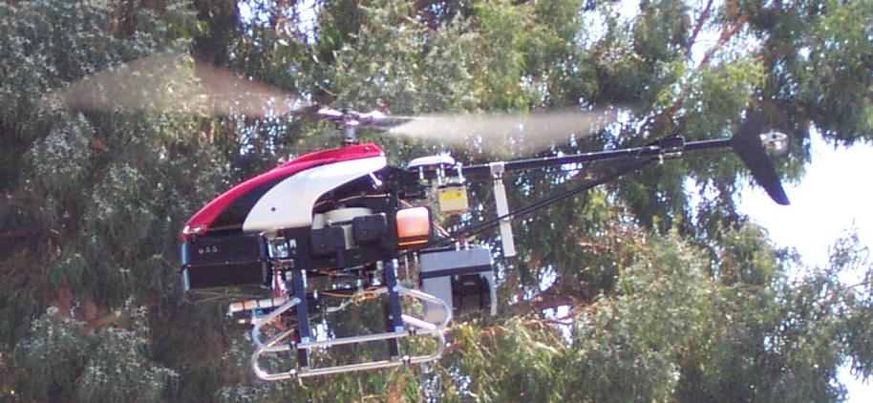
Stanford autonomous helicopter
Notes:
The most common answer I heard back then was autonomous helicopter, so I decided to work on that. Here’s a picture of our autonomous helicopter.

Slide 7
Stanford autonomous helicopter
GPS
Accelerometers
Compass
Computer
Notes:
It’s instrumented with GPS, accelerometers, and a compass, so it always knows where it is. The control problem is: 10 times a second, you’re told the exact position of the helicopter. And 10 times a second, you need to decide how to move the control sticks, in order to keep the helicopter up in the air.

Slide 8
Notes:
So we though, oh, okay! We’ll just write a computer program to fly the helicopter. We’ll just write a piece of code like this, and it’ll decide how to move the control sticks.

Slide 9
Computer program to fly helicopter
[Courtesy of David Shim]
Notes:
Let me show you a video made by a friend, who took this approach. When I play the video, you’ll hear David Shim’s voice say “enable control”, and that’s when his computer program takes over flying the helicopter.
(Play video.)

Slide 10
Option 1 BLACK
Notes:
I realized that it was just too hard to sit down and write a program to do this. We don’t understand the aerodynamics of helicopter too well, and helicopters are just too complicated, so we don’t know how to come up with a mathematical specification for how to fly it. Instead, the best way to fly a helicopter is by watching how human pilots learn to fly, and then getting our computers to go through the same learning process. So, we found ourselves an expert human pilot, and asked him to demonstrate flying a helicopter. Just like an amateur pilot. our computer watch him fly it, and learned to fly “just like him.”
Using this idea—called machine learning—we’ve ended up able to do some very fun things with our helicopter.

Slide 11
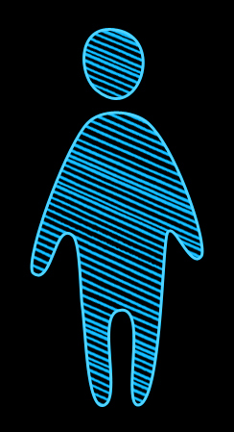
Machine learning
Option 2
Notes:
I realized that it was just too hard to sit down and write a program to do this. We don’t understand the aerodynamics of helicopter too well, and helicopters are just too complicated, so we don’t know how to come up with a mathematical specification for how to fly it. Instead, the best way to fly a helicopter is by watching how human pilots learn to fly, and then getting our computers to go through the same learning process. So, we found ourselves an expert human pilot, and asked him to demonstrate flying a helicopter. Just like an amateur pilot. our computer watch him fly it, and learned to fly “just like him.”
Using this idea—called machine learning—we’ve ended up able to do some very fun things with our helicopter.
[Some nice graphic here explaining the “have a human
pilot demonstrate flying, have the computer watch the human
and learn from it” would be nice….]

Slide 12
Machine learning
Notes:
I realized that it was just too hard to sit down and write a program to do this. We don’t understand the aerodynamics of helicopter too well, and helicopters are just too complicated, so we don’t know how to come up with a mathematical specification for how to fly it. Instead, the best way to fly a helicopter is by watching how human pilots learn to fly, and then getting our computers to go through the same learning process. So, we found ourselves an expert human pilot, and asked him to demonstrate flying a helicopter. Just like an amateur pilot. our computer watch him fly it, and learned to fly “just like him.”
Using this idea—called machine learning—we’ve ended up able to do some very fun things with our helicopter.
[Some nice graphic here explaining the “have a human
pilot demonstrate flying, have the computer watch the human
and learn from it” would be nice….]

Slide 13
Machine learning to fly helicopter
Notes:
(play video). By watching and learning from human pilots, our machines can now fly helicopters at a skill level comparable to the very best pilots in the world, including fly stunt maneuvers like these.

Slide 14
What’s missing?
The software
Control
Perception
Notes:
So, what’s left to do? Remember I said there were two problems: Control and Perception. Since we seemed to be doing pretty well on control, I turned my attention to the perception problem.

Slide 15
“Robot, please find my coffee mug”
Notes:
What’s hard about perception? Let say I want my robot to find my coffee mug. Because we know how to do control, our robot knows how to drive to the kitchen, to look for the coffee mug. Lets say the robot sees this in my kitchen. Where does it think the coffee mug is?

Slide 16
“Robot, please find my coffee mug”
Mug
Mug
Mug
Mug
Mug
Mug
Mug
Notes:
If you run a computer vision algorithm, this is the sort of result you’ll get. It completely fails to find the coffee mug!

Slide 17
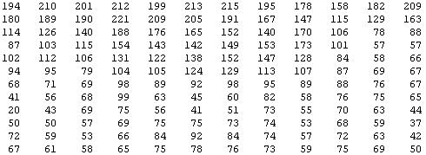
Why is computer vision hard?
But the camera sees this:
Notes:
Why is computer vision hard? You and my visual system is so good that it’s almost hard to understand how a computer program can fail to see what this is. But to understand why this is hard, lets zoom into part of the image. What seems a coffee mug to you, the camera sees as this. As a lot of numbers, corresponding to the pixel intensity values in the image. So, the computer vision problem is to look at this block of numbers, and figure out that this is the rim of a coffee mug.
I started looking at the computer vision literature to see how people are doing this. It seems you must need a very complicated mathematical function to decide that that block of numbers represents a coffee mug. And of course, the visual system also does lots of different things—we recognize faces, we recognize objects, we have depth perception, we can tell if something is far or close-by, and so on, and so it seems you have to write a lot of complicated programs to do all these things.

Slide 18
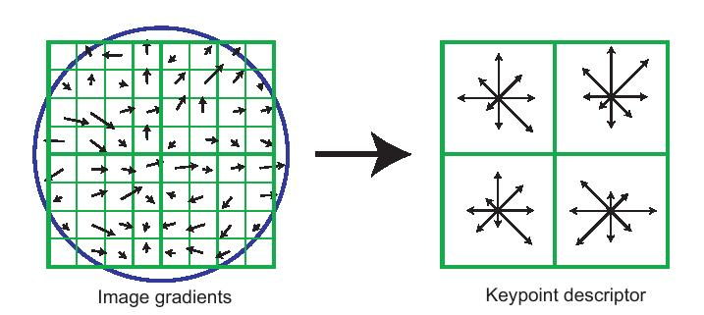
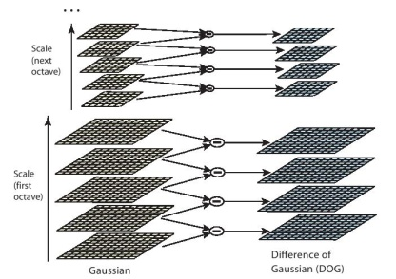
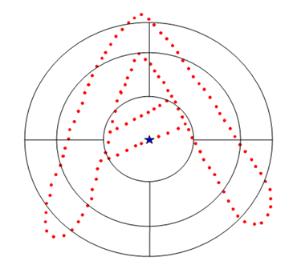
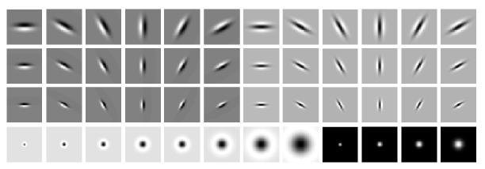
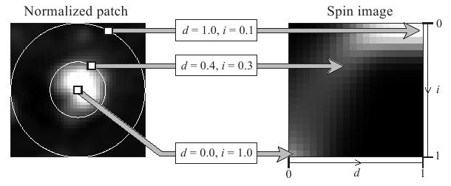
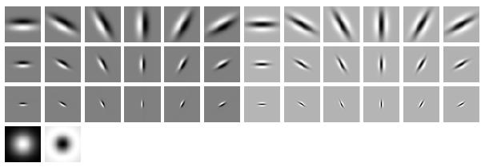
Computer programs (features) for vision
SIFT
GIST
HoG
Shape context
Textons
Spin image
Notes:
And, in the computer vision literature, researchers have started doing exactly this: Writing very complicated programs to capture different things about images. These are illustrations from six of the leading computer vision programs (the technical term is “features”), and you know what… they’re really complicated, but they really don’t work that well.
Now, of course, perception isn’t just about vision. We also have audio. For example, can we get a robot to understand speech; understand our voices?

Slide 19
Why is speech recognition hard?
What a microphone records:
“Robot, please find my coffee mug.”
Notes:
There’s starting to be software that can do this now, but this still turns out to be quite difficult. Why is this hard? Well, similar reason as vision. The microphone records a sound waveform like this. And the speech recognition problem is to figure out that this corresponds to me saying “robot, please find my coffee mug.”
And because it seems you need a very complicated function to go from the waveform to the text…

Slide 20
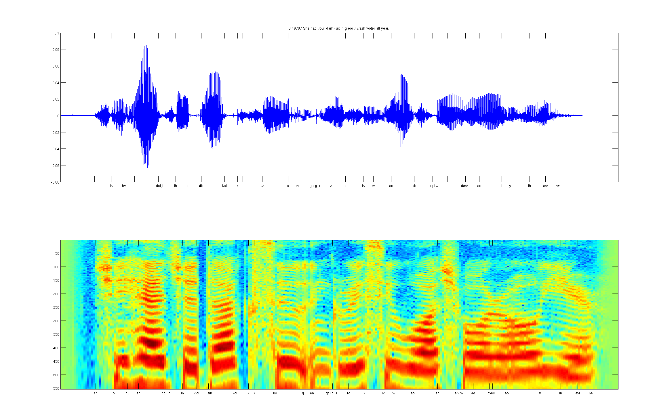
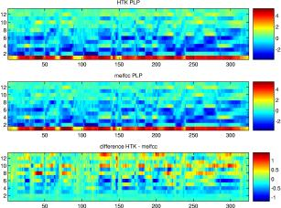
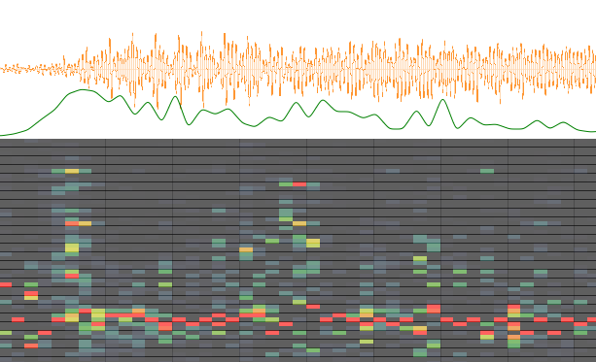
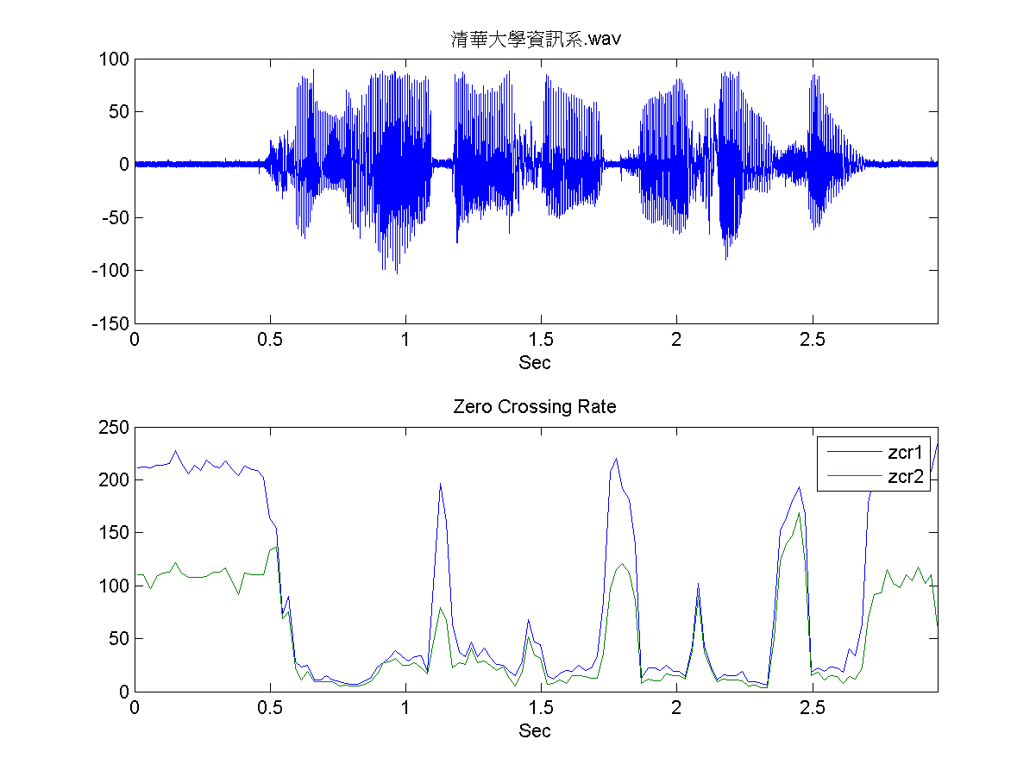
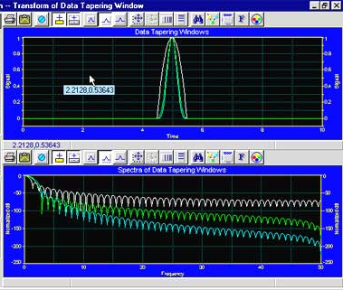
Computer programs (features) for audio
Spectrogram
MFCC
Flux
ZCR
Rolloff
Notes:
… audio researchers have also been writing very complicated computer programs to try to do this, and here are some of the leading approaches.
As I was looking at how vision and audio was progressing, it seemed a bleak state of affairs. We’re writing all these complicated programs for vision, and all these complicated programs for audio, and it was hard to get them to work. I tried writing some even more complicated programs myself, but it was really tough to make progress, and I was losing hope.
But then I learned about one idea… that re-energized my thinking in all this. This idea comes from biology—from neuroscientists.

Slide 21
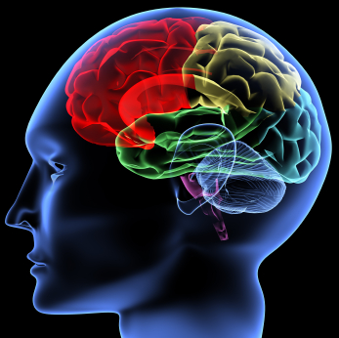
The idea:
Most of perception in the brain may be one simple program
Notes:
It is that rather than writing a lot of different computer programs for vision, and a lot of different computer programs for audio… if you look at how the brain does perception, it might be doing everything with just one program, and perhaps even a fairly simple one. In other words, rather than having some complicated system in your brain for vision, and some other system for audio, and another system for touch, and so on, it might be possible to design just one simple program to do all of these!

Slide 22
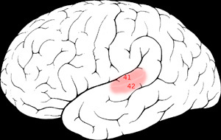
The “one program” hypothesis
Auditory Cortex
Auditory cortex learns to see
[Roe et al., 1992]
Notes:
Here’s why we think this might be true.
That red part of the brain is your auditory cortex. The way you’re understanding my words now is your ears are routing the sound signal to your auditory cortex, and then that’s processing and understanding the sound. What neuroscientists have done is the following fascinating experiment. You can cut the wire from the ears to the auditory cortex. And rewire the signal from the eyes—from the optic nerve—so that it ends up going to the auditory cortex. If you do this, then the auditory cortex will learn to see. This is a very reliable result, replicated by multiple research labs on multiple species of animals. And these animals can do visual discrimination tasks—that is, look at things and make visual judgments—using their auditory cortex.

Slide 23
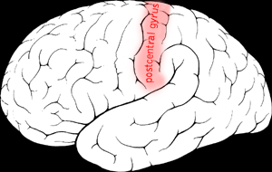
The “one program” hypothesis
Somatosensory Cortex
Somatosensory cortex learns to see
[Roe et al., 1992]
Notes:
Here’s why we think this might be true.
That red part of the brain is your auditory cortex. The way you’re understanding my words now is your ears are routing the sound signal to your auditory cortex, and then that’s processing and understanding the sound. What neuroscientists have done is the following fascinating experiment. You can cut the wire from the ears to the auditory cortex. And rewire the signal from the eyes—from the optic nerve—so that it ends up going to the auditory cortex. If you do this, then the auditory cortex will learn to see. This is a very reliable result, replicated by multiple research labs on multiple species of animals. And these animals can do visual discrimination tasks—that is, look at things and make visual judgments—using their auditory cortex.

Slide 24
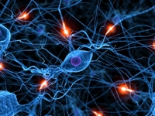
Neurons in the brain
Notes:
How does the brain work? You brain is jam-packed full or neurons that’re connected to and talk to each other.

Slide 25
Neural Network
x₁
x₂
Output
x₃
Layer L₄
x₄
Layer L₃
Layer L₁
Layer L₂
Notes:
In a computer, we can simulate this by building a Neural Network, which is a program that simulates lots of neurons talking to each other. What might we hope for this neural network to do then? Well, lets look more to the biology.

Slide 26
How does the brain process images?
Primary visual cortex looks for “edges.”
Neuron #1 of visual cortex
(model)
Neuron #2 of visual cortex
(model)
Notes:
It turns out that the way the brain processes images is it first looks for edges in images. For example, there’s a neuron in your brain now that’s looking for a 45 degree edge like that (left image)—a black band adjacent to a white band. And there’s probably a different neuron looking for an edge like that in the right image—a vertical white band with two black bands on the side. So, the question is, can we get our algorithms to do this too?

Slide 27
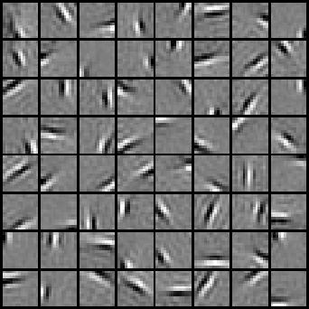
Comparing to Biology
Visual cortex
Learning algorithm
[PICTURE]
Notes:
Left: edge detectors from visual cortex.
Right: Show that algorithms get same thing. Successfully mimicks visual cortex.

Slide 28
Comparing to Biology
Auditory cortex
Learning algorithm
[PICTURE]
[PICTURE]
Notes:
Left: visualization of what auditory cortex is looking for.
Right: Show that algorithms get same thing.
One computer program successfully mimics both the visual and auditory processing systems!

Slide 29
Computer vision results (NORB benchmark)
Classical computer vision (SVM):
Neural Network:
accuracy
accuracy
Notes:
[[Should be 97.0%?]]
Does this work? We took this approach, and applied it to a bunch of computer vision benchmarks. I’ll share with you just one of the results.
Algorithm does well.

Slide 30
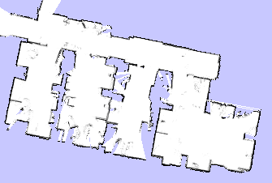
Missed Mugs
True positives
False positives
Notes:
In fact, just for fun, recently, we sent our robot around of office building to take inventory of the coffee mugs in our office .

Slide 31
Missed Mugs
True positives
False positives

Slide 32
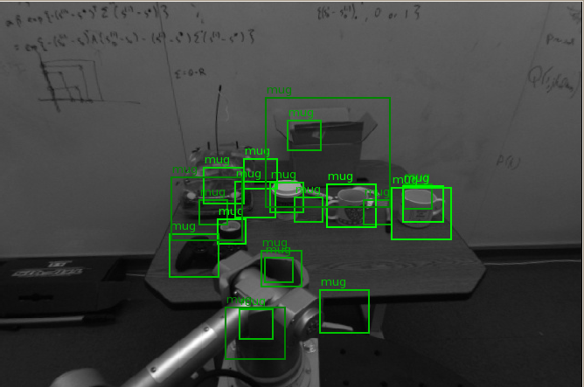
Missed Mugs
True positives
False positives

Slide 33
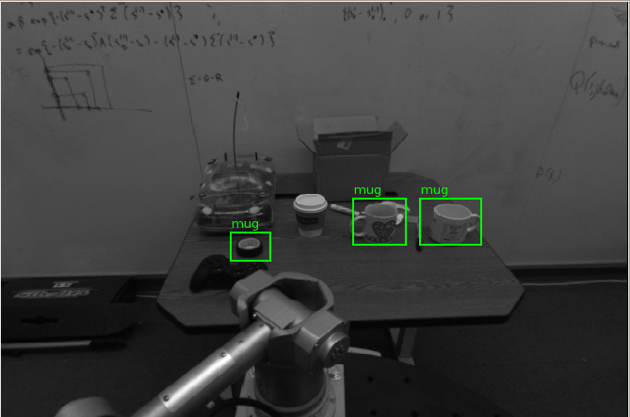
Missed Mugs
True positives
False positives

Slide 34
Results using non-embodied vision
Missed Mugs
True positives
False positives

Slide 35
Missed Mugs
True positives
False positives

Slide 36
Results using non-embodied vision
Missed Mugs
True positives
False positives

Slide 37
Classifications using embodied agent
Missed Mugs
True positives
False positives

Slide 38
Missed Mugs
True positives
False positives
Notes:
In fact, just for fun, recently, we sent our robot around of office building to take inventory of the coffee mugs in our office .

Slide 39
Results using non-embodied vision
Missed Mugs
True positives
False positives

Slide 40
Missed Mugs
True positives
False positives

Slide 41
Missed Mugs
True positives
False positives
Notes:
And there’re the pictures of the mugs found by the robot.

Slide 42
Hope of progress in Artificial Intelligence
Email: ang@cs.stanford.edu
Notes:
Let me close with a personal story. Always wanted to work on AI… gave up, thought too hard. Only after learning about these ideas that most of brain may be one algorithm, felt like for the first time in my life that we might have hope in making progress towards AI. I still know if we’ll success or fail. I see lots of reasons that this might not work. But when I look at our lives, I see us spending a lot of time in acts of mental drudgery. Cleaning our houses, filling out silly paperwork, going shopping for trivial items… and if we can make computers and robots smart enough to free us from many of those tasks, thus leaving us more time to pursue higher endeavors, what could be more exciting than that?
My research group is committed to pursuing this vision. If you’re an engineer or if you know an engineer that’s interested in these ideas, do contact me. I’d love to share with you what we know.

