Slide 1
Vision figures

Slide 2
Model
Biology

Slide 3
Lewicki figures

Slide 4
Smith, E.C., and M.S. Lewicki. “Efficient auditory coding.” Nature 439, no. 7079 (2006): 978-82.

Slide 5
Smith, E.C., and M.S. Lewicki. “Efficient auditory coding.” Nature 439, no. 7079 (2006): 978-82.

Slide 6
I can also try these again in illustrator to make them look smoother

Slide 7
Spectrogram figures

Slide 8
Model
Biology

Slide 9
Touch figure
(in case you’re curious :)

Slide 10
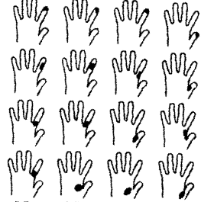
Model
Biology

