Slide 1
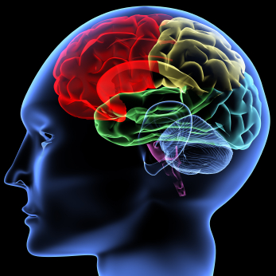
This talk: Deep Learning
Using brain simulations:
- Make learning algorithms much better and easier to use.
- Make revolutionary advances in machine learning and AI.
Vision shared with many researchers:
E.g., Samy Bengio, Yoshua Bengio, Tom Dean, Jeff Dean, Nando de Freitas, Jeff Hawkins, Geoff Hinton, Quoc Le, Yann LeCun, Honglak Lee, Tommy Poggio, Marc’Aurelio Ranzato, Ruslan Salakhutdinov, Josh Tenenbaum, Kai Yu, Jason Weston, ….
I believe this is our best shot at progress towards real AI.

Slide 2
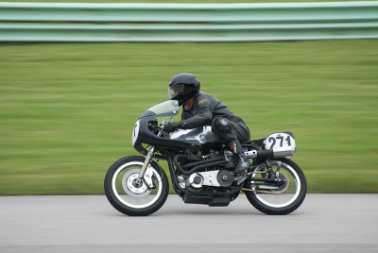
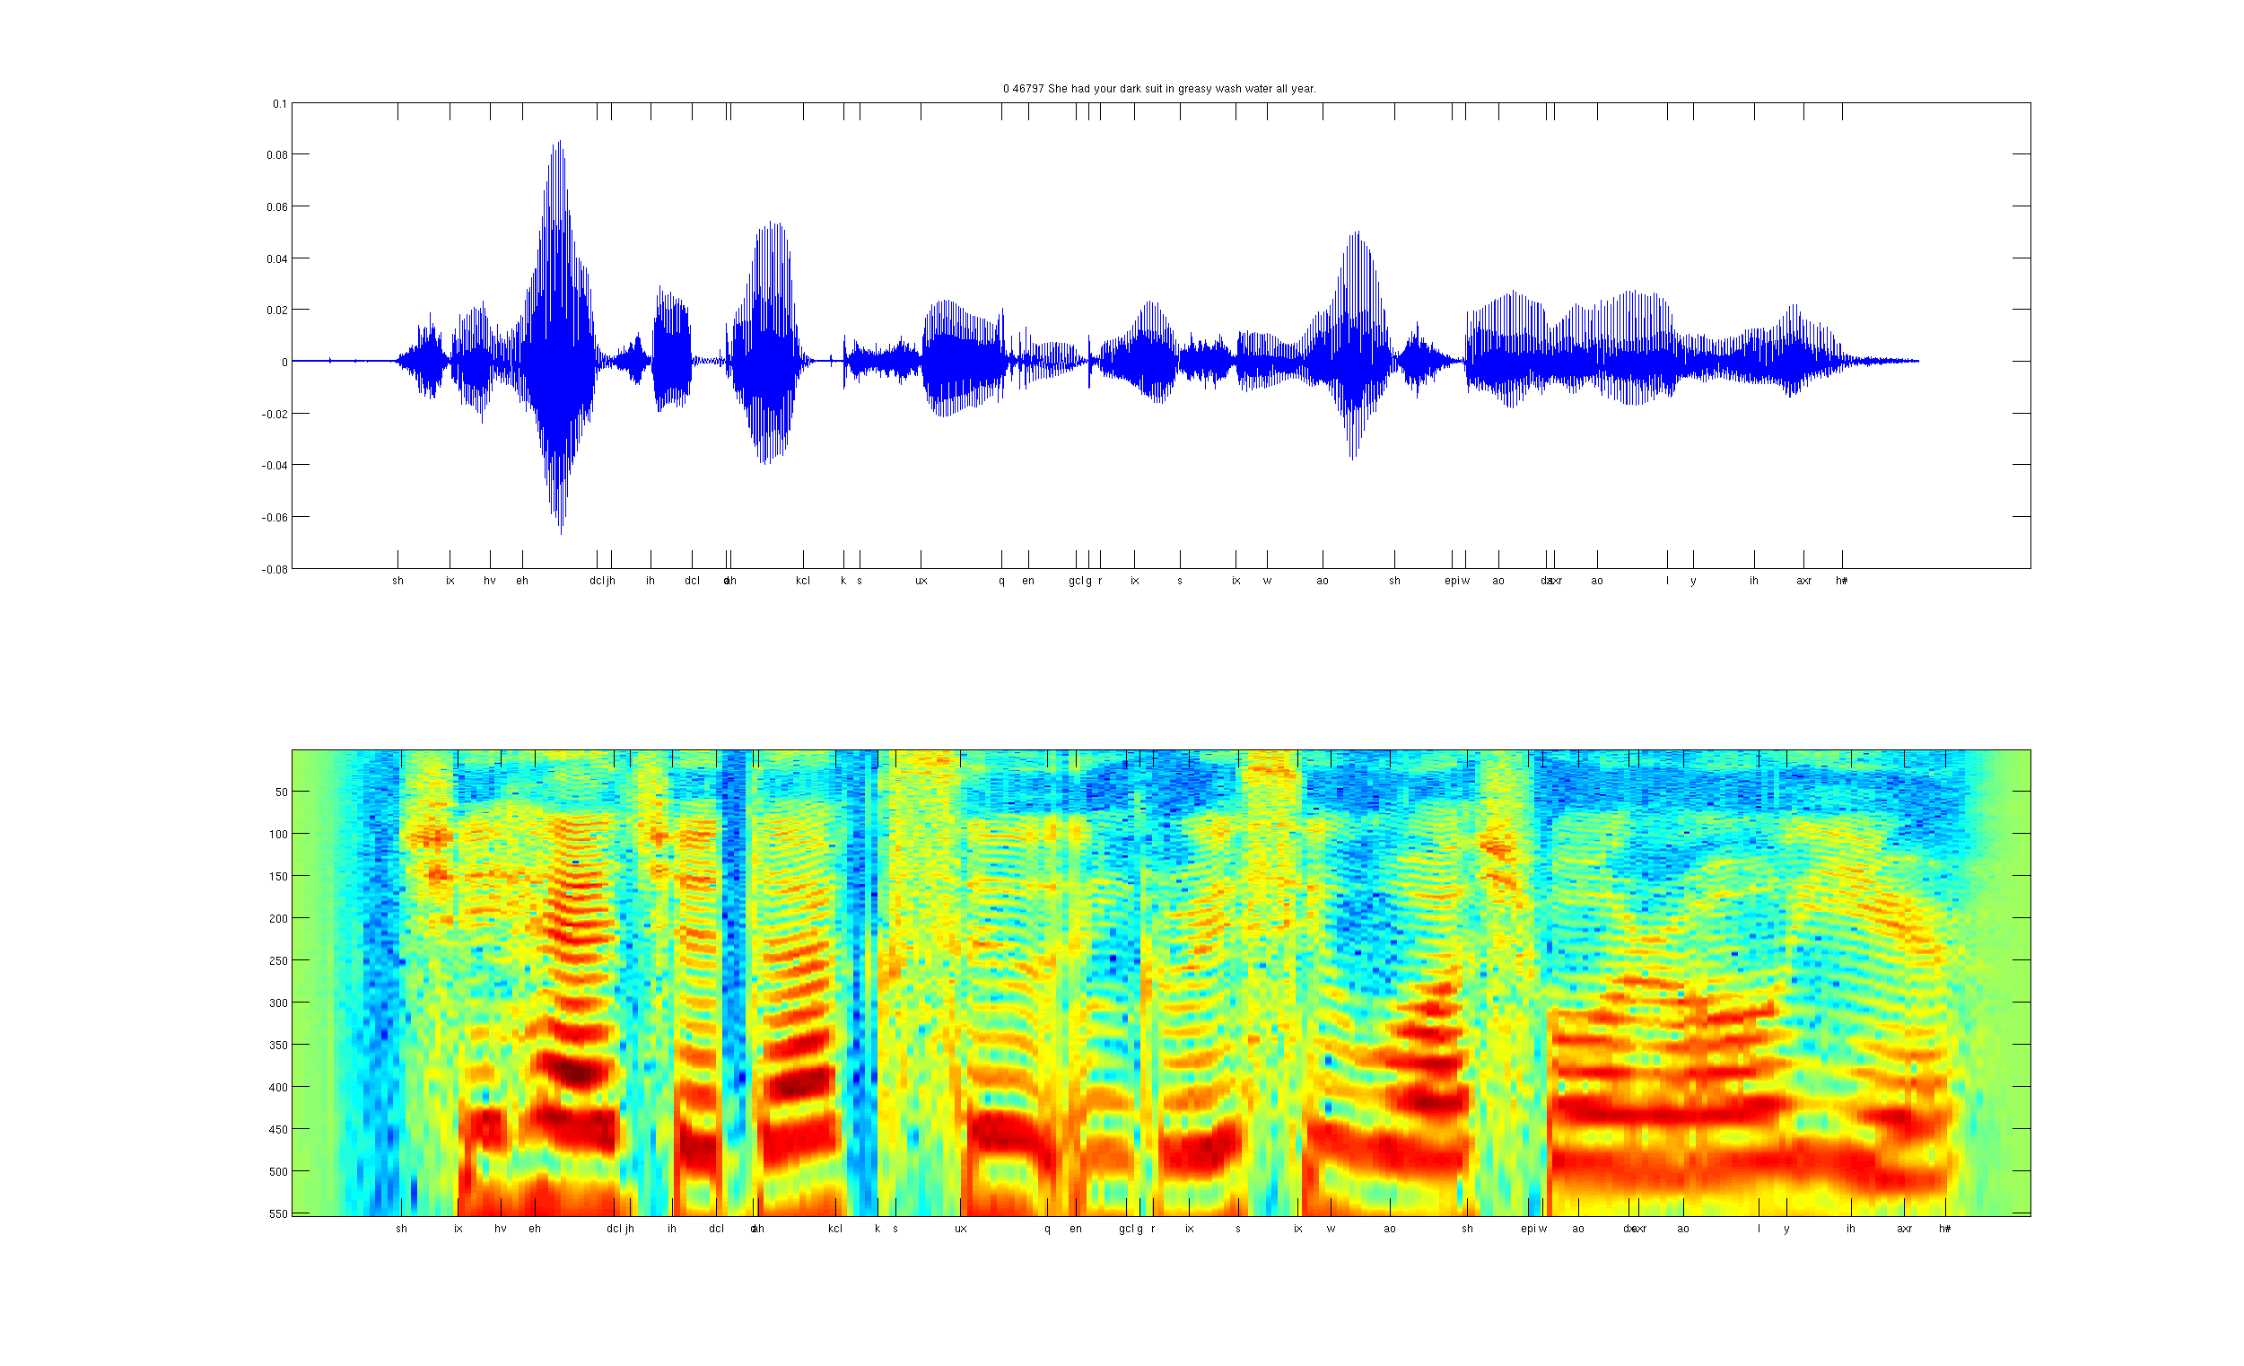


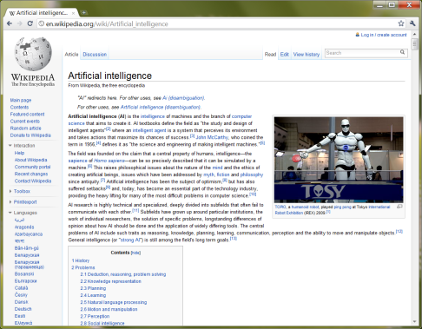
What do we want computers to do with our data?
Label: “Motorcycle”
Suggest tags
Image search
…
Images/video
Audio
Text
Speech recognition
Music classification
Speaker identification
…
Web search
Anti-spam
Machine translation
…

Slide 3
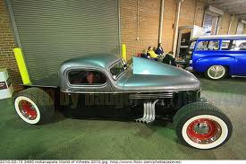
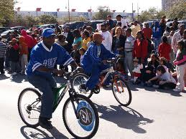
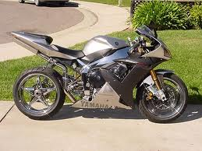
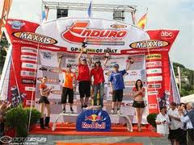
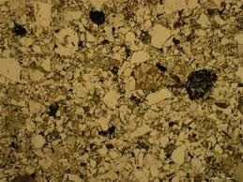
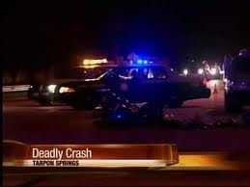
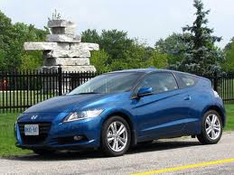
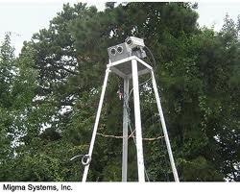
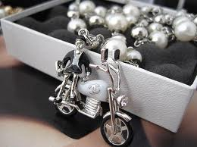
Computer vision is hard!
Motorcycle
Motorcycle
Motorcycle
Motorcycle
Motorcycle
Motorcycle
Motorcycle
Motorcycle
Motorcycle
Notes:
Good faith effort to implement state-of-the-art.
Cluttered scenes.

Slide 4
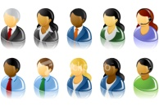
What do we want computers to do with our data?
Label: “Motorcycle”
Suggest tags
Image search
…
Images/video
Audio
Text
Speech recognition
Speaker identification
Music classification
…
Web search
Anti-spam
Machine translation
…
Machine learning performs well on many of these problems, but is a lot of work. What is it about machine learning that makes it so hard to use?

Slide 5

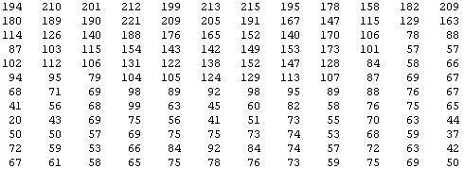
Why is this hard?
You see this:
But the camera sees this:

Slide 6
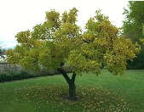


Machine learning and feature representations
pixel 1
Learning
algorithm
pixel 2
Input
Motorbikes
Raw image
“Non”-Motorbikes
pixel 2
pixel 1

Slide 7
Machine learning and feature representations
pixel 1
Learning
algorithm
pixel 2
Input
Motorbikes
Raw image
“Non”-Motorbikes
pixel 2
pixel 1

Slide 8
Machine learning and feature representations
pixel 1
Learning
algorithm
pixel 2
Input
Motorbikes
Raw image
“Non”-Motorbikes
pixel 2
pixel 1

Slide 9
What we want
handlebars
Feature representation
Learning
algorithm
wheel
Input
E.g., Does it have Handlebars? Wheels?
Motorbikes
Raw image
“Non”-Motorbikes
Features
pixel 2
Wheels
pixel 1
Handlebars

Slide 10
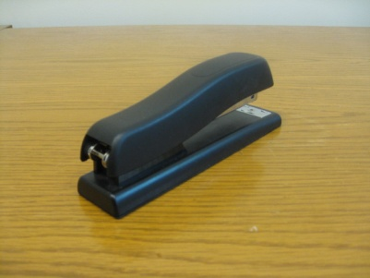
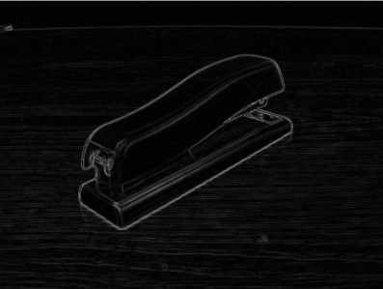





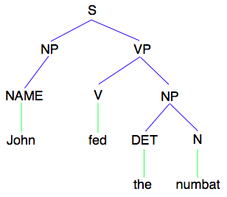
How is computer perception done?
Images/video
Image
Vision features
Detection
Audio
Image
Low-level features
Grasp point
Audio
Audio features
Speaker ID
Text classification, Machine translation, Information retrieval, ....
Text
Text
Text features

Slide 11
Feature representations
Feature Representation
Learning
algorithm
Input
Notes:
Where do we get these low-level representations from?

Slide 12
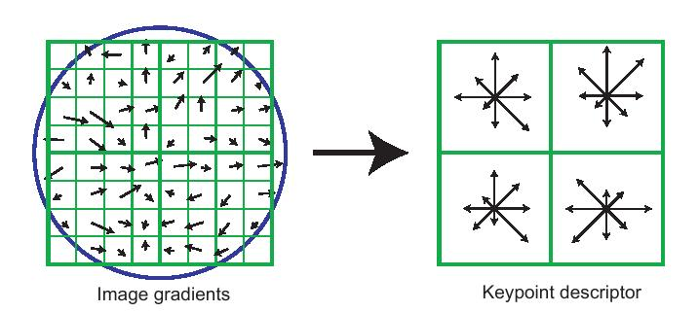
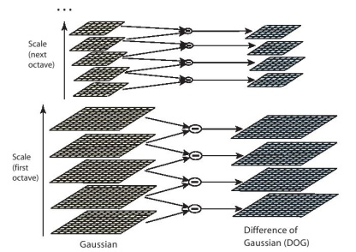
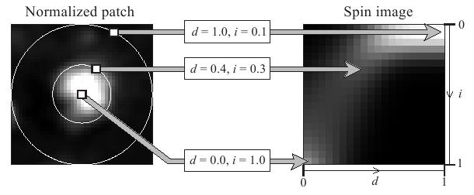
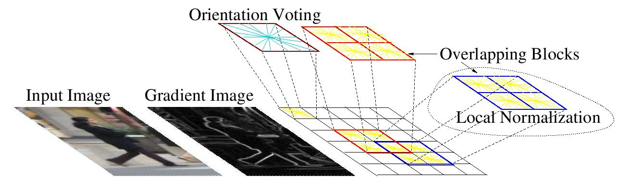
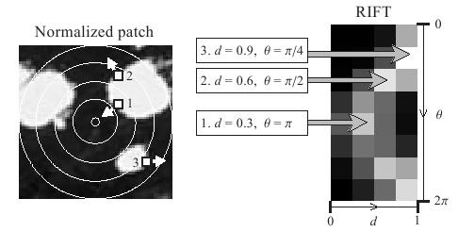
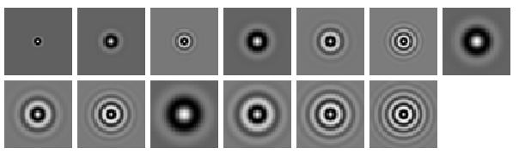
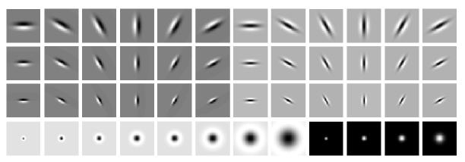
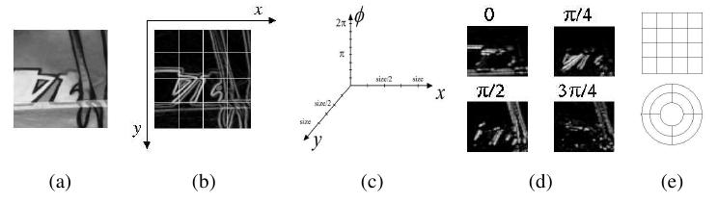
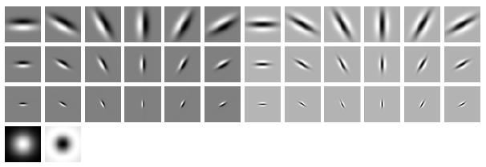
Computer vision features
SIFT
Spin image
HoG
RIFT
Textons
GLOH

Slide 13
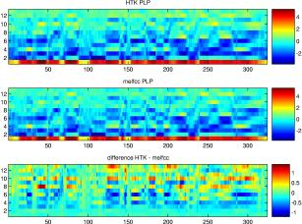
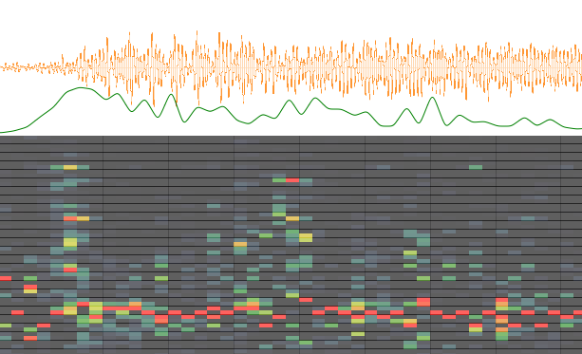
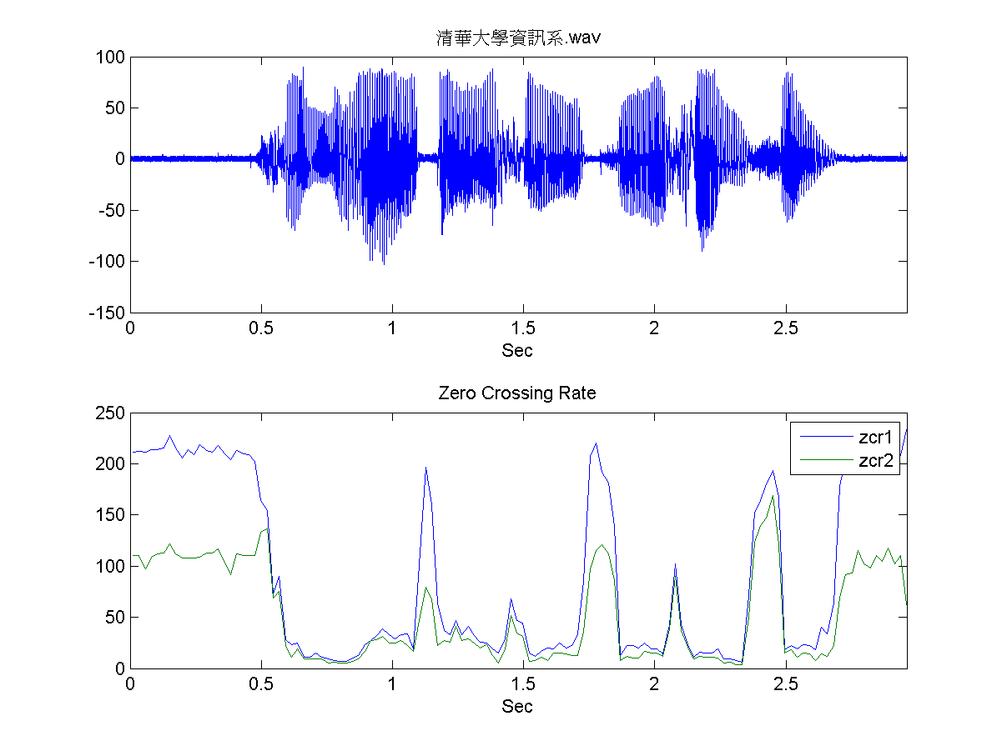
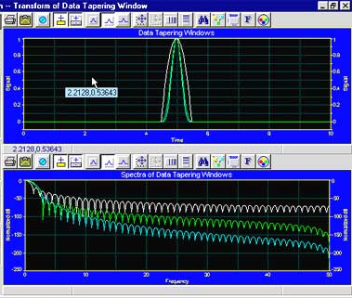
Audio features
Spectrogram
MFCC
Flux
ZCR
Rolloff

Slide 14
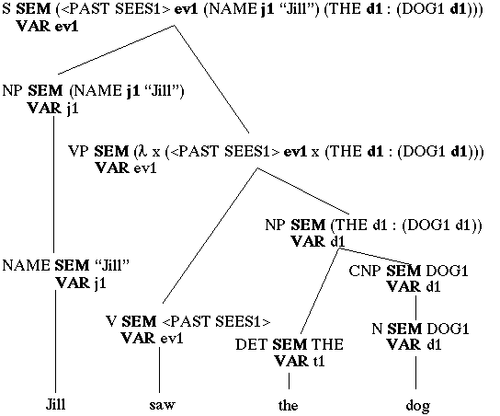
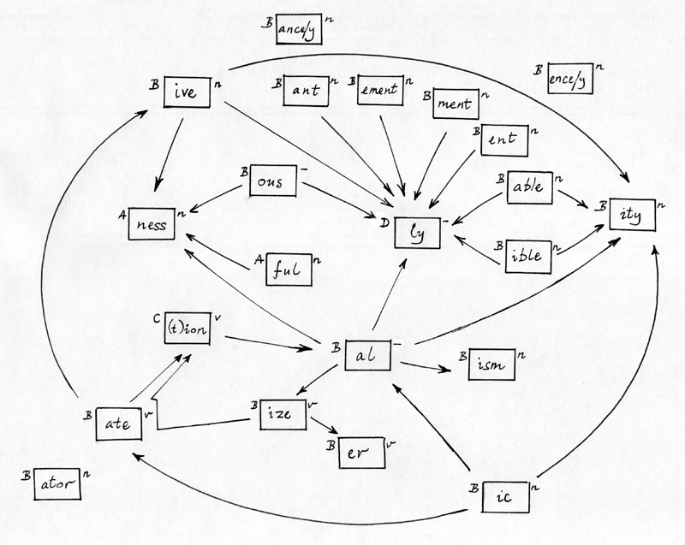
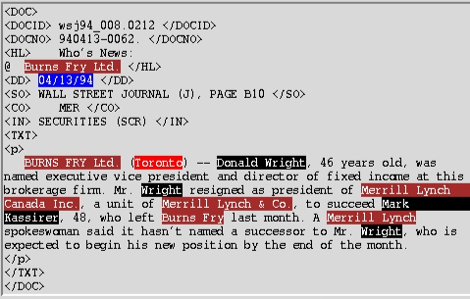
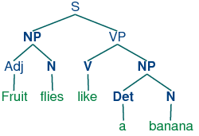
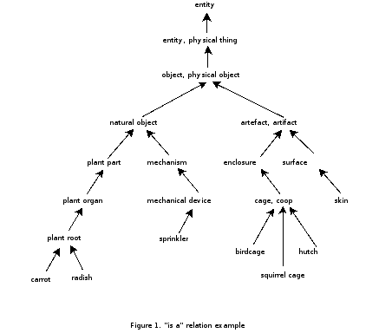
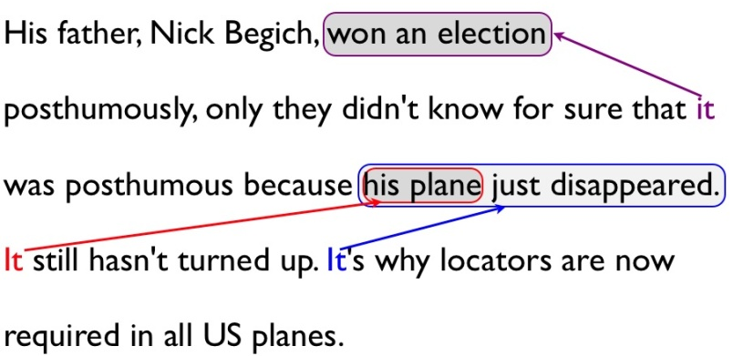
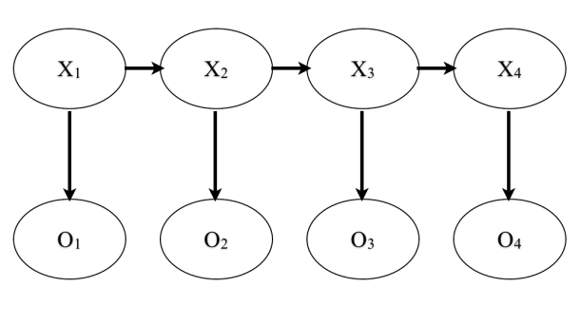
NLP features
Named entity recognition
Stemming
Parser features
Coming up with features is difficult, time-consuming, requires expert knowledge.
“Applied machine learning” is basically feature engineering.
Anaphora
Part of speech
Ontologies (WordNet)

Slide 15
Feature representations
Input
Feature Representation
Learning
algorithm
Notes:
Where do we get these low-level representations from?

Slide 16

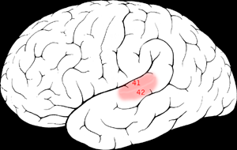

The “one learning algorithm” hypothesis
Auditory Cortex
Auditory cortex learns to see
[Roe et al., 1992]

Slide 17
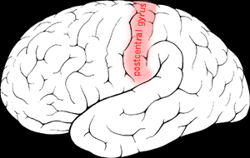

The “one learning algorithm” hypothesis
Somatosensory Cortex
Somatosensory cortex learns to see
[Metin & Frost, 1989]

Slide 18
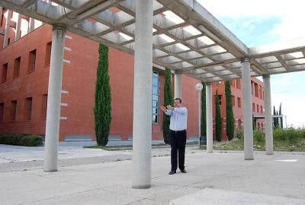
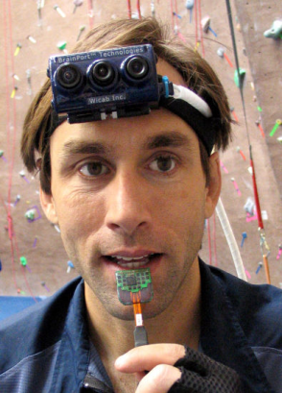
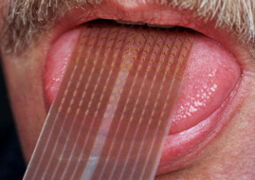
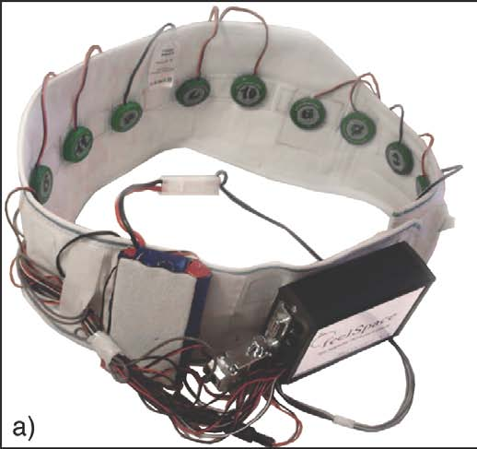
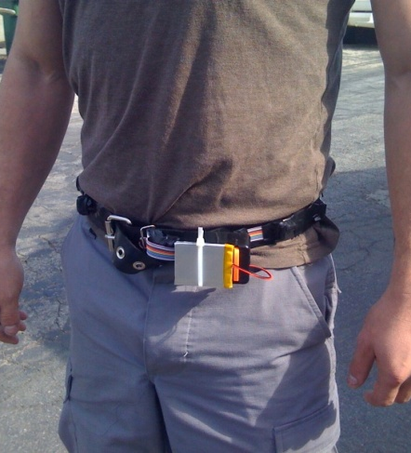
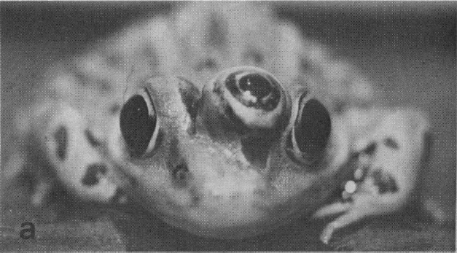
Sensor representations in the brain
Seeing with your tongue
Human echolocation (sonar)
Haptic belt: Direction sense
Implanting a 3rd eye
[BrainPort; Welsh & Blasch, 1997; Nagel et al., 2005; Constantine-Paton & Law, 2009]

Slide 19
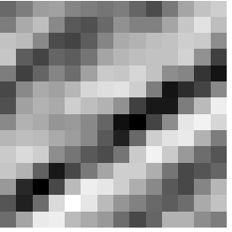
Feature learning problem
Given a 14x14 image patch x, can represent it using 196 real numbers.
Problem: Can we find a learn a better feature vector to represent this?
255
98
93
87
89
91
48
…

Slide 20
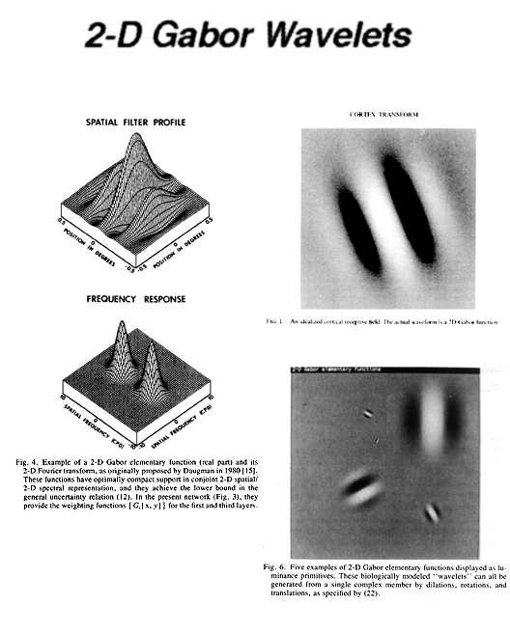
First stage of visual processing: V1
V1 is the first stage of visual processing in the brain.
Neurons in V1 typically modeled as edge detectors:
Neuron #1 of visual cortex
(model)
Neuron #2 of visual cortex
(model)
Notes:
http://www.ldeo.columbia.edu/4d4/wavelets/dm.html

Slide 21

Learning sensor representations
Sparse coding (Olshausen & Field,1996)
Input: Images x⁽¹⁾, x⁽²⁾, …, x^{(m)} (each in R^{n x n})
Learn: Dictionary of bases φ₁, φ₂, …, φ_{k} (also R^{n x n}), so that each input x can be approximately decomposed as:
x ∑ a_{j} φ_{j}
s.t. a_{j}’s are mostly zero (“sparse”)
Use to represent 14x14 image patch succinctly, as [a₇=0.8, a₃₆=0.3, a₄₁ = 0.5]. I.e., this indicates which “basic edges” make up the image.
^{k}
^{j=1}
[NIPS 2006, 2007]

Slide 22
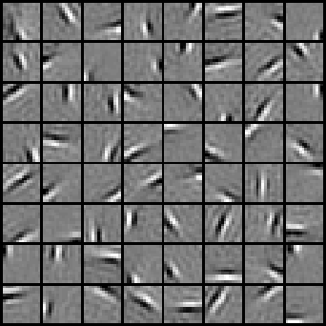






Sparse coding illustration
Natural Images
Learned bases (φ_{1 , …,} φ₆₄): “Edges”
Test example
≈ 0.8 * + 0.3 * + 0.5 *
x ≈ 0.8 * φ₃₆ + 0.3 * φ₄₂ + 0.5 * φ₆₃
[a₁, …, a₆₄] = [0, 0, …, 0, 0.8, 0, …, 0, 0.3, 0, …, 0, 0.5, 0]
(feature representation)
More succinct, higher-level, representation.

Slide 23








More examples
Represent as: [a₁₅=0.6, a₂₈=0.8, a₃₇ = 0.4].
Represent as: [a₅=1.3, a₁₈=0.9, a₂₉ = 0.3].
0.6 * + 0.8 * + 0.4 *
φ₁₅ φ₂₈ φ₃₇
1.3 * + 0.9 * + 0.3 *
φ₅ φ₁₈ φ₂₉
Method “invents” edge detection.
Automatically learns to represent an image in terms of the edges that appear in it. Gives a more succinct, higher-level representation than the raw pixels.
Quantitatively similar to primary visual cortex (area V1) in brain.

Slide 24
Sparse coding applied to audio
Image shows 20 basis functions learned from unlabeled audio.
[Evan Smith & Mike Lewicki, 2006]

Slide 25
Sparse coding applied to audio
Image shows 20 basis functions learned from unlabeled audio.
[Evan Smith & Mike Lewicki, 2006]

Slide 26

Learning feature hierarchies
Higher layer
(Combinations of edges;
cf. V2)
a₁
a₂
a₃
“Sparse coding”
(edges; cf. V1)
x₁
x₂
x₃
x₄
Input image (pixels)
[Technical details: Sparse autoencoder or sparse version of Hinton’s DBN.]
[Lee, Ranganath & Ng, 2007]

Slide 27
Learning feature hierarchies
Higher layer
(Model V3?)
Higher layer
(Model V2?)
a₁
a₂
a₃
Model V1
x₁
x₂
x₃
x₄
Input image
[Technical details: Sparse autoencoder or sparse version of Hinton’s DBN.]
[Lee, Ranganath & Ng, 2007]

Slide 28


Hierarchical Sparse coding (Sparse DBN): Trained on face images
object models
object parts
(combination
of edges)
Training set: Aligned
images of faces.
edges
pixels
[Honglak Lee]

Slide 29
Machine learning applications

Slide 30
















Unsupervised feature learning (Self-taught learning)
Motorcycles
Not motorcycles
Testing:
What is this?
…
Unlabeled images
[Lee, Raina and Ng, 2006; Raina, Lee, Battle, Packer & Ng, 2007]
[This uses unlabeled data. One can learn the features from labeled data too.]

Slide 31

Video Activity recognition (Hollywood 2 benchmark)
Method | Accuracy
Hessian + ESURF [Williems et al 2008] | 38%
Harris3D + HOG/HOF [Laptev et al 2003, 2004] | 45%
Cuboids + HOG/HOF [Dollar et al 2005, Laptev 2004] | 46%
Hessian + HOG/HOF [Laptev 2004, Williems et al 2008] | 46%
Dense + HOG / HOF [Laptev 2004] | 47%
Cuboids + HOG3D [Klaser 2008, Dollar et al 2005] | 46%
Unsupervised feature learning (our method) | 52%
Unsupervised feature learning significantly improves on the previous state-of-the-art.
[Le, Zhou & Ng, 2011]

Slide 32
Audio
TIMIT Phone classification | Accuracy
Prior art (Clarkson et al.,1999) | 79.6%
Stanford Feature learning | 80.3%
TIMIT Speaker identification | Accuracy
Prior art (Reynolds, 1995) | 99.7%
Stanford Feature learning | 100.0%
Images
CIFAR Object classification | Accuracy
Prior art (Ciresan et al., 2011) | 80.5%
Stanford Feature learning | 82.0%
NORB Object classification | Accuracy
Prior art (Scherer et al., 2010) | 94.4%
Stanford Feature learning | 95.0%
Galaxy
Video
Hollywood2 Classification | Accuracy
Prior art (Laptev et al., 2004) | 48%
Stanford Feature learning | 53%
YouTube | Accuracy
Prior art (Liu et al., 2009) | 71.2%
Stanford Feature learning | 75.8%
KTH | Accuracy
Prior art (Wang et al., 2010) | 92.1%
Stanford Feature learning | 93.9%
UCF | Accuracy
Prior art (Wang et al., 2010) | 85.6%
Stanford Feature learning | 86.5%
Text/NLP
Multimodal (audio/video)
AVLetters Lip reading | Accuracy
Prior art (Zhao et al., 2009) | 58.9%
Stanford Feature learning | 65.8%
Paraphrase detection | Accuracy
Prior art (Das & Smith, 2009) | 76.1%
Stanford Feature learning | 76.4%
Sentiment (MR/MPQA data) | Accuracy
Prior art (Nakagawa et al., 2010) | 77.3%
Stanford Feature learning | 77.7%
Notes:
Other SOTA performance records held by Kai Yu, Geoff Hinton.

Slide 33
How do you build a high accuracy learning system?
Notes:
NVIDIA or ATI will be future of AI. Probably NVIDIA.

Slide 34

Supervised Learning: Labeled data
Choices of learning algorithm:
  Memory based
  Winnow
  Perceptron
  Naïve Bayes
  SVM
  ….
What matters the most?
Accuracy
Training set size (millions)
[Banko & Brill, 2001]
“It’s not who has the best algorithm that wins. It’s who has the most data.”

Slide 35

Unsupervised Learning
Large numbers of features is critical. The specific learning algorithm is important, but ones that can scale to many features also have a big advantage.
[Adam Coates]

Slide 37
Learning from Labeled data

Slide 38
Model
Training Data

Slide 39
Model
Machine (Model Partition)
Training Data

Slide 40
Parallelize across ~100 machines (~1600 cores).
Model
Machine (Model Partition)
Training Data
Core

Slide 41
Basic DistBelief Model Training
Model
Unsupervised or Supervised Objective
Minibatch Stochastic Gradient Descent (SGD)
Model parameters sharded by partition
10s, 100s, or 1000s of cores per model
Training Data

Slide 42
Basic DistBelief Model Training
Model
Parallelize across ~100 machines (~1600 cores).
But training is still slow with large data sets.
Add another dimension of parallelism, and have multiple model instances in parallel.
Training Data

Slide 43
Two Approaches to Multi-Model Training
(1) Downpour: Asynchronous Distributed SGD
(2) Sandblaster: Distributed L-BFGS

Slide 44
Parallelize across different model instances
p’ = p + ∆p
Parameter Server
p’’ = p’ + ∆p’
∆p
∆p’
p’
p
Model
Data

Slide 45
Parallelize across different model instances
Parameter Server
p’ = p + ∆p
∆p
p’
Model
Workers
Data
Shards

Slide 46
Parallelize across different model instances
Parameter Server
Slave models
Data Shards
From an engineering standpoint, superior to a single model with the same number of total machines:
Better robustness to individual slow machines
Makes forward progress even during evictions/restarts

Slide 47

Parallel Deep Learning speedup
To reach the same model quality DistBelief reached in 4 days took 55 days using a GPU....
Significant speedup on small models compared to GPU.
Enables training of large models.

Slide 49
Google Deep Learning – Train small models faster
[with Jeff Dean, Quoc Le and many others]

Slide 50

Speech recognition on Android

Slide 51
Learning from Unlabeled data
Notes:
NVIDIA or ATI will be future of AI. Probably NVIDIA.

Slide 52
Google Deep Learning – Train bigger models
10 million parameters
1 billion parameters
[with Jeff Dean, Quoc Le and many others]

Slide 53


Training procedure
What features can we learn if we train a massive model on a massive amount of data. Can we learn a “grandmother cell”?
Train on 10 million images (YouTube)
1000 machines (16,000 cores) for 1 week.
Test on novel images
Training set (YouTube) Test set (FITW + ImageNet)

Slide 54


The face neuron
Top stimuli from the test set
Optimal stimulus
by numerical optimization
Le, et al., Building high-level features using large-scale unsupervised learning. ICML 2012

Slide 55




Cat neuron
Top Stimuli from the test set
Average of top stimuli from test set
[Raina, Madhavan and Ng, 2008]

Slide 56





ImageNet classification: 22,000 classes
…
smoothhound, smoothhound shark, Mustelus mustelus
American smooth dogfish, Mustelus canis
Florida smoothhound, Mustelus norrisi
whitetip shark, reef whitetip shark, Triaenodon obseus
Atlantic spiny dogfish, Squalus acanthias
Pacific spiny dogfish, Squalus suckleyi
hammerhead, hammerhead shark
smooth hammerhead, Sphyrna zygaena
smalleye hammerhead, Sphyrna tudes
shovelhead, bonnethead, bonnet shark, Sphyrna tiburo
angel shark, angelfish, Squatina squatina, monkfish
electric ray, crampfish, numbfish, torpedo
smalltooth sawfish, Pristis pectinatus
guitarfish
roughtail stingray, Dasyatis centroura
butterfly ray
eagle ray
spotted eagle ray, spotted ray, Aetobatus narinari
cownose ray, cow-nosed ray, Rhinoptera bonasus
manta, manta ray, devilfish
Atlantic manta, Manta birostris
devil ray, Mobula hypostoma
grey skate, gray skate, Raja batis
little skate, Raja erinacea
…
Stingray
Mantaray

Slide 57
0.005%
9.5%
?
Random guess
State-of-the-art
(Weston, Bengio ‘11)
Feature learning
From raw pixels
Le, et al., Building high-level features using large-scale unsupervised learning. ICML 2012

Slide 58
0.005%
9.5%
18.7%
Random guess
State-of-the-art
(Weston, Bengio ‘11)
Feature learning
From raw pixels
Le, et al., Building high-level features using large-scale unsupervised learning. ICML 2012

Slide 59

Scaling up with HPC GPU cluster
“Cloud” infrastructure
GPUs with CUDA
Many inexpensive nodes.
Comm. bottlenecks, node failures.
1 very fast node.
Limited memory; hard to scale out.
Network fabric
HPC cluster: GPUs with Infiniband
Difficult to program---lots of MPI and CUDA code.
Notes:
Cloud infrastructure: attractive because it uses existing web-service infrastructure. Tools available (e.g., Hadoop)
GPUs with CUDA: inexpensive, very fast. But hard to use several at once---they’re so fast that networks cannot keep up with them.
Our system: a miniature supercomputer. Hard to program.

Slide 60
Stanford GPU cluster
Current system
  64 GPUs in 16 machines.
  Tightly optimized CUDA for Deep Learning operations.
  47x faster than single-GPU implementation.
  Train 11.2 billion parameter, 9 layer neural network in < 4 days.
Notes:
other notes:
Able to duplicate the google “cat” result in a few days with 3 machines.
Largest networks are > 11B parameters, trained in 3 days.

Slide 61

Vehicular perception

Slide 62
Discussion: Engineering vs. Data
Notes:
NVIDIA or ATI will be future of AI. Probably NVIDIA.

Slide 63
Discussion: Engineering vs. Data
Contribution to performance
Human
ingenuity
Data/
learning
Notes:
NVIDIA or ATI will be future of AI. Probably NVIDIA.

Slide 64
Discussion: Engineering vs. Data
Contribution to performance
Time
Now
Notes:
NVIDIA or ATI will be future of AI. Probably NVIDIA.

Slide 65





















Deep Learning: Things you should knpw
Why it works: Lets you take advantage of your ever-growing datasets.
Scaling up and getting your infrastructure right is key.
Supervised learning versions work really well now.
Unsupervised learning versions exciting for the longer term.
Coursera’s online machine learning class:
http://ml-class.org
Learn to make them work for yourself:
            http://deeplearning.stanford.edu/wiki
Stanford
Adam Coates Quoc Le Andrew Saxe Andrew Maas Chris Manning Jiquan Ngiam Richard Socher Will Zou
Google
Kai Chen Greg Corrado Jeff Dean Matthieu Devin Andrea Frome Rajat Monga Marc’Aurelio Paul Tucker Kay Le
Ranzato

