Slide 1
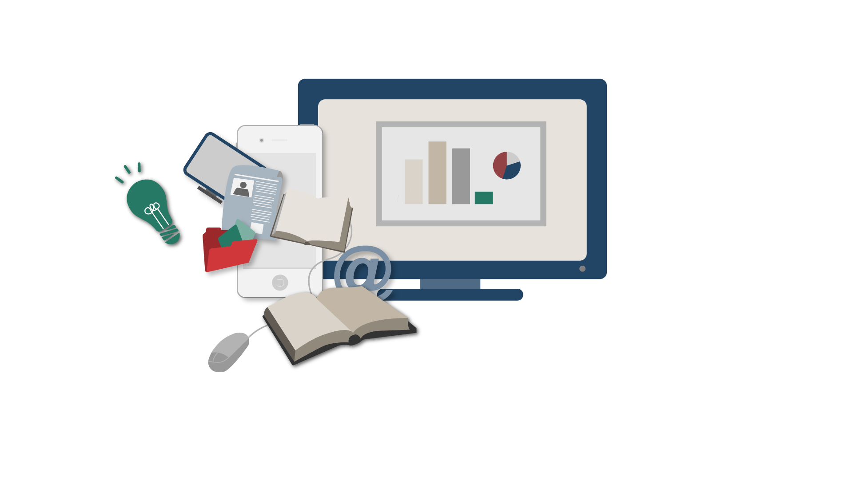
The Online Revolution:
Education for Everyone
Daphne Koller & Andrew Ng
Stanford University & Coursera
Notes:
I’m a Stanford professor, and co-founder of Coursera. Most people today will never get to take a Stanford class. But we’re changing that. Working with Princeton, Caltech, Columbia, Stanford and Penn, and others, we’re taking classes from the these top universities, and putting them on the web, free for anyone to take.

Slide 2
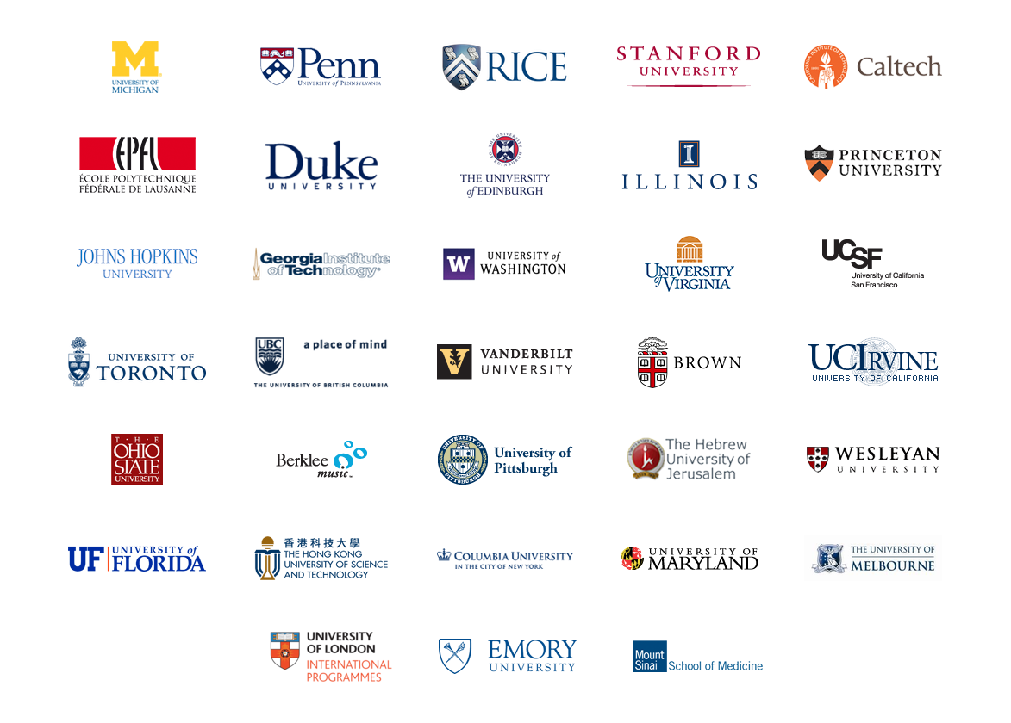
Courses from Top Universities
Notes:
We’re using technology to address the problem of high quality education, at scale.

Slide 3
400
100,000

Slide 4
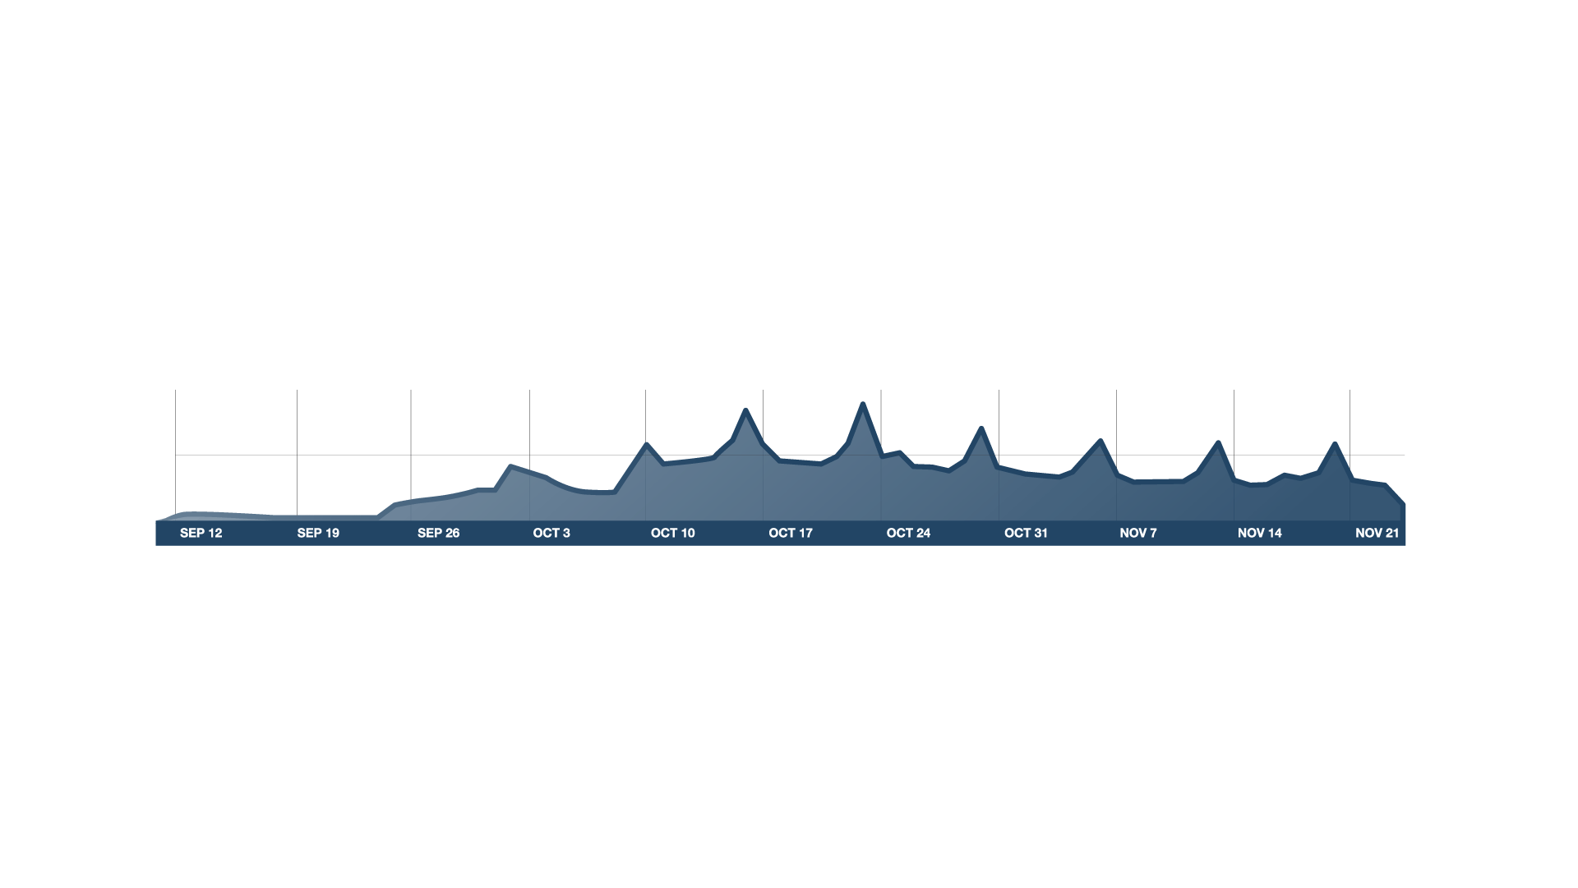

Course Begins
100K
# users on site
50K
v
Timeline
Real Course

Slide 5

Video-Based Instruction

Slide 6
Retrieval Practice Improves Learning
"Retrieval Practice Produces More Learning than Elaborative Studying with Concept Mapping."
J. Karpicke, J. Blunt. Science (2011).
Study
Repeated Study
Retrieval
Practice
Practice is Critical

Slide 7
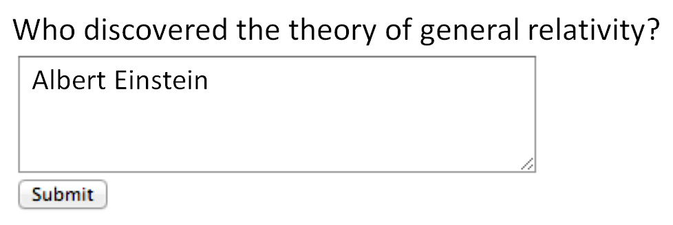
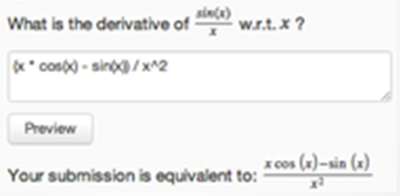
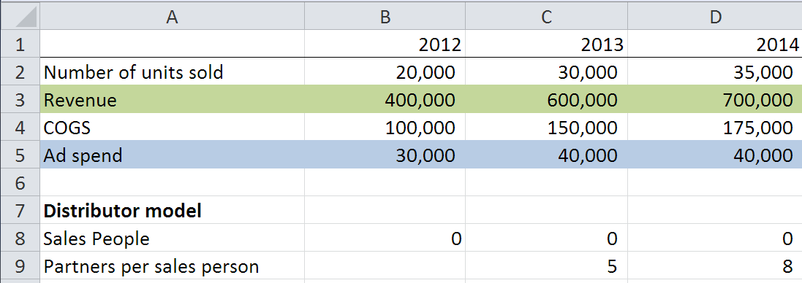
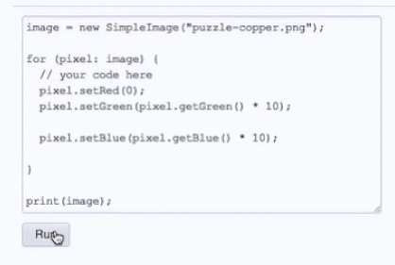
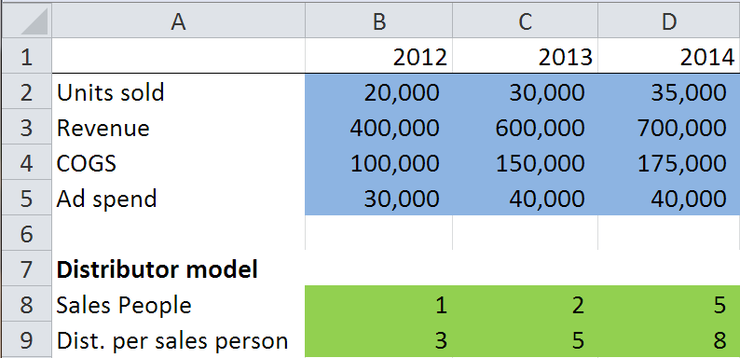
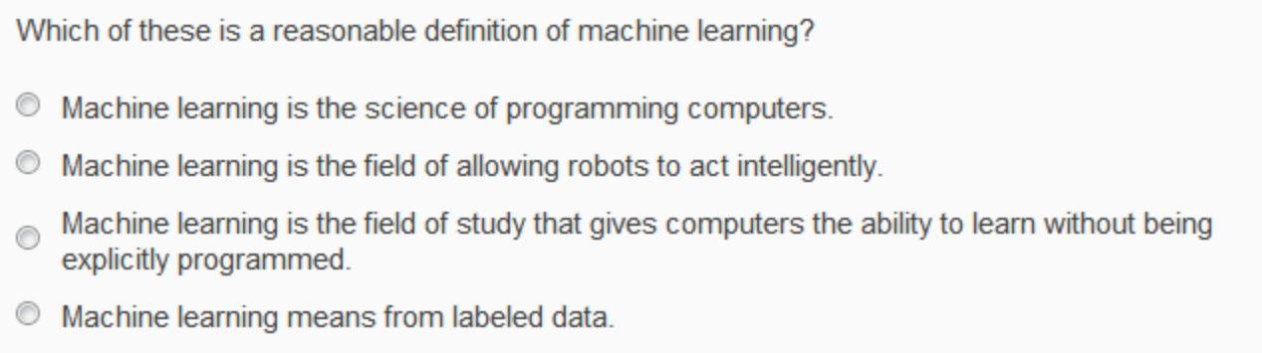
Autograded Homeworks and Exercises

Slide 8
“The Impact of Self-and Peer-Grading on Student Learning”.
P. Sadler, E. Good. Educational Assessment (2006).
Student Grade
Peer Grade
Self Grade
Teacher Grade
Peer Grading: Open-Ended Work

Slide 9
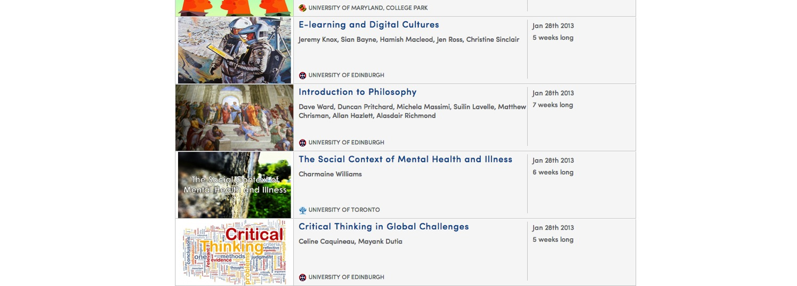
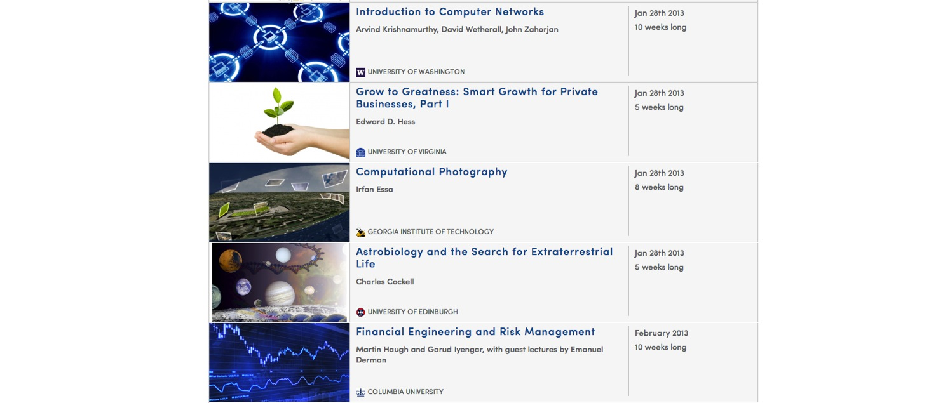
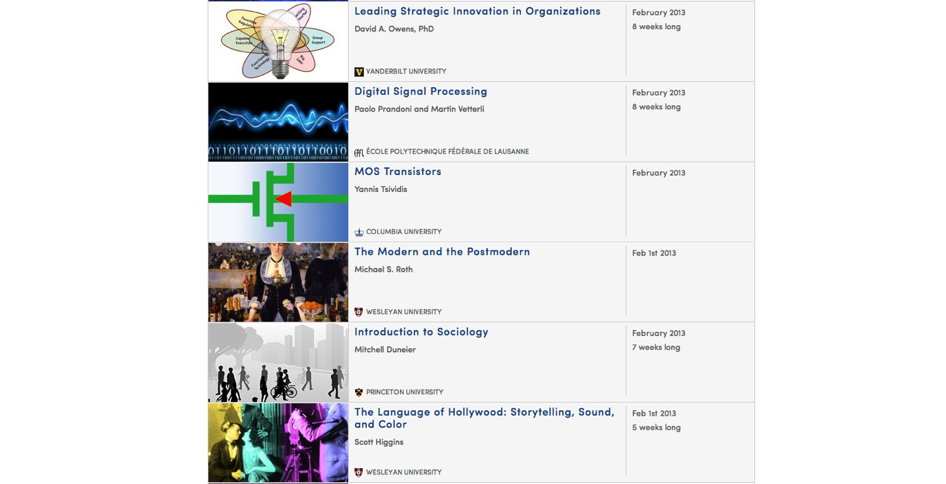
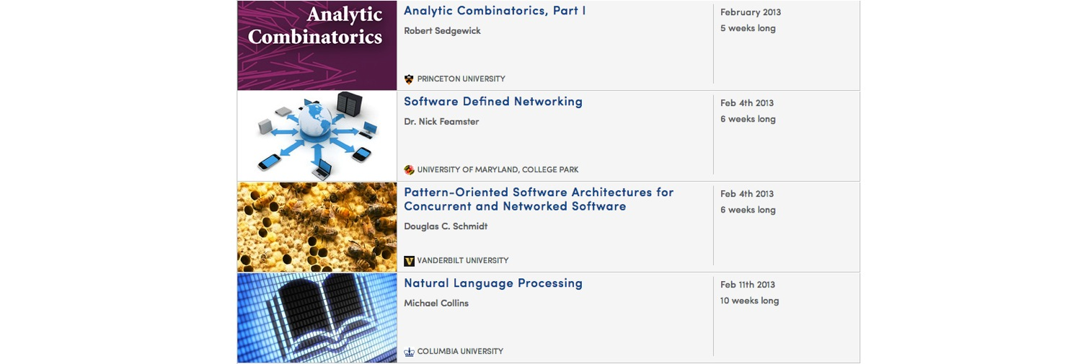
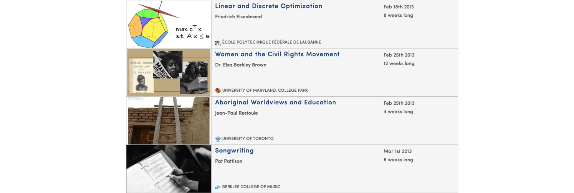
The Humanities, Sciences, Engineering, Business, ….

Slide 10
190 countries
Discussion forum
33 Universities
Video lectures
1.25 million
198 courses
Community
4 million enrollments
1.5 million students
Assessments

Slide 11
The mind is not a vessel that
needs filling, but wood that
needs igniting.
—Plutarch
from Ian Kidd's translation of Essays
Notes:
I’ve often been asked: If anyone can now take online Princeton courses for free, why would anyone still pay for a Princeton degree? I think the value of a Princeton education isn’t just the content—instead it’s the interactions with the professors and with other equally bright students. To quote Plutarch: The mind is not a vessel that needs filling, but wood that needs igniting. Using what’s called the flipped classroom, many of our partner universities are using the online courses to give their on-campus students a better education as well. By moving the lecture, or the content conveyal onto a website that the students can watch from home, this preserves the classroom time for deeper professor-student and student-student interactions, which I think is the real value of attending a top university.

Slide 12
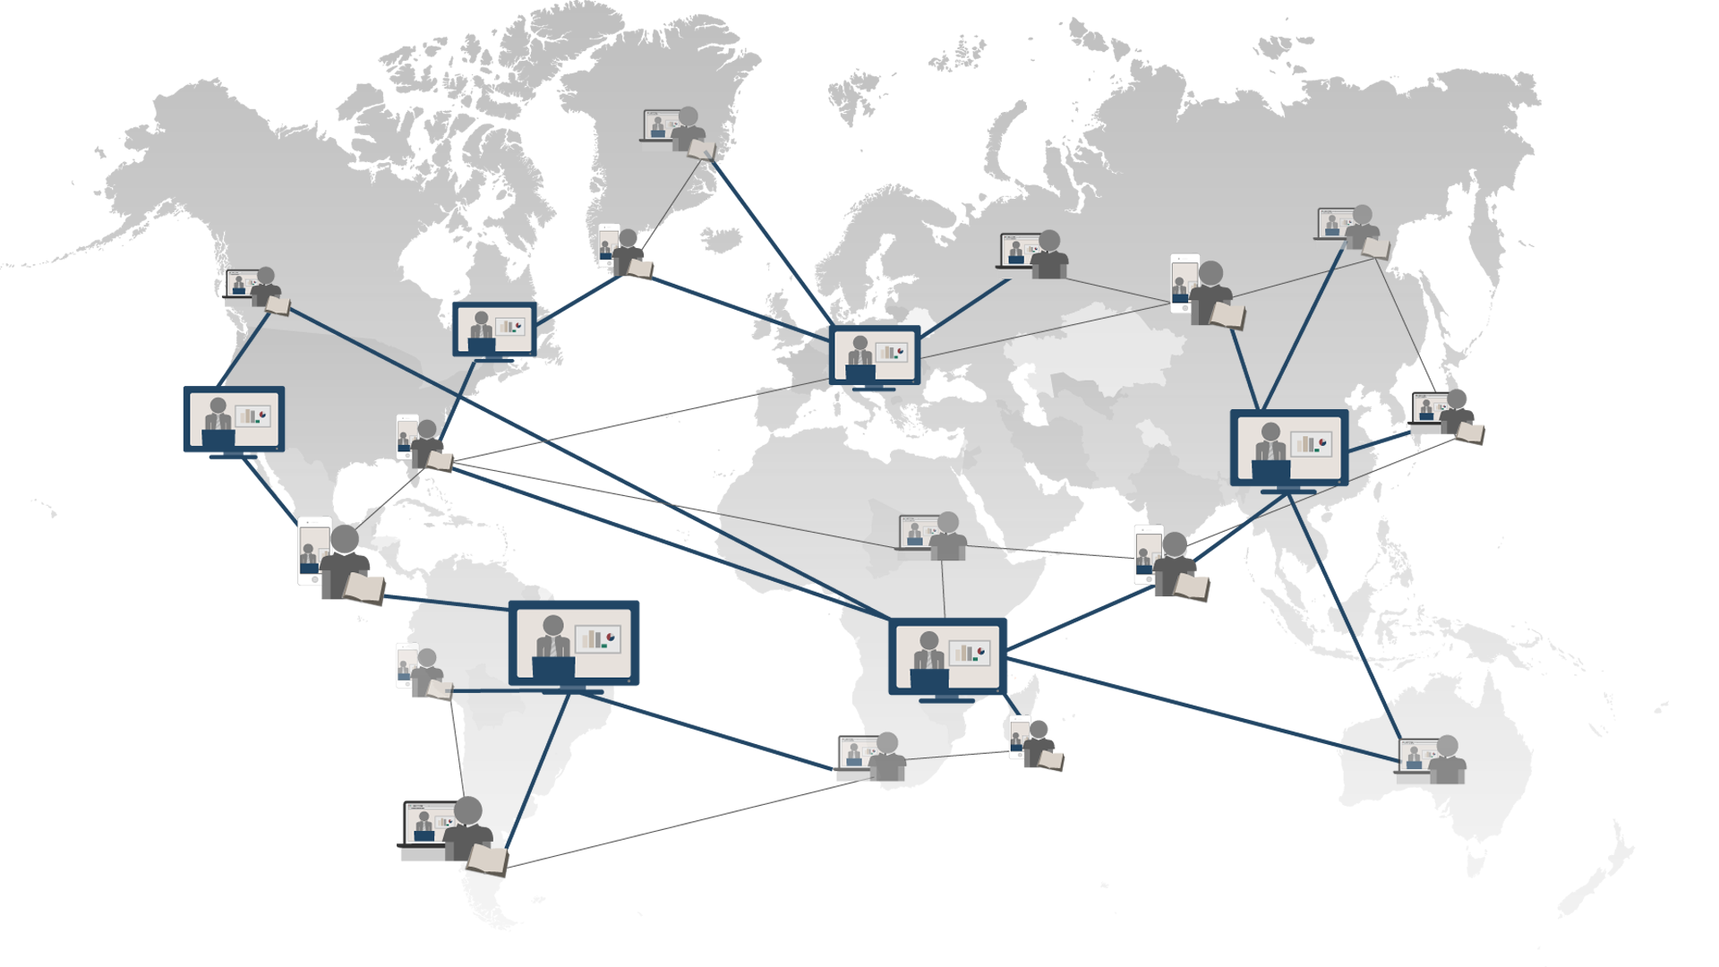
Universal Access to Education
Notes:
Even today, the best education is available only to a privileged few. But I think a high quality education is a fundamental human right. Using technology, we’re working to bring it to everyone.

