Slide 1

The Online Revolution:
Education for Everyone
Daphne Koller & Andrew Ng
Stanford University & Coursera

Slide 2
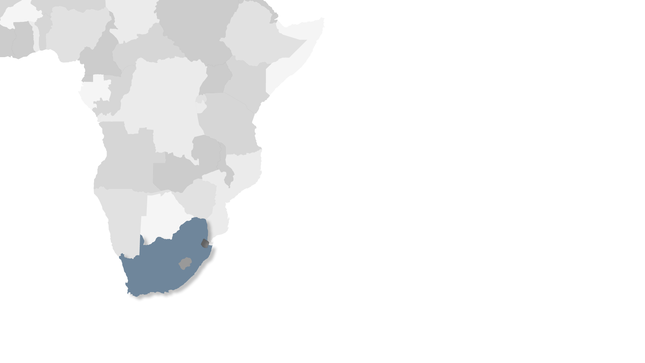

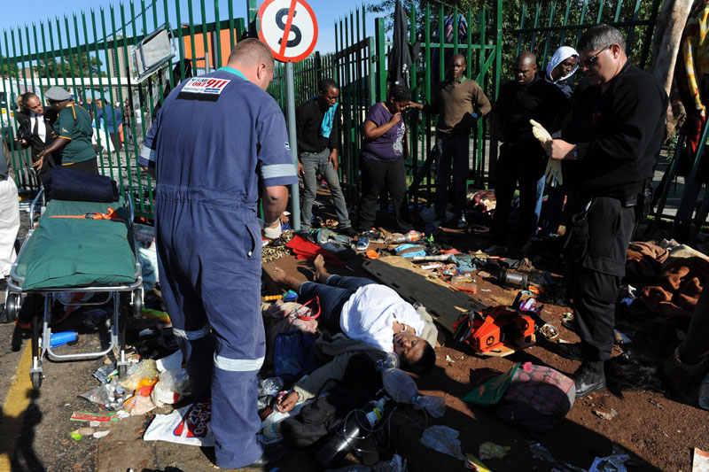
South Africa
University of Johannesburg
Scarcity

Slide 3
Price Changes Since 1985
College Tuition & Fees
559% Increase
Medical Care
Gas
All consumer items
Source: Bureau of Labor Statistics
Affordability
Notes:
Let’s add the actual percentage increase to the tuition line. —OKAY

Slide 4
55.6%
22%
In jobs not requiring
a college degree
In jobs requiring
a college degree
22.4%
Not working
Source: "A College Degree, but Not a College Job." (A. Sum, New York Times,19 May 2011)
Quality

Slide 5

Education at Scale

Slide 6
Big breakthroughs happen when what is suddenly possible meets what is desperately necessary.
—Thomas Friedman
May 15, 2012 · New York Times
Notes:
Need a date and source on the quote. OKAY

Slide 7
400
100,000

Slide 8
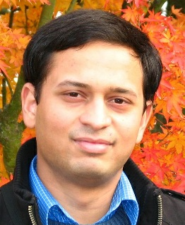
Coming from a middle class family from a small town in India. Never had the luck and guidance to reach Stanford for education. Guess what? God has sent the opportunity right across my door step! Heartfelt thanks to the great team and teachers who made this happen! (Akash Goswami)

Slide 9
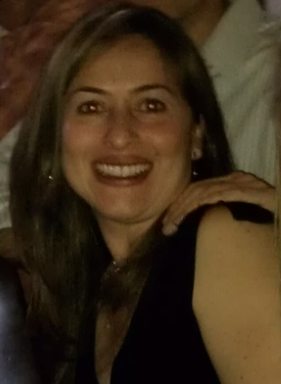
I'm a single mom 39 years old with two college boys... I've been trying to get back to college for my masters and want to learn more about computers. Looking forward to this class!
(Jenny Ramirez)

Slide 10
I have a metabolic disease and with my compromised immune system the computer is basically my whole life. I am so happy there are courses like this available and affordable too. I plan to work really hard and am so excited for the next 6 weeks. :)

Slide 11
Coming from a middle class family from a small town in India. Never had the luck and guidance to reach Stanford for education. Guess what? God has sent the opportunity right across my door step! Heartfelt thanks to the great team and teachers who made this happen!

Slide 12
I'm a single mom 39 years old with two college boys... I've been trying to get back to college for my masters and want to learn more about computers. Looking forward to this class!

Slide 13
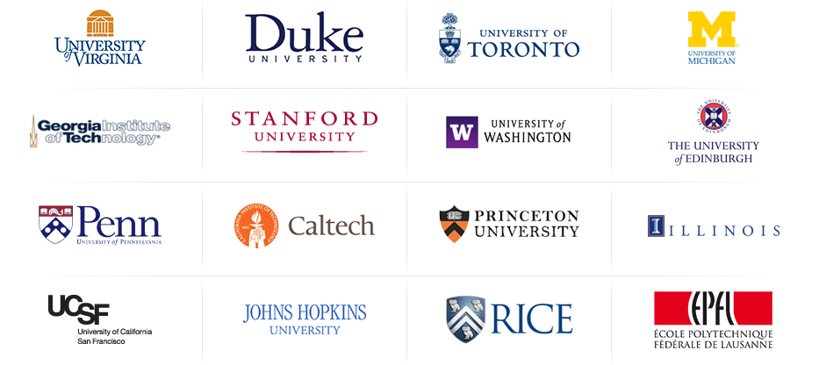
High academic standards

Slide 14
190 countries
1.25 million students
Video lectures
2.7 million enrollments
1.25 million
Community
120 courses
16 Universities
Assessments
Notes:
It turns out that people like to get great content from the best instructors … for free. Since mid-February, when our website opened, we have accumulated more than 600K students from 190 countries. We have close to 1.5 million enrollments in 41 courses, across a range of disciplines. In the 15 courses that have already launched, we have 14 million video views and 6 million quiz submissions.

Slide 15
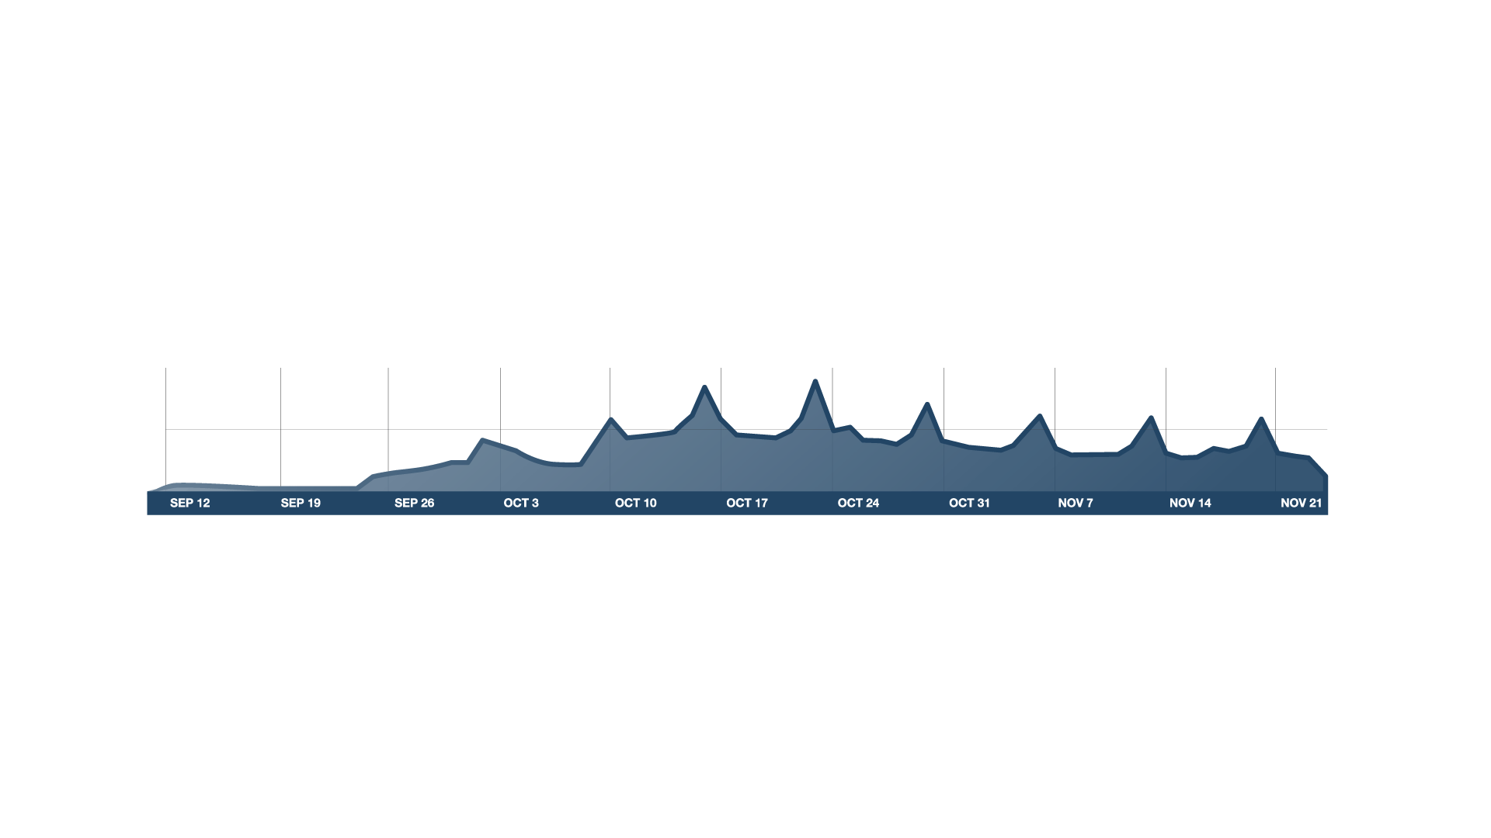

First lectures posted
100,000
# users on site
50,000
v
Statement of Completion
Timeline
Real Course

Slide 16
Course Begins
100K
# users on site
50K
v
Timeline
Real Course

Slide 17
Video-Based Instruction
Notes:
ADD GRAPH?

Slide 18
Basic Genetics
Refresher (OPTIONAL)
Modern Genomics
Genes and alleles (10 min)
Modern sequencing methods (11 min)
Commercial Genomics
(OPTIONAL)
Mendelian
inheritance
(13 min)
History: The Human Genome Project (12 min)
Genetic testing in the commercial world (11 min)
What is DNA?
(12 min)
Genomic economics (8 min)
Protecting privacy (9 minutes)
Personalized medicine (13 min)
Case study: direct-to-consumer genetics (12 min)
Case study: family planning (13 min)
Personalized Learning
Notes:
Let’s talk about some of the key elements that went into these courses. First, when we designs content for the online environment, we can remove the constraints of classroom scheduling, and abandon the monolithic 1hr lecture. The content can be divided into short, coherent modules of 8-12 minutes each, which can be traversed in different ways by different students. Some students might benefit from some additional preparation. Others might want go into depth in certain topics. So we can finally move away from the one-size-fits-all model of education into a much more personalized experience.

Slide 19
Basic Genetics
Refresher (OPTIONAL)
Modern Genomics
Genes and alleles (10 min)
Modern sequencing methods (14 min)
Commercial Genomics
(OPTIONAL)
Mendelian
inheritance
(13 min)
History: The Human Genome Project (12 min)
Genetic testing in the commercial world (11 min)
What is DNA?
(12 min)
Genomic economics (8 min)
Protecting privacy (9 minutes)
Personalized medicine (16 min)
Case study: direct-to-consumer genetics (14 min)
Case study: family planning (13 min)
Concept Map

Slide 20
Retrieval Practice Improves Learning
"Retrieval Practice Produces More Learning than Elaborative Studying with Concept Mapping."
J. Karpicke, J. Blunt. Science (2011).
Study
Repeated Study
Retrieval
Practice
Practice is Critical

Slide 21
Interactive Video

Slide 22
In-Depth Exercises

Slide 23
“The Impact of Self-and Peer-Grading on Student Learning”.
P. Sadler, E. Good. Educational Assessment (2006).
Student Grade
Peer Grade
Self Grade
Teacher Grade
Open-Ended Work

Slide 24
Individual
Tutoring
Mastery Learning
Lecture
Achievement Score
"The 2 Sigma Problem: The Search for Methods of Group Instruction as Effective as One-to-One Tutoring." B. Bloom, Educational Researcher (1984).
The 2 Sigma Problem

Slide 25
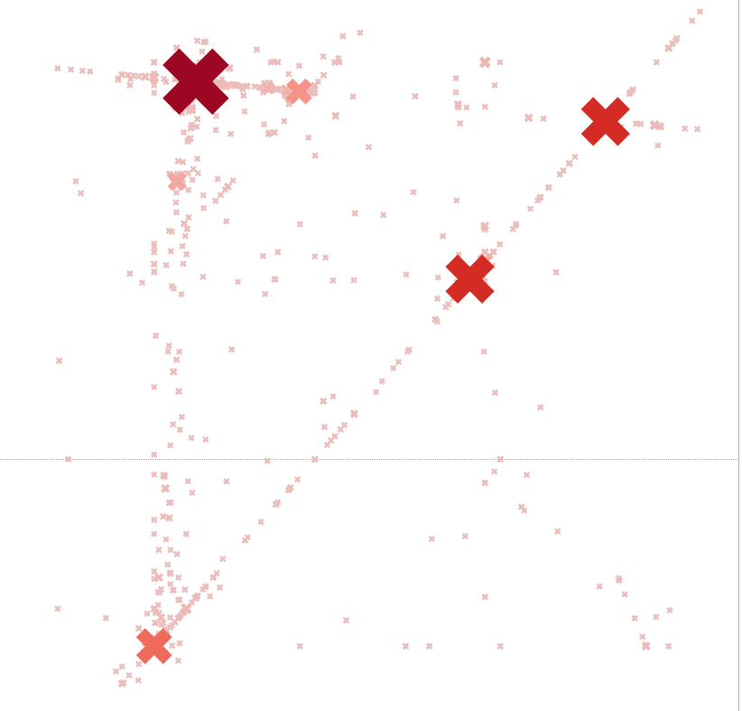
Answers submitted for
ML-class programming
assignment
New Window into Human Learning
Notes:
ON HOLD

Slide 26
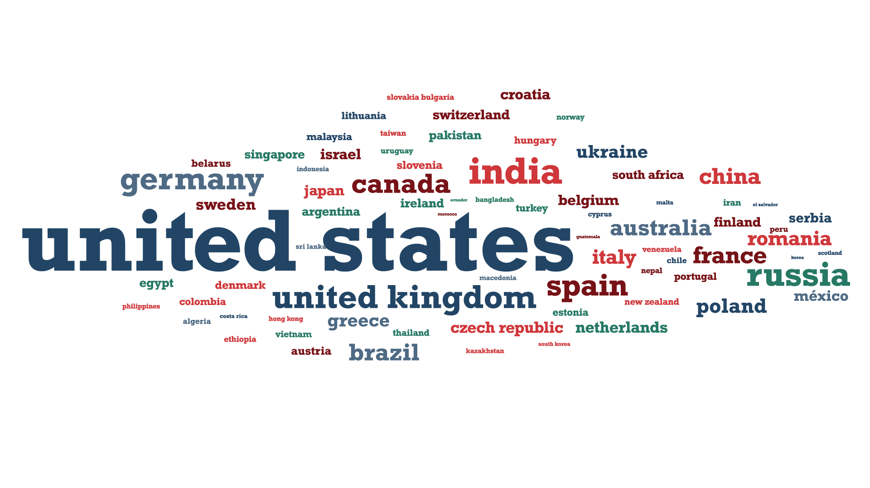
Global Community
Notes:
I prefer the original, with the country names in different sizes… USE TYPOGRAPHY DESIGN REPLACE OKAY

Slide 27
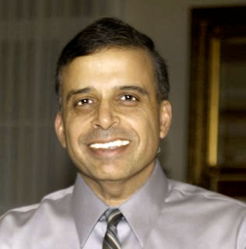
vv
Fellow students on these forums really
gave the sense that I wasn't just sitting in my
office working on it by myself. The spirit of cooperation and information sharing has
been far more than any “non-virtual”
course I ever took. (Sanjaya Kumar)

Slide 28
San Francisco HCI-Class Study Group
Student Study Groups

Slide 29
College is a place where a professor’s lecture notes go straight to the students’ lecture notes, without passing through
the brains of either.
—Mark Twain
The mind is not a vessel that
needs filling, but wood that
needs igniting.
—Plutarch
from Ian Kidd's translation of Essays

Slide 30
"Improved Learning in a Large-Enrollment Physics Class."
L. Deslauriers, E. Schelew, and C. Wieman. Science (2011).
Lecture
Active
Learning
Flipping the Classroom
Notes:
Let’s remove the title at the top, it’s redundant with the smaller one.

Slide 31
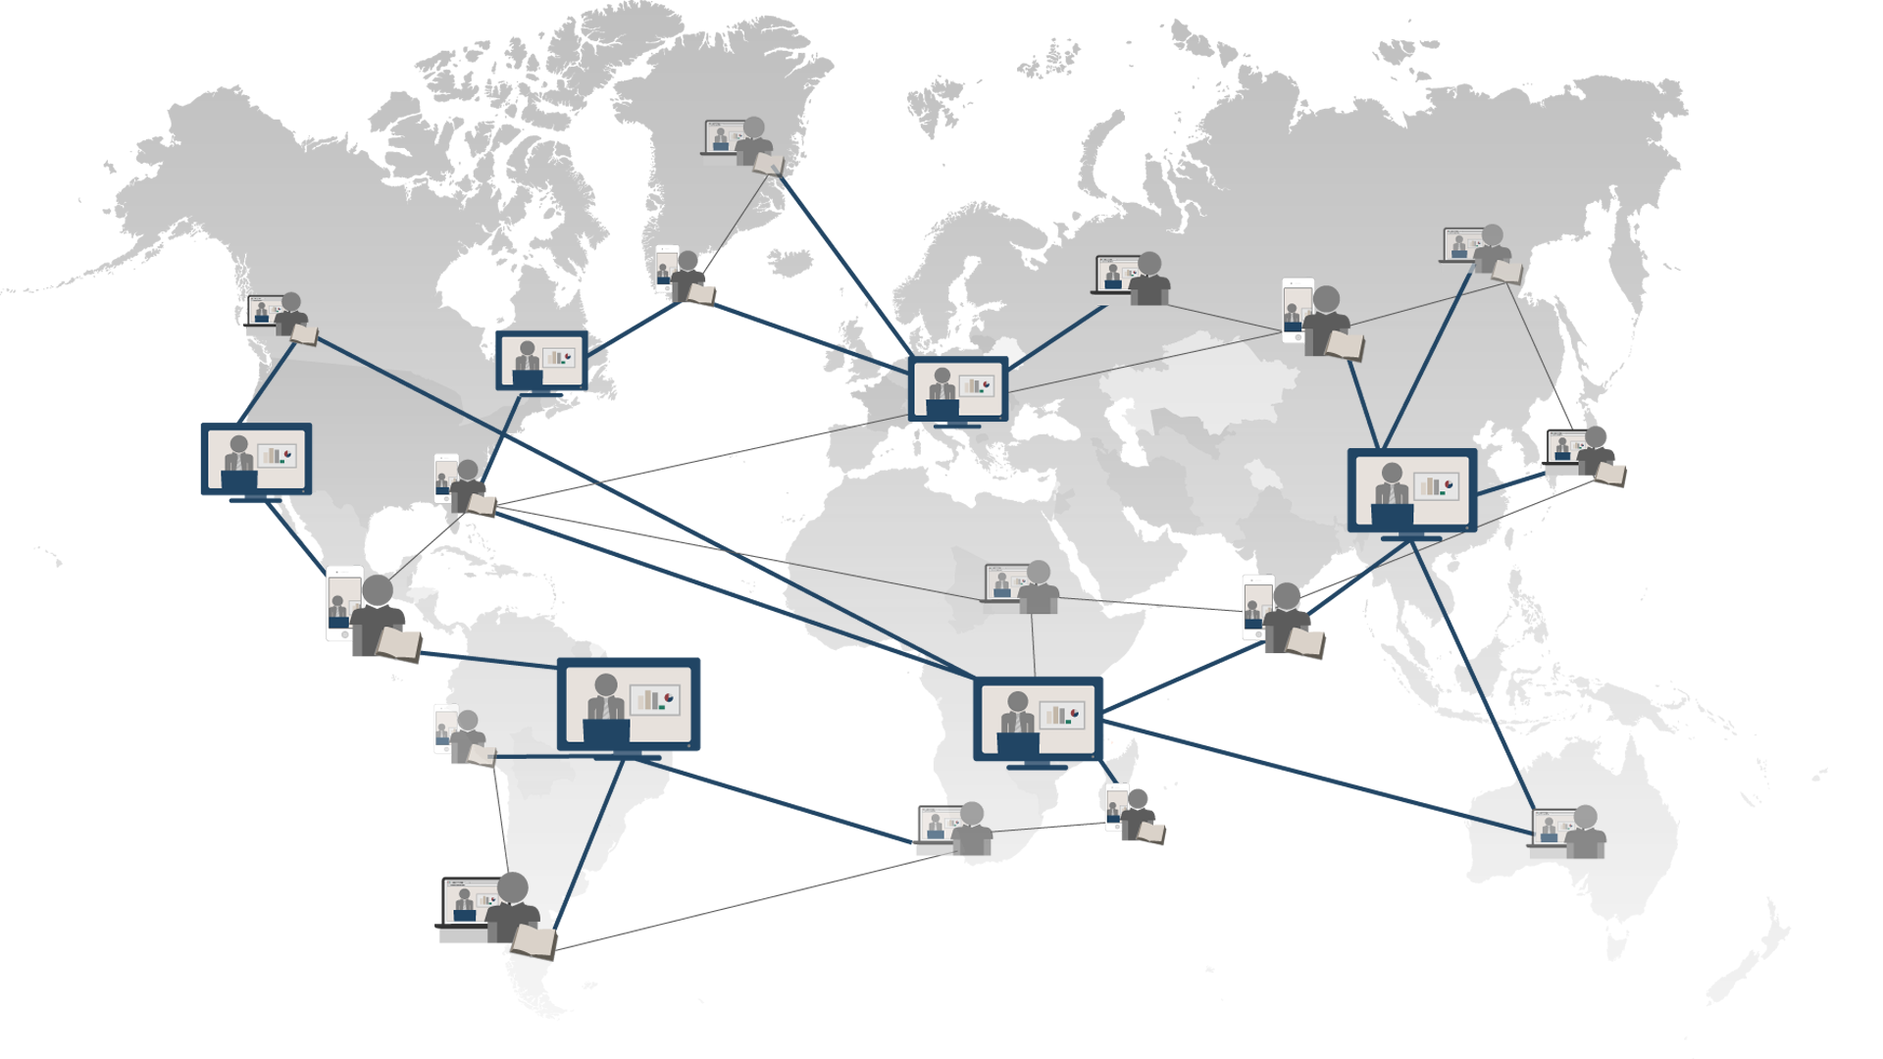
Universal Access to Education
Notes:
Let’s change the title to “Global Access to Education”. Every student should be connected to at least one professor. All lines to professors should be the thicker ones. It would be good to have more lines, including ones that span the globe.

