Slide 1
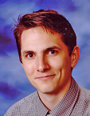
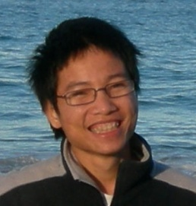

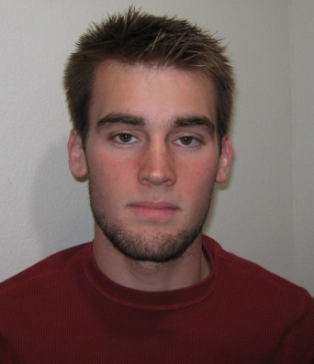


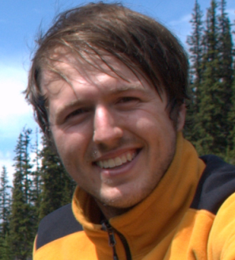
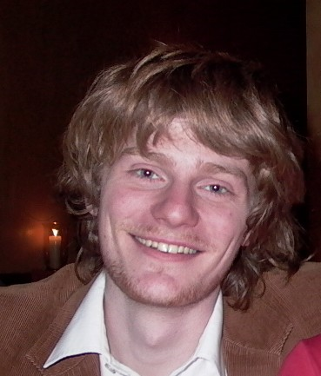
Deep Learning, Self-Taught Learning and Unsupervised Feature Learning
Andrew Ng and Dragos Magineantu
Thanks to:
Adam Coates Quoc Le Honglak Lee Andrew Maas Chris Manning Jiquan Ngiam Andrew Saxe Richard Socher
This work supported by: Boeing, DARPA Deep Learning program, DARPA Machine Reading program, Google, ONR MURI, NSF.

Slide 2
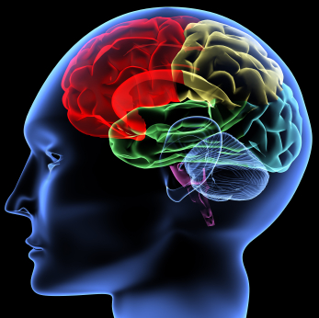
Good News
Neural Networks had previously died out at ICML and NIPS.
But they are now making a comeback.

Slide 3
This talk
Deep Learning and Self-Taught Learning: Using neural networks and a particular unsupervised learning formalism, hope to:
- Make learning algorithms much better and easier to use.
- Significantly advance machine learning and AI.
Ideas are not mine; vision shared with many other researchers:
Samy Bengio, Yoshua Bengio, Greg Corrado, Jeff Dean, Tom Dean, Nando de Freitas, Jeff Hawkins, Geoff Hinton, Yann LeCun, Honglak Lee, Tommy Poggio, Marc’Aurelio Ranzato, Kai Yu, ….
I think this is our best shot at significant progress in computer perception (computer vision, audio, …).

Slide 4
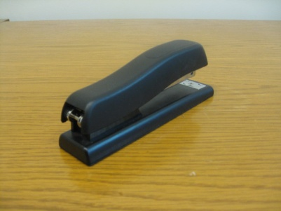
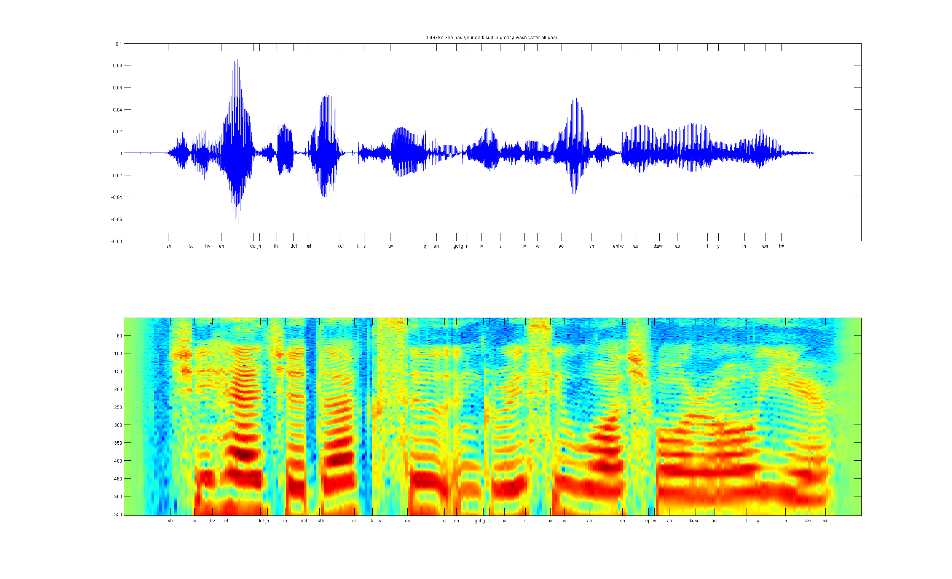
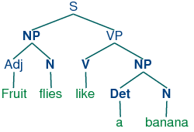
Develop ideas using…
Computer vision
Audio
Text

Slide 5
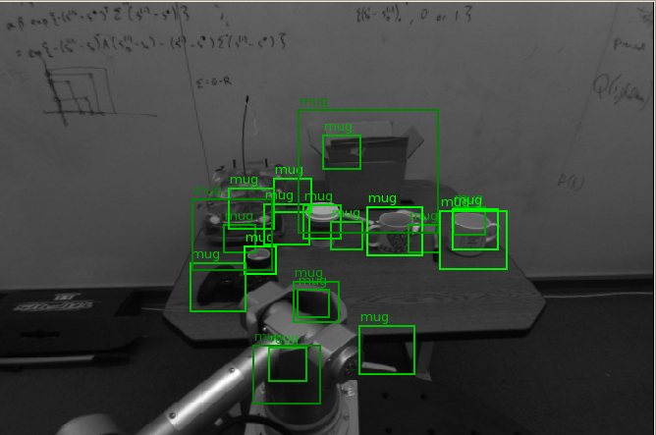
Computer vision is hard!
Notes:
Good faith effort to implement state-of-the-art.
Cluttered scenes.

Slide 6

Machine learning and feature representations
pixel 1
Learning
algorithm
pixel 2
Input
Motorbikes
Input space
“Non”-Motorbikes
pixel 2
pixel 1

Slide 7
Machine learning and feature representations
Learning
algorithm
Input
Motorbikes
Input space
“Non”-Motorbikes
pixel 2
pixel 1

Slide 8
Machine learning and feature representations
handle
Feature representation
Learning
algorithm
wheel
Input
Motorbikes
Input space
Feature space
“Non”-Motorbikes
“handle”
pixel 2
pixel 1
“wheel”

Slide 9
Object classification
handlebars
Feature representation
Learning
algorithm
wheel
Input
Feature space
Motorbikes
“Non”-Motorbikes
“handlebars”
“wheel”

Slide 10
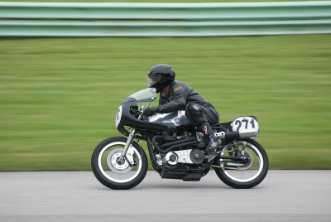


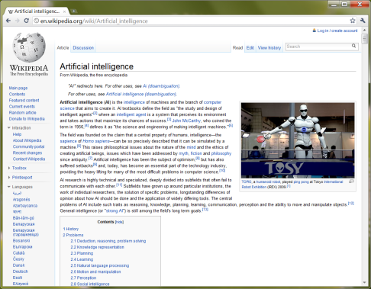
What do we want computers to do with our data?
Label: “Motorcycle”
Suggest tags
Image search
…
Images/video
Audio
Text
Speech recognition
Music classification
Speaker identification
…
Web search
Anti-spam
Machine translation
…

Slide 11
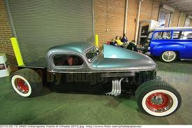
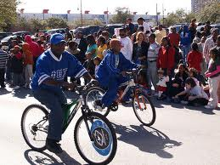
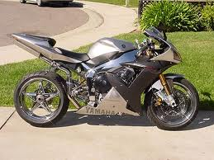
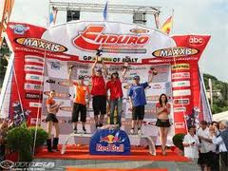
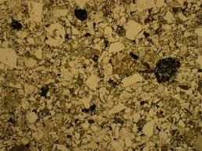
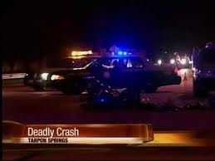
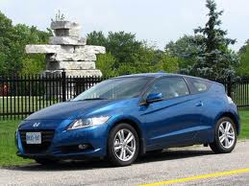
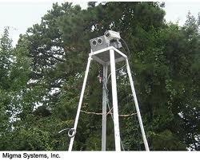
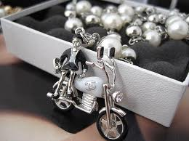
Computer vision is hard!
Motorcycle
Motorcycle
Motorcycle
Motorcycle
Motorcycle
Motorcycle
Motorcycle
Motorcycle
Motorcycle
Notes:
Good faith effort to implement state-of-the-art.
Cluttered scenes.

Slide 12
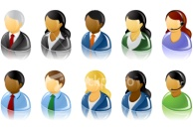
What do we want computers to do with our data?
Label: “Motorcycle”
Suggest tags
Image search
…
Images/video
Audio
Text
Speech recognition
Speaker identification
Music classification
…
Web search
Anti-spam
Machine translation
…
Machine learning performs well on many of these problems, but is a lot of work. What is it about machine learning that makes it so hard to use?

Slide 13
Machine learning for image classification
“Motorcycle”
This talk: Develop ideas using images and audio. Ideas apply to other problems (e.g., text) too.

Slide 14


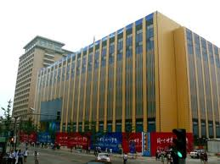
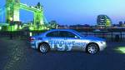
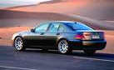
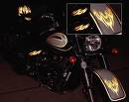

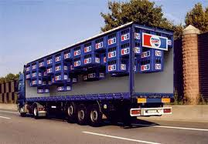
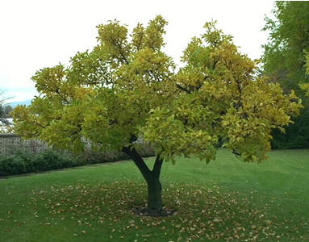


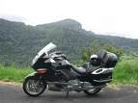

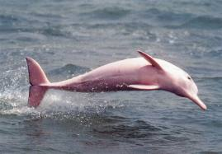
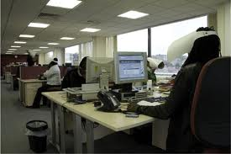


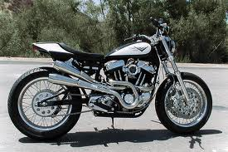
Machine learning for image classification
Motorcycles
Not a motorcycle
Testing:
What is this?

Slide 15
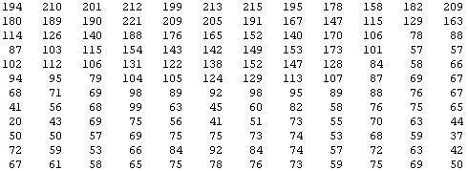
Why is this hard?
You see this:
But the camera sees this:

Slide 16

Machine learning and feature representations
pixel 1
Learning
algorithm
pixel 2
Input
Motorbikes
Raw image
“Non”-Motorbikes
pixel 2
pixel 1

Slide 17
Machine learning and feature representations
pixel 1
Learning
algorithm
pixel 2
Input
Motorbikes
Raw image
“Non”-Motorbikes
pixel 2
pixel 1

Slide 18
Machine learning and feature representations
pixel 1
Learning
algorithm
pixel 2
Input
Motorbikes
Raw image
“Non”-Motorbikes
pixel 2
pixel 1

Slide 19
What we want
handlebars
Feature representation
Learning
algorithm
wheel
Input
E.g., Does it have Handlebars? Wheels?
Motorbikes
Raw image
“Non”-Motorbikes
Features
pixel 2
Wheels
pixel 1
Handlebars

Slide 20
The idea of feature representations
Learning
algorithm
Input
Motorbikes
“Non”-Motorbikes
Raw image
pixel 2
pixel 1

Slide 21
Object classification
handlebars
Feature representation
Learning
algorithm
wheel
Input
Feature space
Motorbikes
“Non”-Motorbikes
“handlebars”
“wheel”

Slide 22

















Computing features in computer vision
But… we don’t have a handlebars detector. So, researchers try to hand-design features to capture various statistical properties of the image.
0.1
0.7
0.4
0.6
0.1
0.7
0.4
0.6
0.1
0.4
0.5
0.5
…
0.1
0.4
0.5
0.5
0.1
0.6
0.5
0.7
0.2
0.3
0.4
0.4
Final
feature
vector
Find edges
at four
orientations
Sum up edge
strength in
each quadrant

Slide 23
Feature representations
Feature Representation
Learning
algorithm
Input
Notes:
Where do we get these low-level representations from?

Slide 24
Feature representations
Notes:
Where do we get these low-level representations from?

Slide 25
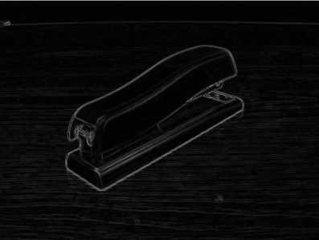




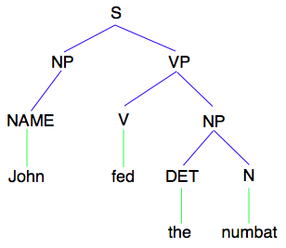
How is computer perception done?
Images/video
Image
Vision features
Detection
Audio
Image
Low-level features
Grasp point
Audio
Audio features
Speaker ID
Text classification, Machine translation, Information retrieval, ....
Text
Text
Text features

Slide 26
How is computer perception done?
Images/video
“Motorcycle”
Image
Vision features
Recognition
Audio
Image
Low-level features
Grasp point
Audio
Audio features
Speaker ID
Information retrieval,
Machine translation,
Text classification,
etc.
Text
Text
Text features

Slide 27
Feature representations
Feature Representation
Learning
algorithm
Input
Notes:
Where do we get these low-level representations from?

Slide 28
Feature representations
Learning
algorithm
Input
Notes:
Where do we get these low-level representations from?

Slide 29
Feature representations
Feature Representation
Learning
algorithm
Input
E.g., SIFT, HoG, etc.
Notes:
Where do we get these low-level representations from?

Slide 30
Feature representations
Input
Feature Representation
Learning
algorithm
Notes:
Where do we get these low-level representations from?

Slide 31
How is computer perception done?
Object detection
Image
Vision features
Detection
Audio classification
Image
Low-level features
Grasp point
Audio
Audio features
Speaker ID
Text classification, Machine translation, Information retrieval, etc.
NLP
Text
Text features

Slide 32
Feature representations
Input
Feature Representation
Learning
algorithm
Notes:
Where do we get these low-level representations from?

Slide 33
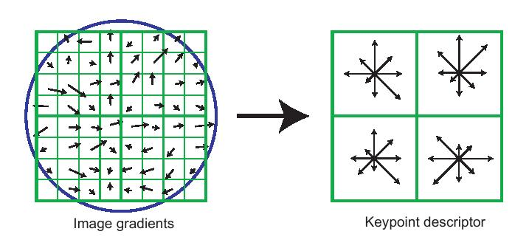
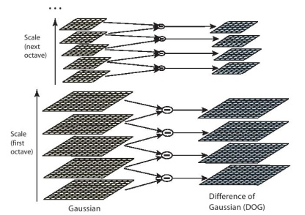
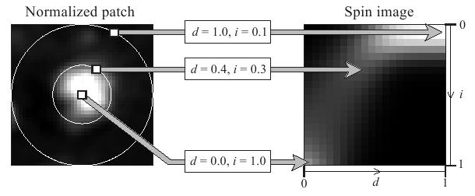
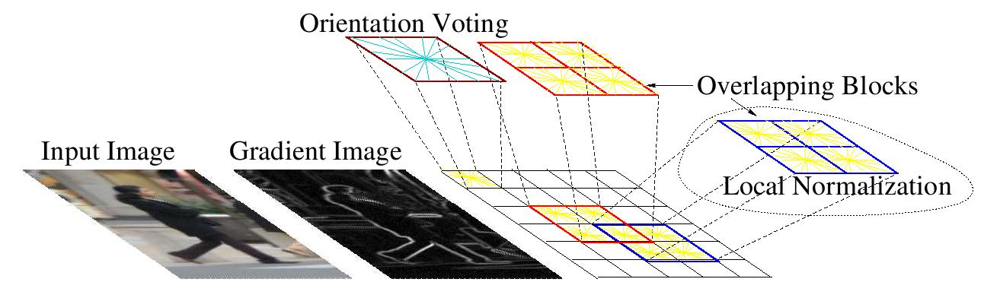
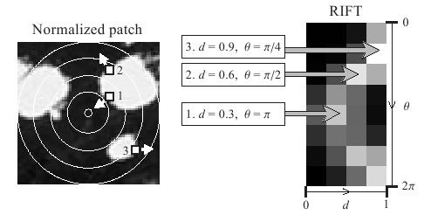
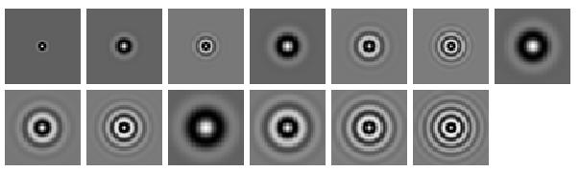
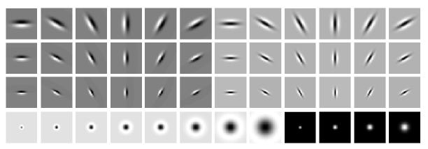
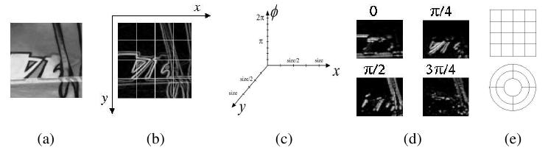
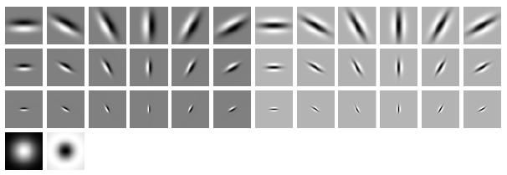
Computer vision features
SIFT
Spin image
HoG
RIFT
Textons
GLOH

Slide 34
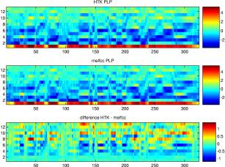
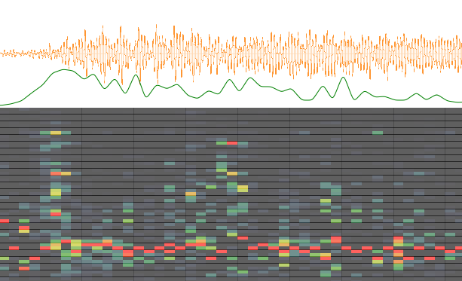
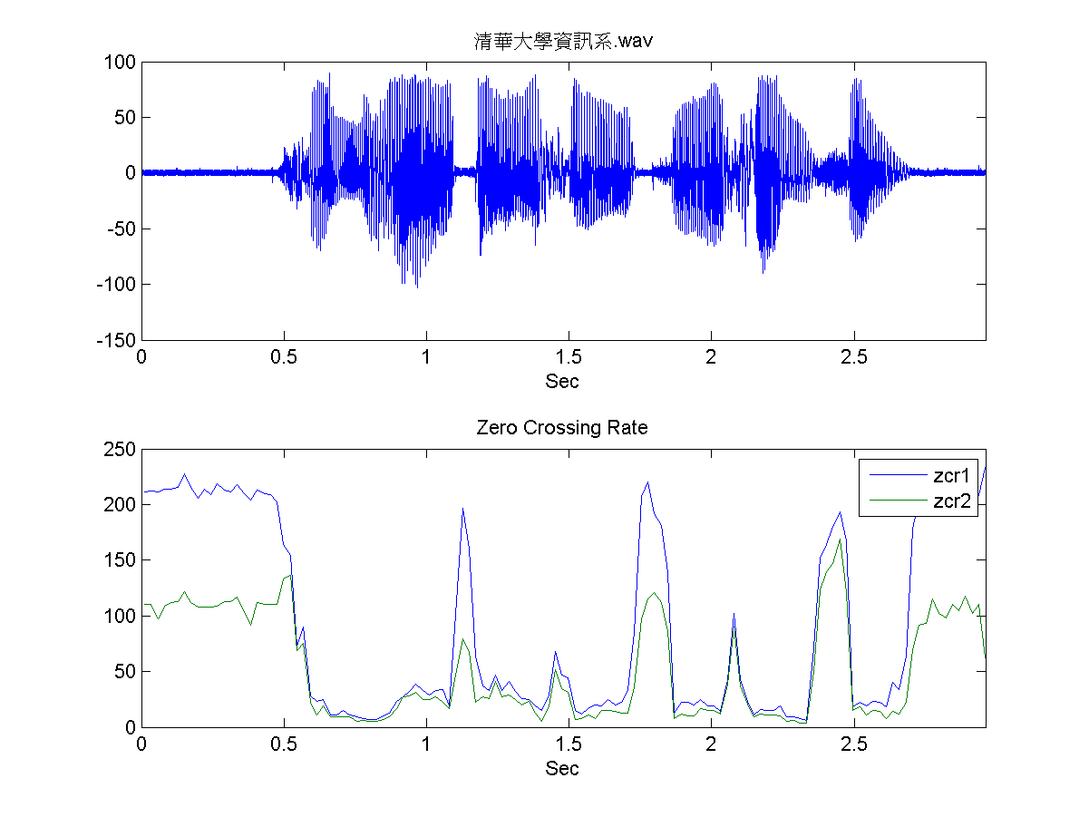
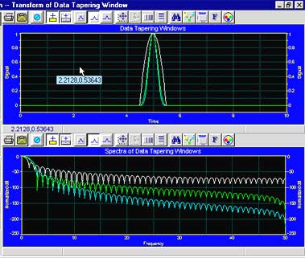
Audio features
Spectrogram
MFCC
Flux
ZCR
Rolloff

Slide 35
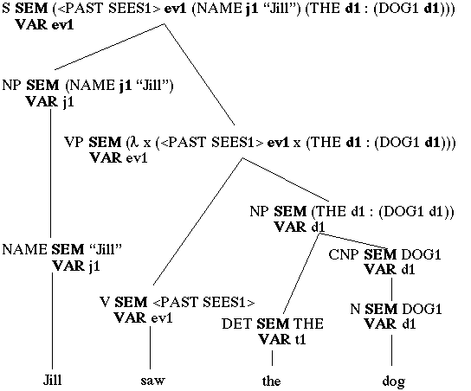
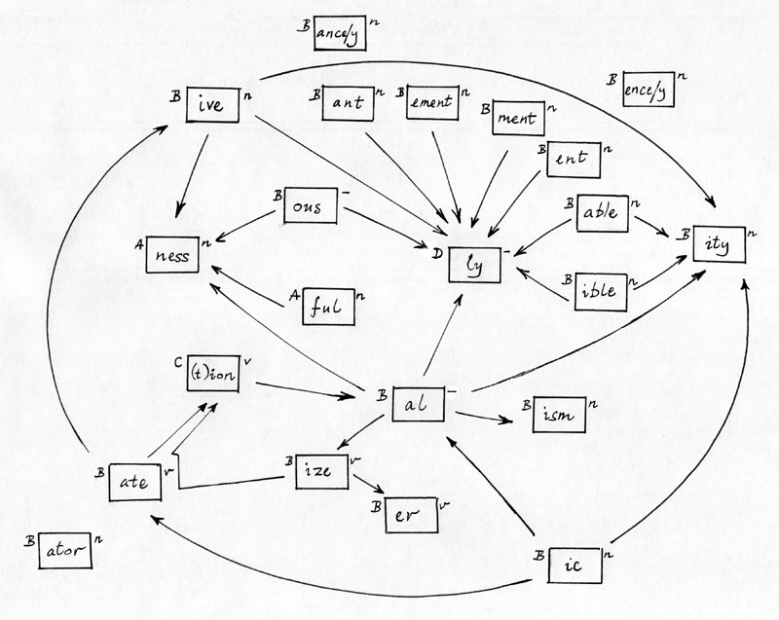




NLP features
NER/SRL
Stemming
Parser features
Anaphora
POS tagging
WordNet features

Slide 36
NLP features
Named entity recognition
Stemming
Parser features
Coming up with features is difficult, time-consuming, requires expert knowledge.
When working applications of learning, we spend a lot of time tuning the features.
Anaphora
Part of speech
Ontologies (WordNet)

Slide 37
Feature representations
Input
Feature Representation
Learning
algorithm
Notes:
Where do we get these low-level representations from?

Slide 38
The hypothesis
Much of perception in the brain can be explained with a single learning algorithm.

Slide 39



The “one learning algorithm” hypothesis
Auditory Cortex
Auditory cortex learns to see
[Roe et al., 1992]

Slide 40


The “one learning algorithm” hypothesis
Somatosensory Cortex
Somatosensory cortex learns to see
[Metin & Frost, 1989]

Slide 41






Sensor representations in the brain
Seeing with your tongue
Human echolocation (sonar)
Haptic belt: Direction sense
Implanting a 3rd eye
[BrainPort; Welsh & Blasch, 1997; Nagel et al., 2005; Constantine-Paton & Law, 2009]

Slide 42

Sensor representations in the brain
Array of electrodes
allows you to see with your tongue.
Human echolocation (sonar)
[BrainPort; Welsh & Blasch, 1997]

Slide 43


Sensor representation in the brain
Auditory cortex learns to see.
(Same rewiring process also works for touch/ somatosensory cortex.)
Auditory
Cortex
Seeing with your tongue
Human echolocation (sonar)
[Roe et al., 1992; BrainPort; Welsh & Blasch, 1997]

Slide 44

Other sensory remapping examples
Haptic compass belt. North facing motor vibrates. Gives you a “direction” sense.
Implanting a 3rd eye.
[Nagel et al., 2005; Constantine-Paton & Law, 2009]
Dunlop et al., 2006

Slide 45
On two approaches to computer perception
The adult visual (or audio) system is incredibly complicated.
We can try to directly implement what the adult visual (or audio) system is doing. (E.g., implement features that capture different visual properties: 2d and 3d shapes, context, relations between object parts, …).
Or, if there is a more general computational principal/algorithm that underlies most of perception, can we instead try to discover and implement that?

Slide 46






Learning input representations
Find a better way to represent images than pixels.

Slide 47

Learning input representations
Find a better way to represent audio.

Slide 48

Feature learning problem
Given a 14x14 image patch x, can represent it using 196 real numbers.
Problem: Can we find a learn a better feature vector to represent this?
255
98
93
87
89
91
48
…

Slide 49


















Self-taught learning (Unsupervised Feature Learning)
…
Unlabeled images
Testing:
What is this?
Motorcycles
Not motorcycles
[This uses unlabeled data. One can learn the features from labeled data too.]

Slide 50
Self-taught learning (Feature learning problem)
Motorcycles
Labeled Motorcycles
Labeled Cars
Not motorcycles
Testing:
What is this?
[Lee, Raina and Ng, 2006; Raina, Lee, Battle, Packer & Ng, 2007]

Slide 51
Self-taught learning (Feature learning problem)
Motorcycles
Not motorcycles
Testing:
What is this?
…
Unlabeled images
[Lee, Raina and Ng, 2006; Raina, Lee, Battle, Packer & Ng, 2007]
[This uses unlabeled data. One can learn the features from labeled data too.]

Slide 52
Supervised Learning
Labeled Cars
Labeled Motorcycles
Testing:
What is this?
[Lee, Raina and Ng, 2006; Raina, Lee, Battle, Packer & Ng, 2007]

Slide 53
Unsupervised Feature Learning (Self-taught learning)
Labeled Cars
Labeled Motorcycles
Testing:
What is this?
Unlabeled images
[Lee, Raina and Ng, 2006; Raina, Lee, Battle, Packer & Ng, 2007]

Slide 54
Traditional machine learning
Labeled Cars
Labeled Motorcycles
Testing:
What is this?

Slide 55
Unsupervised feature learning (Self-taught learning)
Unlabeled images
Testing:
What is this?
Labeled Car(s)
Labeled Motorcycle(s)
[Lee, Raina and Ng, 2006; Raina, Lee, Battle, Packer & Ng, 2007]

Slide 56

First stage of visual processing: V1
V1 is the first stage of visual processing in the brain.
Neurons in V1 typically modeled as edge detectors:
Neuron #1 of visual cortex
(model)
Neuron #2 of visual cortex
(model)
Notes:
http://www.ldeo.columbia.edu/4d4/wavelets/dm.html

Slide 57

Learning sensor representations
Sparse coding (Olshausen & Field,1996)
Model developed to explain visual perception in the brain.
Input: Images x⁽¹⁾, x⁽²⁾, …, x^{(m)} (each in R^{n x n})
Learn: Dictionary of bases φ₁, φ₂, …, φ_{k} (also R^{n x n}), so that each input x can be approximately decomposed as:
x ∑ a_{j} φ_{j}
s.t. a_{j}’s are mostly zero (“sparse”)
^{k}
^{j=1}
[NIPS 2006, 2007]

Slide 58



First stage of visual processing: V1
V1 is the first stage of visual processing in the brain.
Hubel & Wiesel (1962)’s simple cell model:
Green: Responds to white dot.
Red: Responds to black dot.
Schematic of simple cell
Actual simple cell
Alternative treatment: Model as “Gabor functions.”
Also used in image compression and denoising.
[Images from DeAngelis, Ohzawa & Freeman, 1995]
Notes:
http://www.ldeo.columbia.edu/4d4/wavelets/dm.html

Slide 59
Learning sensor representations
Sparse coding (Olshausen & Field,1996)
Input: Images x⁽¹⁾, x⁽²⁾, …, x^{(m)} (each in R^{n x n})
Learn: Dictionary of bases φ₁, φ₂, …, φ_{k} (also R^{n x n}), so that each input x can be approximately decomposed as:
x ∑ a_{j} φ_{j}
s.t. a_{j}’s are mostly zero (“sparse”)
Use to represent 14x14 image patch succinctly, as [a₇=0.8, a₃₆=0.3, a₄₁ = 0.5]. I.e., this indicates which “basic edges” make up the image.
^{k}
^{j=1}
[NIPS 2006, 2007]

Slide 60
Feature Learning via Sparse Coding
Sparse coding (Olshausen & Field,1996). Originally developed to explain early visual processing in the brain (edge detection).
Input: Images x⁽¹⁾, x⁽²⁾, …, x^{(m)} (each in R^{n x n})
Learn: Dictionary of bases φ₁, φ₂, …, φ_{k} (also R^{n x n}), so that each input x can be approximately decomposed as:
x ∑ a_{j} φ_{j}
s.t. a_{j}’s are mostly zero (“sparse”)
^{k}
^{j=1}
[NIPS 2006, 2007]

Slide 61







Sparse coding illustration
Natural Images
Learned bases (φ_{1 , …,} φ₆₄): “Edges”
Test example
≈ 0.8 * + 0.3 * + 0.5 *
x ≈ 0.8 * φ₃₆ + 0.3 * φ₄₂ + 0.5 * φ₆₃
[a₁, …, a₆₄] = [0, 0, …, 0, 0.8, 0, …, 0, 0.3, 0, …, 0, 0.5, 0]
(feature representation)
More succinct, higher-level, representation.

Slide 62








More examples
Represent as: [a₁₅=0.6, a₂₈=0.8, a₃₇ = 0.4].
Represent as: [a₅=1.3, a₁₈=0.9, a₂₉ = 0.3].
0.6 * + 0.8 * + 0.4 *
φ₁₅ φ₂₈ φ₃₇
1.3 * + 0.9 * + 0.3 *
φ₅ φ₁₈ φ₂₉
Method “invents” edge detection.
Automatically learns to represent an image in terms of the edges that appear in it. Gives a more succinct, higher-level representation than the raw pixels.
Quantitatively similar to primary visual cortex (area V1) in brain.

Slide 63
Sparse coding applied to audio
Image shows 20 basis functions learned from unlabeled audio.
[Evan Smith & Mike Lewicki, 2006]

Slide 64
Sparse coding applied to audio
Image shows 20 basis functions learned from unlabeled audio.
[Evan Smith & Mike Lewicki, 2006]

Slide 65



Sparse coding applied to touch data
Collect touch data using a glove, following distribution of grasps used by animals in the wild.
Grasps used by animals
[Macfarlane & Graziano, 2009]
Example learned representations
Biological data
Learning Algorithm
[Andrew Saxe]

Slide 66
What about text?
Sparse coding works great on “natural signals” like images and audio.
But text is different!
≈ 0.8 * + 0.3 * + 0.5 *
φ₃₆ φ₄₂ φ₆₃
Image ≈ 0.8 * “Edge 36” + 0.3 * “Edge 42” + 0.5 * “Edge 63”

Slide 67
Sparse coding on bag-of-word vectors (illustration)
a
aardvark
aardwolf
able
account
acid
across
…
baby
back
…
cradle
…
…
…
zylophone
1
0
0
0
1
0
0
0
1
0
0
1
0
0
0
1
x
Document

Slide 68
Sparse coding on bag-of-word vectors (illustration)
a
aardvark
aardwolf
able
account
acid
across
…
baby
back
…
cradle
…
…
…
zylophone
1
0
0
0
1
0
0
0
1
0
0
1
0
0
0
1
.1
.2
0
0
.1
.1
0
0
1.2
0
0
1
0
.1
0
.1
1.8
0
.1
0
0
.1
0
.2
0
0
.2
.1
0
.1
.1
0
.1
0
0
0.8
0
0
.1
.2
.1
.2
0
.3
0
0
0
1.2
0.8 * + 0.3 * + 0.5 *
Basis functions correspond to topics. But who needs another topic model? (Already have LSA, LDA, etc….)
φ₃₆ φ₄₂ φ₆₃
x
Document ≈ 0.8 * “Topic 36” + 0.3 * “Topic 42” + 0.5 * “Topic 63”

Slide 69
Sparse coding on text
Top five words in example “topics”:
Topic 1: Share, exchange, stock securities, commission.
Topic 2: Subscribe, online, service, server, database.
Topic 3: Actor, actress, film, comedian, star.
But… who needs another topic model? LSA (Landauer, et al., 1998), Distributional clustering (Brown et al 1992; Pereira et al., 1993) LDA (Blei et al., 2003), ….

Slide 70

Learning feature hierarchies
Higher layer
(Combinations of edges;
cf. V2)
a₁
a₂
a₃
“Sparse coding”
(edges; cf. V1)
x₁
x₂
x₃
x₄
Input image (pixels)
[Technical details: Sparse autoencoder or sparse version of Hinton’s DBN.]
[Lee, Ranganath & Ng, 2007]

Slide 71
Learning feature hierarchies
Higher layer
(Model V3?)
Higher layer
(Model V2?)
a₁
a₂
a₃
Model V1
x₁
x₂
x₃
x₄
Input image
[Technical details: Sparse autoencoder or sparse version of Hinton’s DBN.]
[Lee, Ranganath & Ng, 2007]

Slide 72


Hierarchical Sparse coding (Sparse DBN): Trained on face images
object models
object parts
(combination
of edges)
edges
Note: Sparsity important for these results.
pixels
[Honglak Lee]

Slide 73
Hierarchical Sparse coding (Sparse DBN)
Features learned from different object classes.
Faces
Cars
Elephants
Chairs
[Honglak Lee]

Slide 74
Training on multiple objects
Features learned by training on 4 classes (cars, faces, motorbikes, airplanes).
Third layer bases learned from 4 object categories.
Object specific features
Features shared across object classes
Second layer bases learned from 4 object categories.
Edges
[Honglak Lee]

Slide 75

Training on multiple objects
Trained on 4 classes (cars, faces, motorbikes, airplanes).
Second layer: Shared-features and object-specific features.
Third layer: More specific features.
Third layer bases learned from 4 object categories.
Plot of H(class|neuron active)
Second layer bases learned from 4 object categories.

Slide 76

Hierarchical probabilistic inference
Generating posterior samples from faces by “filling in” experiments
(cf. Lee and Mumford, 2003). Combine bottom-up and top-down inference.
Input images
Samples from
feedforward
Inference (control)
Samples from
Full posterior
inference
Notes:
Aglioti et al., 1994; Halligan et al., 1993; Weinstein, 1969; Ramachandran, 1998; Halligan et al., 1993; Sadato et al., 1996; Halligan et al., 1999

Slide 77
Machine learning applications

Slide 78
Traditional machine learning
Cars
Motorcycles
Testing:
What is this?

Slide 79
Unsupervised feature learning (Self-taught learning)
Unlabeled data
Testing:
What is this?
Car
Motorcycle
[Lee, Raina and Ng, 2007; Raina, Lee, Battle, Packer & Ng, 2008]

Slide 80


Unsupervised feature learning (Self taught learning)
Natural scenes
Testing:
What is this?
Segway
[NIPS 2006, ICML 2007]

Slide 81



Unsupervised feature learning (Self-taught learning)
Unlabeled data
Image
Learned bases φ_{i}
Learned representation [a₁, ... , a₆₄]
Off-the-shelf classifier (SVM)
In NLP:
Distributional representations and vector space model ideas. (Brown et al., 1992; Pereira, Tishby & Lee, 1993; Salton et al., 1975; Pantel & Lin, 2002; Rapp, 2003; Turney et al., 2003).
Latent Semantic Analysis (Deerwester et al.,1990)
Structural Learning (Ando & Zhang, 2005)
….

Slide 82

Video Activity recognition (Hollywood 2 benchmark)
Method | Accuracy
Hessian + ESURF [Williems et al 2008] | 38%
Harris3D + HOG/HOF [Laptev et al 2003, 2004] | 45%
Cuboids + HOG/HOF [Dollar et al 2005, Laptev 2004] | 46%
Hessian + HOG/HOF [Laptev 2004, Williems et al 2008] | 46%
Dense + HOG / HOF [Laptev 2004] | 47%
Cuboids + HOG3D [Klaser 2008, Dollar et al 2005] | 46%
Unsupervised feature learning (our method) | 52%
Unsupervised feature learning significantly improves on the previous state-of-the-art.
[Le, Zhou & Ng, 2011]

Slide 83



Self-taught learning: Example applications
Handwritten character classification
Speaker identification
Digits
Alphabets
Spectrogram | 38.5%
MFCCs | 43.8%
Sparse coding | 48.7%
Raw | 54.8%
PCA | 54.8%
Sparse coding | 58.5%
8.7% error reduction
8.2% error reduction
Music genre classification
Text classification
Newswire
Webpages
Spectrogram | 48.4%
MFCCs | 54.0%
Music-specific model | 49.3%
Sparse coding | 56.6%
# examples | 4 | 10 | 20
Raw words | 70.4% | 75.7% | 81.6%
LDA | 66.8% | 75.3% | 82.4%
Exp. Fam. Sparse coding | 75.0% | 81.4% | 85.1%
5.7% error reduction
15-23% error reduction
[Lee, Battle, Raina, & Ng, 2006; Raina, Battle, Lee, Packer & Ng, 2007, Grosse, Raina, Kwong & Ng, 2007]

Slide 84

CDBN for audio
Max pooling unit
Detection units
Spectrogram
[ICML 2009, NIPS 2009]

Slide 85

Sparse coding on audio (speech)
Spectrogram
≈ 0.9 * + 0.7 * + 0.2 *
x φ₃₆ φ₄₂ φ₆₃

Slide 86
Probabilistic max pooling
Convolutional DBN:
Convolutional Neural net:
max {x₁, x₂, x₃, x₄}
max {x₁, x₂, x₃, x₄}
X₁
X₂
X₃
X₄
Where x_{i} are {0,1}, and mutually exclusive. Thus, 5 possible cases:
X₁
X₂
X₃
X₄
Where x_{i} are real numbers.
Collapse 2^{n} configurations into n+1 configurations. Permits bottom up and top down inference.

Slide 87
Dictionary of bases φ_{i} learned for speech
Many bases seem to correspond to phonemes.
[Honglak Lee]
Notes:
Visual bases: Look at them and see if make sense/correspond to Gabors. Try to perform similar analysis on audio bases.

Slide 88








Many bases seem to be detecting phonemes
“oy”
“el”
“s”
Phoneme
First layer bases
[Lee, Pham and Ng, 2009]
Notes:
We select the bases that have the highest average activation for each phoneme.
Visual inspection shows bases capture patterns relevant to the phoneme.

Slide 89






Comparison of bases to gender (“ae” phoneme)
Phonemes
First layer bases
Second layer bases
Female
Male
[Lee, Pham and Ng, 2009]
Notes:
Female speech is characterized by clear horizontal banding patterns whereas male speech is characterized by intensity spread across lower frequencies.
Both first and second CRBM layers found these patterns even though they were trained in an unsupervised manner.

Slide 90
Sparse DBN for audio
Spectrogram
[Lee, Pham and Ng, 2009]
Notes:
Time-invariant features

Slide 91
Hierarchical Sparse coding (sparse DBN) for audio
Spectrogram
[Honglak Lee]
Notes:
Time-invariant features

Slide 92
Hierarchical Sparse coding (sparse DBN) for audio
Spectrogram
[Honglak Lee]

Slide 93

Convolutional DBN for audio
Max pooling
Second CDBN
layer
Detection units
Max pooling
One CDBN
layer
Detection units
[ICML 2009, NIPS 2009]

Slide 94
Hierarchical Sparse coding (sparse DBN) for audio
[Honglak Lee]

Slide 95
Application to speech recognition tasks
Speaker identification
Phone classification
Gender classification
Music classification
Use same set of learned features for all three tasks.
Notes:
Basic idea: compute CDBN activations and use them as features for supervised learning algorithms. We used the same CDBN for all three tasks.

Slide 96

Phone Classification (TIMIT benchmark)
Test set accuracy:
Feature Learning
Clarkson and Moreno (1999): 77.6%
Gunawardana et al. (2005): 78.3%
Sung et al. (2007): 78.5%
Petrov et al. (2007): 78.6%
Sha and Saul (2006): 78.9%
Yu et al. (2009): 79.2%
Unsupervised feature learning significantly improves on the previous state-of-the-art.

Slide 97
Phoneme Classification (TIMIT benchmark)
Method | Accuracy
Clarkson and Moreno (1999) | 77.6%
Gunawardana et al. (2005) | 78.3%
Sung et al. (2007) | 78.5%
Petrov et al. (2007) | 78.6%
Sha and Saul (2006) | 78.9%
Yu et al. (2006) | 79.2%
Unsupervised feature learning (our method) | 80.3%
Clarkson and Moreno (1999): 77.6%
Gunawardana et al. (2005): 78.3%
Sung et al. (2007): 78.5%
Petrov et al. (2007): 78.6%
Sha and Saul (2006): 78.9%
Yu et al. (2009): 79.2%
Unsupervised feature learning significantly improves on the previous state-of-the-art.

Slide 98



Audio problems
Gender classification:
Music genre classification:
Music artist classification:
Outperforms MFCC baselines. Having a deeper network generally does better.

Slide 99

Speaker Identification
Test set accuracy:
[16] D. A. Reynolds. Speech Commun,1995.
The CDBN features outperform the MFCC features, especially when the number of training examples is small.

Slide 100
State-of-the-art Unsupervised feature learning

Slide 101
Audio
TIMIT Phone classification | Accuracy
Prior art (Clarkson et al.,1999) | 79.6%
Stanford Feature learning | 80.3%
TIMIT Speaker identification | Accuracy
Prior art (Reynolds, 1995) | 99.7%
Stanford Feature learning | 100.0%
Images
CIFAR Object classification | Accuracy
Prior art (Ciresan et al., 2011) | 80.5%
Stanford Feature learning | 82.0%
NORB Object classification | Accuracy
Prior art (Scherer et al., 2010) | 94.4%
Stanford Feature learning | 95.0%
Galaxy
Video
Hollywood2 Classification | Accuracy
Prior art (Laptev et al., 2004) | 48%
Stanford Feature learning | 53%
YouTube | Accuracy
Prior art (Liu et al., 2009) | 71.2%
Stanford Feature learning | 75.8%
KTH | Accuracy
Prior art (Wang et al., 2010) | 92.1%
Stanford Feature learning | 93.9%
UCF | Accuracy
Prior art (Wang et al., 2010) | 85.6%
Stanford Feature learning | 86.5%
Multimodal (audio/video)
AVLetters Lip reading | Accuracy
Prior art (Zhao et al., 2009) | 58.9%
Stanford Feature learning | 65.8%
Other unsupervised feature learning records:
Pedestrian detection (Yann LeCun)
Different audio tasks (Geoff Hinton, Honglak Lee)
PASCAL VOC object classification (Kai Yu)
Notes:
Other SOTA performance records held by Kai Yu, Geoff Hinton.

Slide 102
Technical challenge: Scaling up

Slide 103

Scaling and classification accuracy (CIFAR-10)
Large numbers of features is critical. The specific learning algorithm is important, but ones that can scale to many features also have a big advantage.
[Adam Coates]

Slide 104

Approaches to scaling up
Efficient sparse coding algorithms. (Lee et al., NIPS 2006)
GPUs for deep learning. (Raina et al., ICML 2008)
Tiled Convolutional Networks (Le et al., NIPS 2010)
  The scaling advantage of convolutional networks, but without hard-coding translation invariance.
Simple, fast feature decoders (Coates et al., 2011)
[Raina, Madhavan and Ng, 2008]

Slide 105
Approaches to scaling up
Efficient sparse coding algorithms. (Lee et al., NIPS 2006)
Parallel implementations via Map-Reduce (Chu et al., NIPS 2006)
GPUs for deep learning. (Raina et al., ICML 2008)
Tiled Convolutional Networks (Le et al., NIPS 2010)
Efficient optimization algorithms (Le et al., ICML 2011)
Simple, fast feature decoders (Coates et al., AISTATS 2011)
[Raina, Madhavan and Ng, 2008]

Slide 106
Application focus: People detection

Slide 107




Video activity recognition: Version 0
Learn features from Hollywood 2. Train classifier to recognize activities on surveillance video.
Notes:
Activity recognition. Anomaly detection.

Slide 108

Video activity detection: Version 0
Digging
Learn features from Hollywood 2. Train classifier to recognize activities on surveillance video.

Slide 109

Video activity recognition: Version 0
Getting
In car

Slide 110
People detection
People detection is probably the single most important application of computer vision.
The most interesting thing in videos are the people. (Surveillance.)
Warfighter situational awareness. (“Paintball helper.”)
Sniper detection.
Notes:
Activity recognition. Anomaly detection.

Slide 111


Overview of System
Octo-Cam
Haptic Belt
8 Logitech HD Pro Webcam C910 “Octo-Cam” mounted system
~65 degree viewing angle per webcam (allowing for some overlap)
12 vibration motors spaced equally apart along belt
Controlled through Arduino MEGA2560
[Justin Chen, Jean Feng, Tiffany Low, Marc Rasi, Morgan Quigley]

Slide 112

Convolutional Neural Network
Forward propagation through convolution neural network to produce image features
Classify each region of the image based on the features to locate pedestrians

Slide 113


Algorithm Speedup via GPU
6x speedup by transferring code from CPU (4 cores) to GPU (480 cores)
Modules from Neural Network transferred to the GPU include convolution, sampling, and nonlinear functions
GPU implementation of Convolutional Neural Network

Slide 114




Screenshots of Detection Algorithm in action
True positive
True positive
False positive
False negative

Slide 115

Pedestrian Detection Haptic Belt System
Octo-cam
Display and CPU
Haptic Belt

Slide 116
Scaling up using GPU hardware
Use GPU (Graphics Processor Unit) hardware.
You already have this in your desktop, and it runs 10-100x faster than your CPU.
[Raina, Madhavan and Ng, 2008]

Slide 117
Summary

Slide 118












Unsupervised Feature Learning Summary
Deep Learning and Self-Taught learning: Lets learn rather than manually design our features.
Discover the fundamental computational principles that underlie perception?
Sparse coding and deep versions very successful on vision and audio tasks. Other variants for learning recursive representations.
Application focus: People detection; activity recognition.
Did not talk about: Text/NLP applications (recursive representations; many state-of-the-art results).
Thanks to:
Car
Motorcycle
Unlabeled images
Adam Coates Quoc Le Honglak Lee Andrew Maas Chris Manning Jiquan Ngiam Andrew Saxe Richard Socher
This work supported by: Boeing, DARPA Deep Learning, DARPA machine reading program, Google, ONR MURI, NSF.

