Slide 1
AI and the Internet
Andrew Ng (吴恩达)
Thanks to Adam Coates, Kai Yu, Tong Zhang.
Notes:
Takeaways:
Virtuous circle of AI. Deep learning will help power this.
Longer term: Take a shot a real AI. Optimistic about Baidu’s prospects.
Building innovation. Look forward to collaborations and sharing ideas.
Internet is being changed by machine learning and AI. One of the most powerful tools for that is Deep Learning.
Share with you what I’ve seeing in industry and academic; help design strategy for your teams thinking through deep learning/machine learning.
I’m currently putting together a relatively non-technical presentation on AI/Machine Learning/Deep learning, some internet applications that I think it will impact, and on some of Baidu Research’s plans. But please let me know if you have any further suggestions on what/how to present.
--------
Jing Wang: Talk about AI, ML, big data. How to change the internet.

Slide 2
Virtuous circle of AI
Great product
AI
Data
Users
Notes:
Great products.
Either improve an existing product: Web search gets click data help improve ads
Or help us launch adjacent vertical products. E.g. LBS helps us launch local recommendations service.

Slide 3
Data and machine learning
New AI methods
(deep learning)
Performance
Most learning
algorithms
Amount of data

Slide 4
Virtuous circle of AI
Great product
AI
Data
Users
Notes:
Great products.
Either improve an existing product: Web search gets click data help improve ads
Or help us launch adjacent vertical products. E.g. LBS helps us launch local recommendations service.

Slide 5
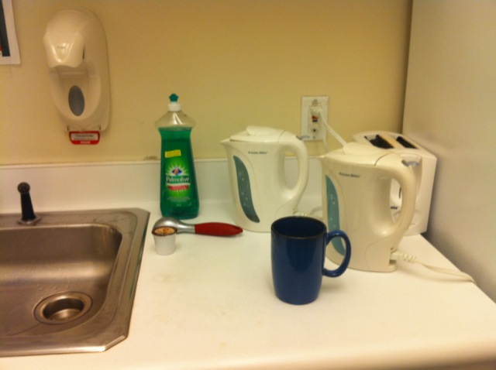
Computer vision: Identify coffee mug

Slide 6
Computer vision: Identify coffee mug
Mug
Mug
Mug
Mug
Mug
Mug
Mug

Slide 7
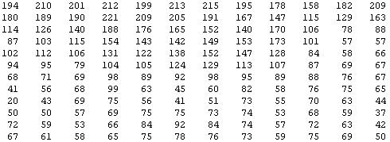
Why is computer vision hard?
The camera sees :

Slide 8
Computer vision
Learning
algorithm
Notes:
Why is computer vision hard? You and my visual system is so good that it’s almost hard to understand how a computer program can fail to see what this is. But to understand why this is hard, lets zoom into part of the image. This looks like a coffee mug to you, but what it looks like to the camera… is this. It sees this block of numbers, corresponding to the pixel brightness values, also called the pixel intensity values, in the image. The computer vision problem is to look at all these numbers, and figure out that this is the rim of a coffee mug.
It seems you must need a very complicated mathematical function to decide that that block of numbers represents a coffee mug. And of course, we don’t just want to recognize coffee mugs. We also want to recognize people and faces, we want our robot have depth perception—to tell if things are nearby or far away—and figure out many other things from pictures. And so it seems you have to write a lot of complicated programs to do all these things.

Slide 9
Computer vision
Features
Learning
algorithm
Notes:
Why is computer vision hard? You and my visual system is so good that it’s almost hard to understand how a computer program can fail to see what this is. But to understand why this is hard, lets zoom into part of the image. This looks like a coffee mug to you, but what it looks like to the camera… is this. It sees this block of numbers, corresponding to the pixel brightness values, also called the pixel intensity values, in the image. The computer vision problem is to look at all these numbers, and figure out that this is the rim of a coffee mug.
It seems you must need a very complicated mathematical function to decide that that block of numbers represents a coffee mug. And of course, we don’t just want to recognize coffee mugs. We also want to recognize people and faces, we want our robot have depth perception—to tell if things are nearby or far away—and figure out many other things from pictures. And so it seems you have to write a lot of complicated programs to do all these things.

Slide 10
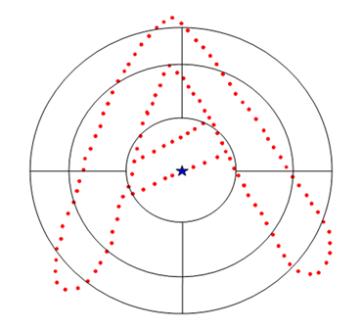
Features for vision
SIFT
GIST
Shape context

Slide 11
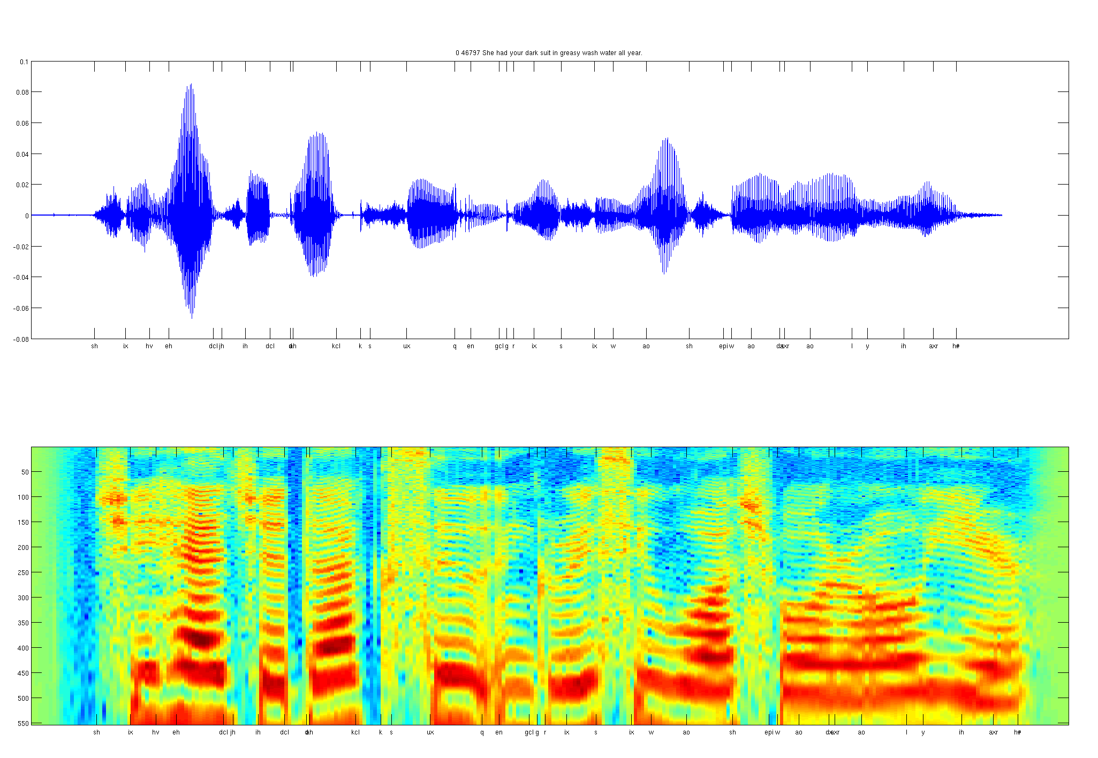
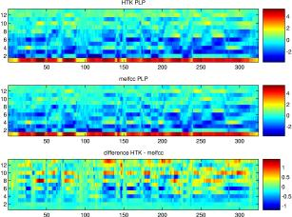
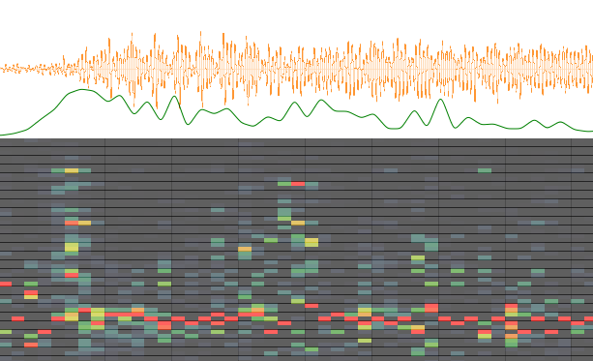
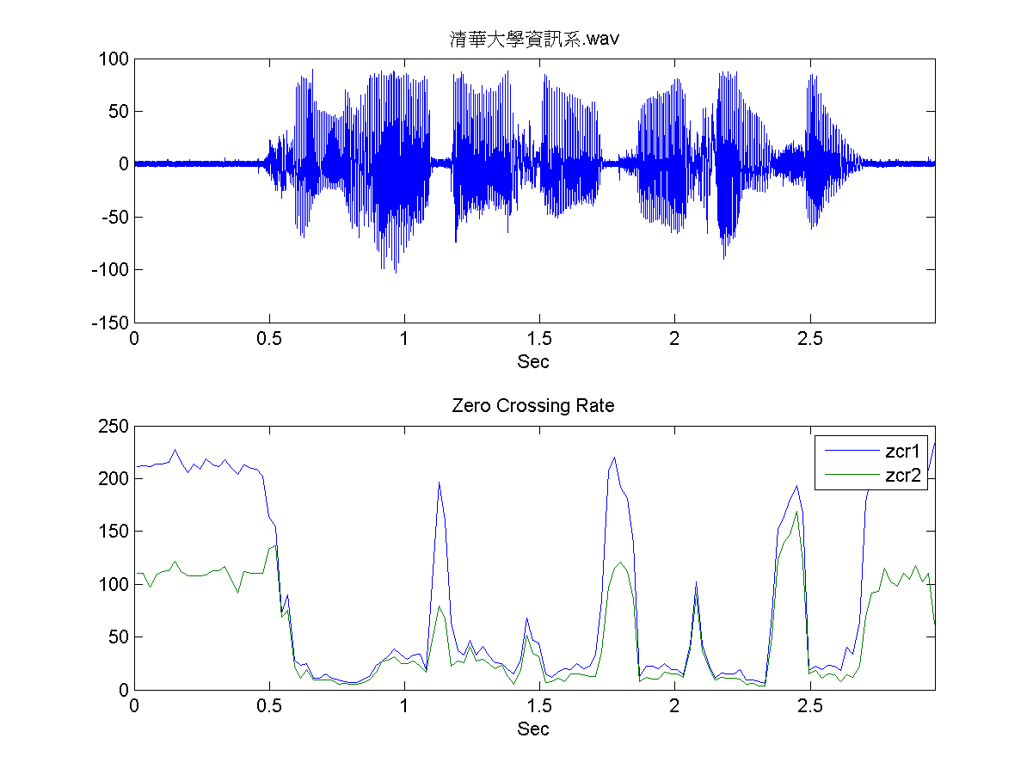
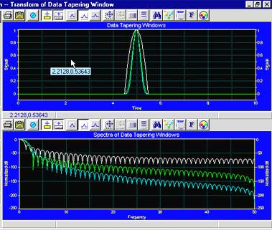
Features for audio
Spectrogram
MFCC
Flux
ZCR
Rolloff

Slide 12
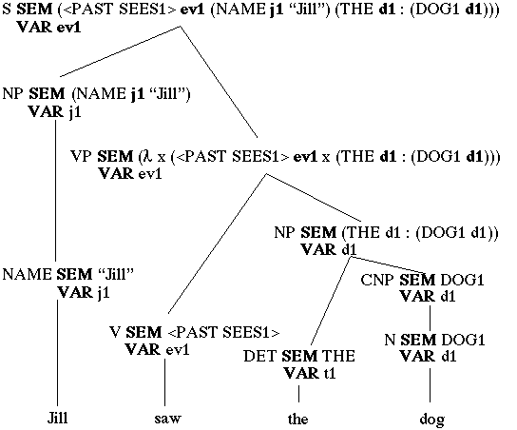
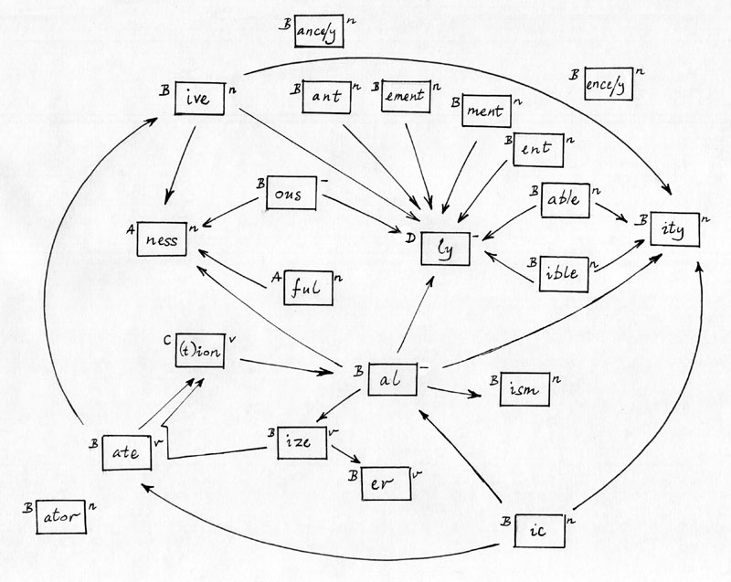
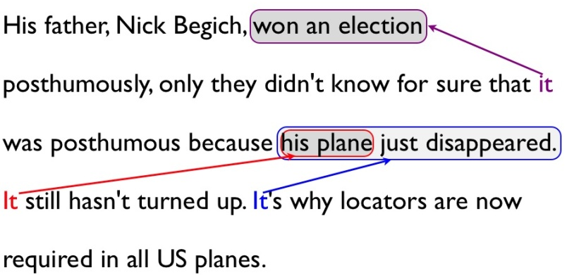
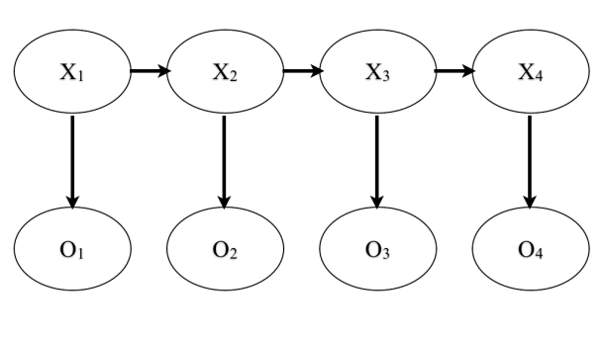
Features for text
Parser
Named entity
Stemming
Co-reference
Part of speech

Slide 13
Computer vision
Learning
algorithm
Notes:
Why is computer vision hard? You and my visual system is so good that it’s almost hard to understand how a computer program can fail to see what this is. But to understand why this is hard, lets zoom into part of the image. This looks like a coffee mug to you, but what it looks like to the camera… is this. It sees this block of numbers, corresponding to the pixel brightness values, also called the pixel intensity values, in the image. The computer vision problem is to look at all these numbers, and figure out that this is the rim of a coffee mug.
It seems you must need a very complicated mathematical function to decide that that block of numbers represents a coffee mug. And of course, we don’t just want to recognize coffee mugs. We also want to recognize people and faces, we want our robot have depth perception—to tell if things are nearby or far away—and figure out many other things from pictures. And so it seems you have to write a lot of complicated programs to do all these things.

Slide 14
Computer vision
Feature representation
Learning
algorithm
Notes:
Why is computer vision hard? You and my visual system is so good that it’s almost hard to understand how a computer program can fail to see what this is. But to understand why this is hard, lets zoom into part of the image. This looks like a coffee mug to you, but what it looks like to the camera… is this. It sees this block of numbers, corresponding to the pixel brightness values, also called the pixel intensity values, in the image. The computer vision problem is to look at all these numbers, and figure out that this is the rim of a coffee mug.
It seems you must need a very complicated mathematical function to decide that that block of numbers represents a coffee mug. And of course, we don’t just want to recognize coffee mugs. We also want to recognize people and faces, we want our robot have depth perception—to tell if things are nearby or far away—and figure out many other things from pictures. And so it seems you have to write a lot of complicated programs to do all these things.

Slide 15
Why is speech recognition hard?
Microphone recording:
Please find the coffee mug

Slide 16
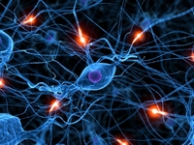
Neurons in the brain
Notes:
How does the brain work? You brain is jam-packed full or neurons that’re connected to and talk to each other.

Slide 17
Neural Network (Deep Learning)
x₁
x₂
Output
x₃
Layer L₄
x₄
Layer L₃
Layer L₁
Layer L₂

Slide 18
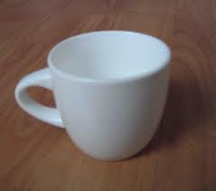
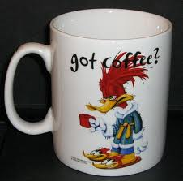
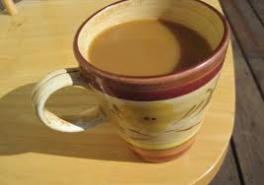
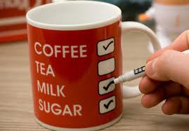
Learning from tagged data (supervised)
Coffee mug
Coffee mug
Coffee mug
Coffee mug
Coffee mug
Coffee mug
Testing: What is this?

Slide 19
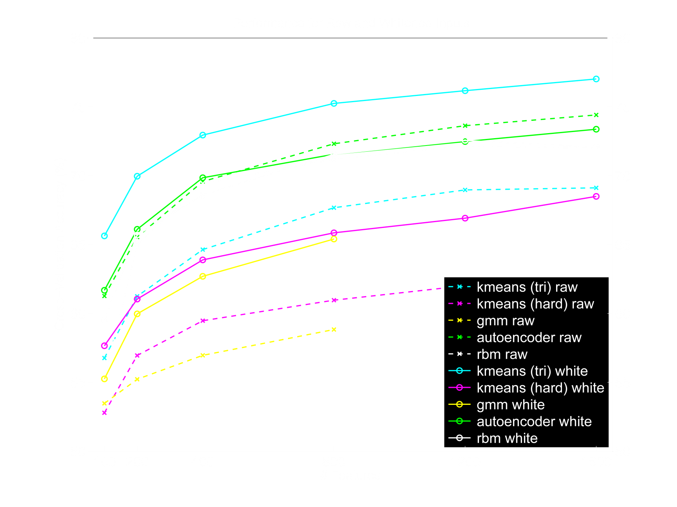
Bigger is better
Performance
Size of neural network
[ Adam Coates]

Slide 20
AI as a computer systems problem
10 million connections
1 billion connections
(1000 servers)
Notes:
Learned a lot of lessons.
Model parallelism.
Adagrad
Paramater server

Slide 21
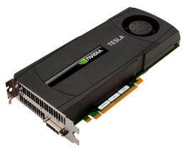
GPUs (Graphics Processor Unit)
[Adam Coates, Bryan Catanzaro, et al.]

Slide 22
Building huge neural networks
10 million connections
1 billion connections
(1000 servers)
(3 servers)
10 billion connections
(16 servers)
[Adam Coates, Bryan Catanzaro]

Slide 23
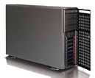
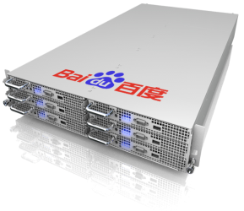
Baidu’s GPU infrastructure
CPU
GPU
ARM
Notes:
左边放CPU、GPU、ARM
右边放深度、200亿参数、

Slide 24
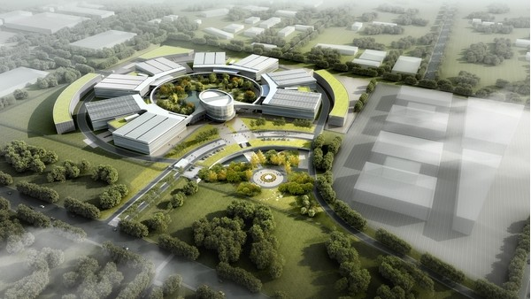
3M cores
4000 PB storage

Slide 25
Deep Learning applications
Speech recognition
(Jia Lei)
Image Search
(Huang Chang;
Xu Wei)
Ads; Web Ranking
(He Yu, Guo Xie;
Shen Dou, Xu Wei)

Slide 26
Building huge neural networks
10 million connections
1 billion connections
10 billion connections
100 billion connections (Minerva)
[Ren Wu]

Slide 27
Learning from tagged data
Deep learning
Performance
Older
algorithms
Amount of data

Slide 28
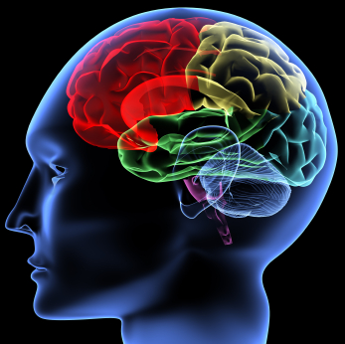
Deep Learning trends
0-2 years
Tagged data
3-5 years
Tagged & untagged data

Slide 29
Computer vision
A yellow driving down a road with green trees and green grass in the background.
Living room with white couch and blue carpeting. The room in the apartment gets some afternoon sun.
Notes:
Great products.
Either improve an existing product: Web search gets click data help improve ads
Or help us launch adjacent vertical products. E.g. LBS helps us launch local recommendations service.

Slide 30
Computer vision (~6 years)
Feature extraction
(SIFT)
Prediction
(SVM)
Combine
(Maxpool)
Deep Learning
Deep Learning
Deep Learning
Notes:
Short-term impact.

Slide 31
Speech recognition (next 2-3 years)
Acoustic model
(GMM)
Language model
(ngram)
Inference
(HMM)
Deep Learning
Deep Learning
Deep Learning
Notes:
Short-term impact.

Slide 32
Text Speech Image Behavioral
AI will transform the internet

Slide 33
Speech recognition
10%

Slide 34
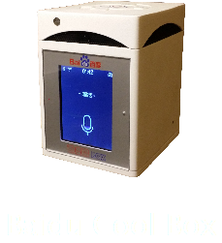
Baidu Cool Box

Slide 35
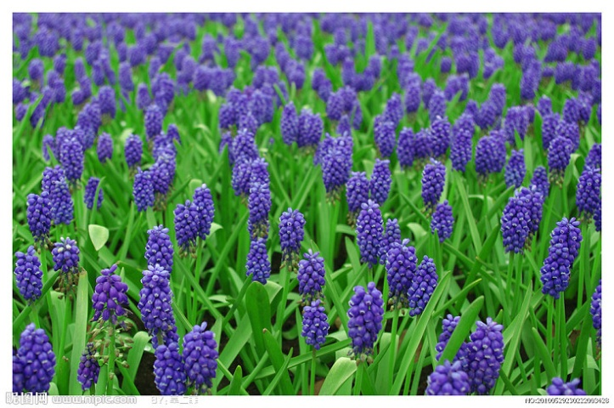
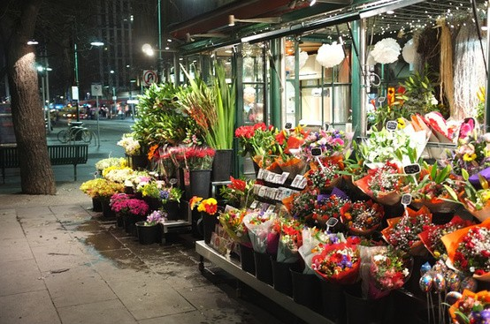
Baidu
Encyclopedia
Encyclopedia
Hyacinth
Flower shop
Notes:
全屏展现花海
手机拍张照片
花海消失
手机拍的花，被百度识别

Slide 36
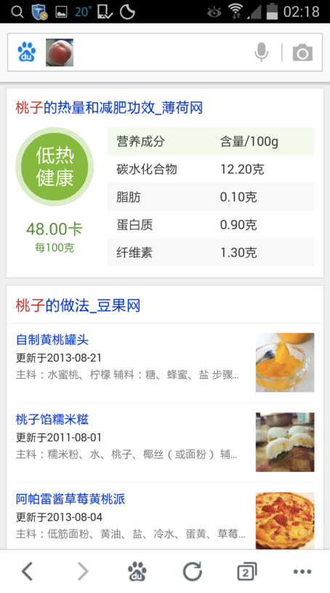
Clothing Bags Fruits & Vegetables
Image queries

Slide 37
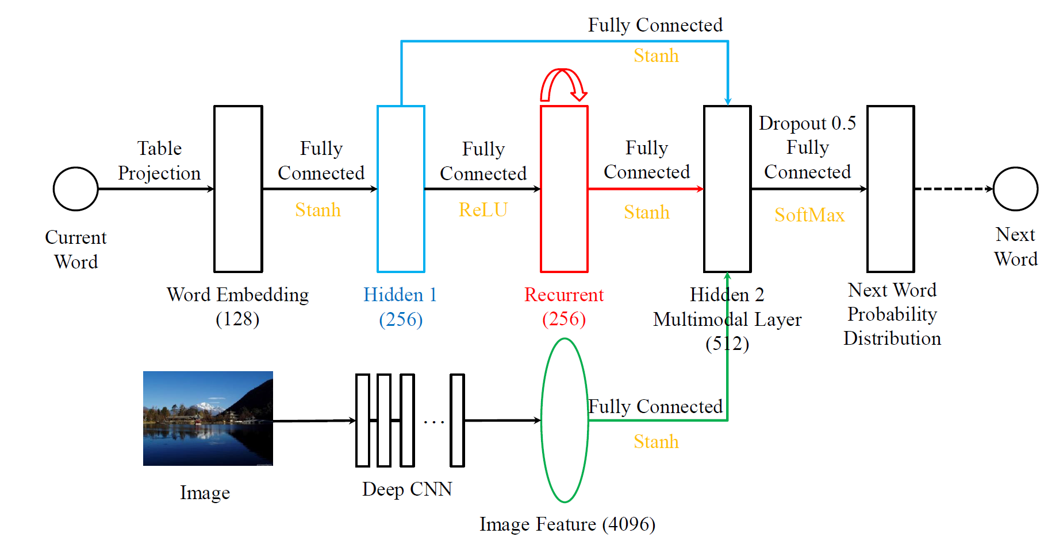
Generating Sentences to Describe Images

Slide 38
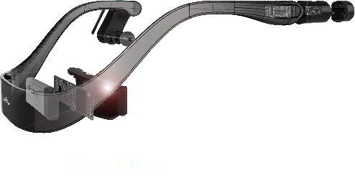
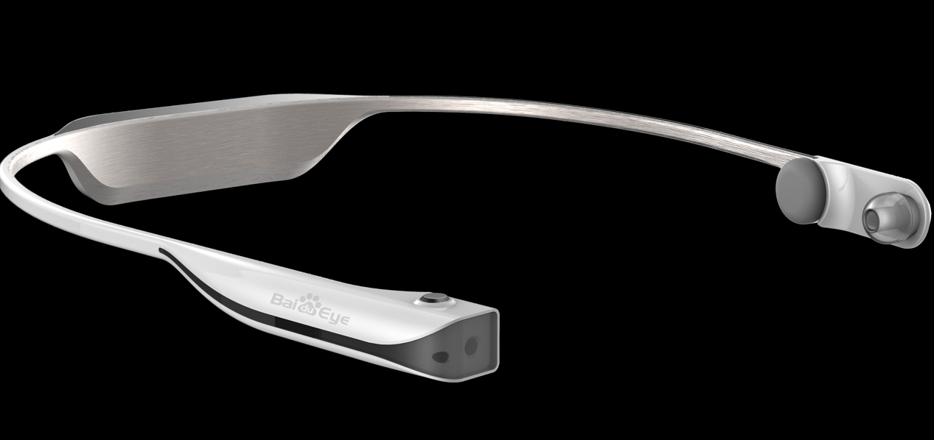
Baidu Eye

Slide 39
Notes:
···在美化

Slide 40
Text Speech Image Behavioral
AI will transform the internet

Slide 41
Unified user models
…
Search
Ads
Translation
LBS
Database
…
Search
Ads
Translation
LBS
Notes:
Short-term impact.

Slide 42
Unified user models
…
Ads
Translation
Search
Ads
Translation
LBS
Database
…
Search
Ads
Translation
LBS
Notes:
Short-term impact.

Slide 43
Unified user models
…
Search
Ads
Translation
LBS
Database
Deep Learning
Lingua Franca (共同语言)
(“Universal language”)
…
Search
Ads
Translation
LBS
Notes:
Short-term impact.

Slide 44
DNA project
Hobby
Gender
Click
Age
User data
User data
User data
User data

Slide 45
DNA project
Hobby
Gender
Click
Age
Music
发现
DNA vector
User data

Slide 46
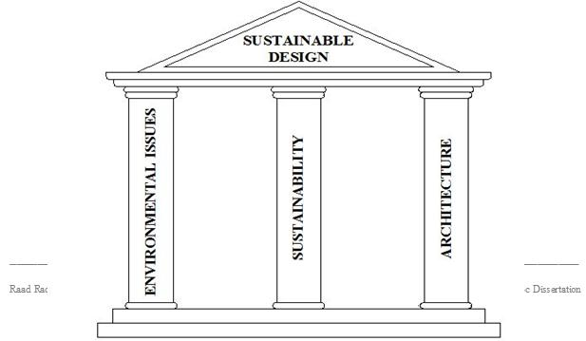
Why Baidu?
AI
Data
Infrastructure
Talent

Slide 47
AI throughout Baidu
Notes:
Great products.
Either improve an existing product: Web search gets click data help improve ads
Or help us launch adjacent vertical products. E.g. LBS helps us launch local recommendations service.

Slide 48
慧眼 (Wisdom Eyes)
陈治宇 （Chen Zhiyu）
Manually examine ~400 files/day

Slide 49
Machine learning for anti-virus
文字
图像
数据
逻辑
Malware?
结构
关系
统计
差异

Slide 50
Anti-virus classification
Goal: 70%
Adobe (DT)
40,000
IDL (GBDT)
40,000
IDL (GBDT)
8,000,000

Slide 51
Machine learning research
Idea
Experiment
Code

Slide 52
Paddle platform

Slide 53
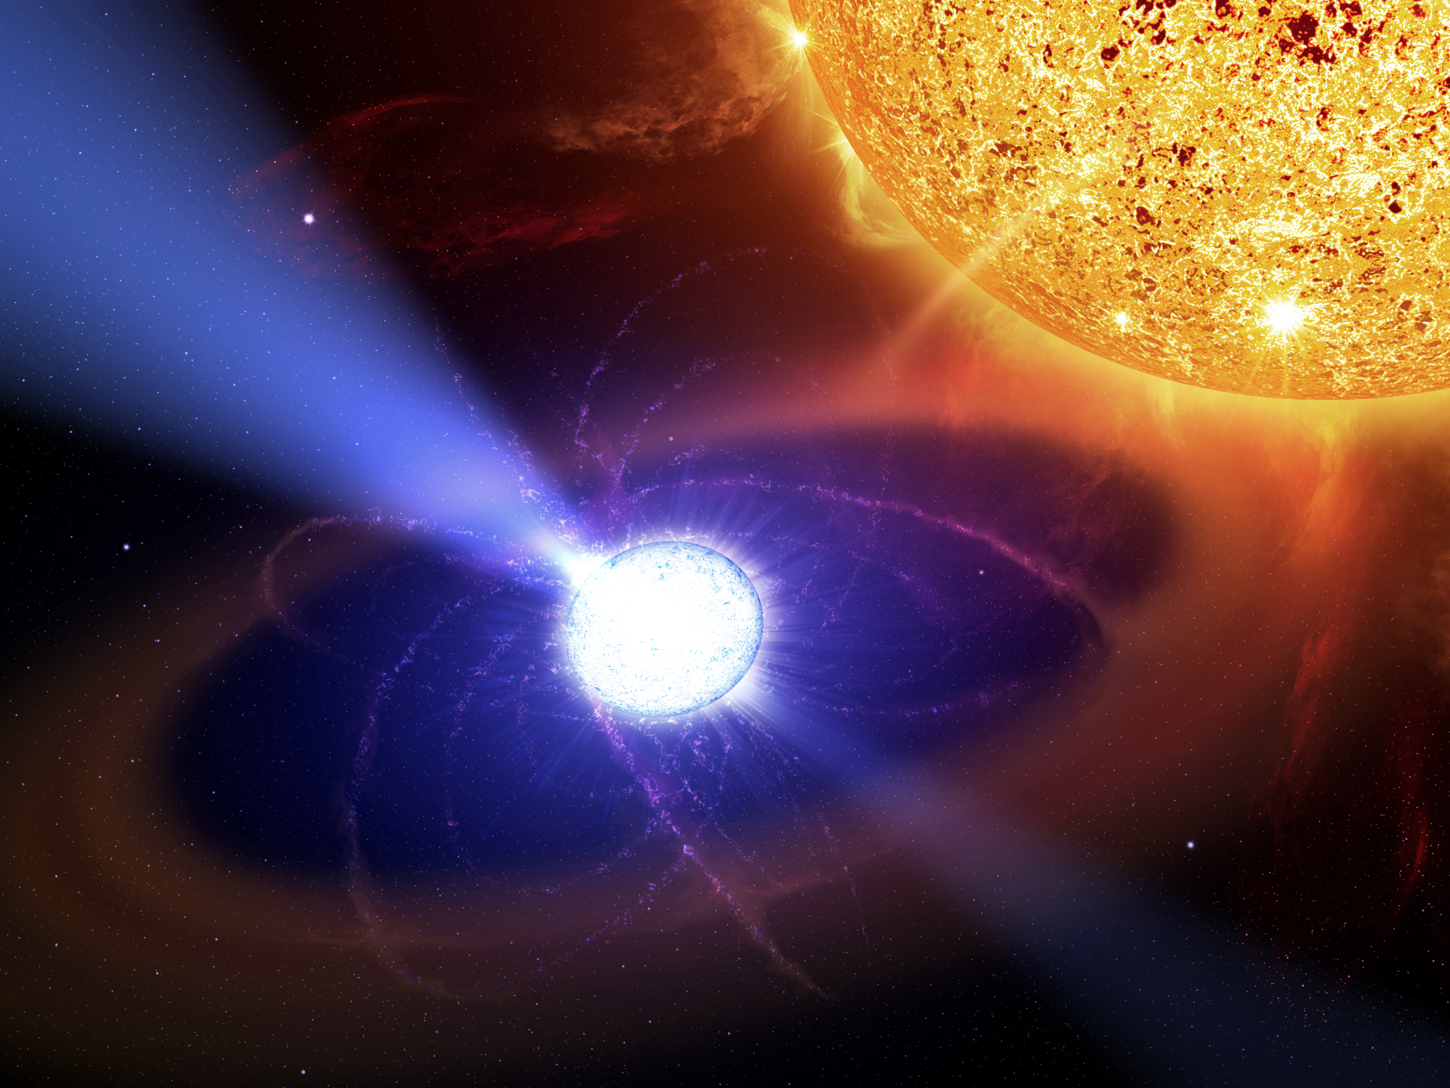
Pulsar system
1 trillion parameter models

Slide 54
Employee development
Notes:
Great products.
Either improve an existing product: Web search gets click data help improve ads
Or help us launch adjacent vertical products. E.g. LBS helps us launch local recommendations service.

Slide 55
Deep Learning tutorial

Slide 56
Baidu AI Fellowship (奇点人才计划)
Notes:
Great products.
Either improve an existing product: Web search gets click data help improve ads
Or help us launch adjacent vertical products. E.g. LBS helps us launch local recommendations service.

Slide 57
Baidu AI Fellowship
4 AI Fellowships per year across Baidu.
Spend 6 months in the US working with us.
Learn about AI and deep learning
Develop leading AI technologies
Engineers T6 or above. Require Director nomination.
Notes:
Great products.
Either improve an existing product: Web search gets click data help improve ads
Or help us launch adjacent vertical products. E.g. LBS helps us launch local recommendations service.

Slide 58
Thank you.

Slide 59
END END END END

Slide 60
Tagged vs. untagged data
Coffee mug
Coffee mug
Coffee mug
Coffee mug
Coffee mug
Coffee mug

Slide 61
Untagged data (unsupervised learning)
Unknown
Unknown
Unknown
Unknown
Unknown
Unknown

